Slide 1
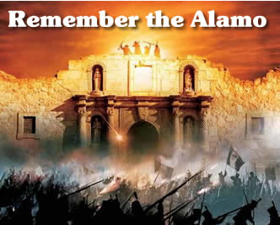
FAMA FALL MEETING 2010
Friday, October 8, 2010

Slide 2
Call to Order
Peter Darley

Slide 3
Call to Order
Salute to USA and Canada
Opening Remarks
Invocation
Introduction of Board, guests, honorary and new members, first time attendees
Sponsor Recognition

Slide 4
FAMA Would Like To Thank
Our Sponsors
FAMA Breakfast Sponsor
Notes:
4

Slide 5


FAMA/FEMSA Would Like To Thank our Sponsors
Banquet Open Bar Sponsor
Notes:
5

Slide 6


FAMA/FEMSA Would Like To Thank
Our Sponsors
Hospitality Room Sponsor
Notes:
6

Slide 7

FAMA/FEMSA Would Like To Thank Our Sponsors
Friday Reception Sponsor
Notes:
7

Slide 8

FAMA/FEMSA Would Like To Thank Our Sponsors
Future of the Fire Service Round Table
Notes:
8

Slide 9

FEMSA Would Like To Thank Our Sponsors
Breakfast Sponsor
Notes:
9

Slide 10
FAMA/FEMSA Would Like To Thank Our Sponsors
Coffee Break Sponsor
Notes:
10

Slide 11
Roll Call
Harold Boer

Slide 12
Proof of Notice
Harold Boer

Slide 13
Review and Enter Minutes
Harold Boer

Slide 14
Anti-Trust Guidelines/Policy
Jim Juneau

Slide 15
Treasurer’s Report
Gregory Kozey

Slide 16
2010 year to Date
Budget YTD Actual
Revenues $ 328,425 $ 302,121
Expenses $ 328,425 $ 198,939
Year to Date Change in Net Worth $ 103,182

Slide 17
Revenue and Expense Notes
Revenue:
We are currently $26,714 under budgeted revenues. However, $15,425 of this amount was slated to come from a “Contingency Fund” IE: Our Net Worth Fund Balance. We are currently $11,289 under budget in other
areas.

Slide 18
Revenue and Expense Notes
Revenue:
We expect to collect $5,000 of the expected revenue shortfall, leaving us with a net expected shortfall of approximately $ 6,200 at year end.

Slide 19
Revenue and Expense Notes
Expenses:
We are currently $135,603 under budgeted expenses.
$42,375 of fall membership meeting expenses still to be incurred along with normal monthly expenditures.

Slide 20
Revenue and Expense Notes
Conclusion:
In order to “ZERO BUDGET” we need to plan on the following for year end:
Remaining Budgeted Expenses $ 135,603
Est. Fall Meeting Expenses (42,375)
Est. Revenue Shortfall ( 6,200)
Contingency Fund (Not Yet Funded) (15,425)
Final 3 month Budgeted Expenses $ 71,603
If we limit expenses to this amount, we will avoid having to deplete our net worth. Amounts in excess of this number will have to be funded from our net worth.

Slide 21
President’s Report
Peter Darley

Slide 22
Board Report
Tough year but FAMA is healthy
Good board that works hard
Meeting goals and initiatives – on target
Scorecards, policy, bylaws, budgets, priorities
Also attention to big issues – strategic
Communication is key

Slide 23
2010 Key Initiatives
Improve value to member companies: Attention to breakout notes, improved meetings, technical support, timely statistics, education, trade show benefit
Increase FAMA visibility: Provide more value to end-users (website information, magazine / tradeshow support, marketing initiatives)
Increase research and education to support need for increased funding for apparatus: Development of FAMA specific message for fire act grants. Improve knowledge of customers and marketplace.
Alignment of initiatives with other committees

Slide 24
Board Big Issues
Knowing and meeting member expectations – now and future
Meet our key initiatives - Answering the call
Right People in Right Places
Operate Effective and Efficient as possible
Are we who we want to be? Size, Scope, qualifications, etc. For now leaving qualifications as currently written.
Open Mike Topics

Slide 25
GAC Alliance Luncheon
FAMA / FEMSA / GAC
IAFC
CFSI
IAFF
IAAI
NFVC

Slide 26
GAC Alliance Luncheon Topic
We hear that DHS is asking US Fire Administration for help to justify the SAFER and Fire Equipment Grant Programs.
What does this mean?

Slide 27
THE Message
Fire Departments – who, what, when, how often seems forgotten
Single message as well as 10 FACTS
Fire Departments are the – “Who they are gonna call”
All Hazards

Slide 28

Who they gonna call?
FAMA FEMSA Patch

Slide 29
FAMA FEMSA Joint Meetings
Joint Meetings – Responsibilities
Joint Surveys –Industry Knowledge – “know thy market”
Alliance Luncheon Topic (funding)
Synergy and Efficiency (Websites, Newsletters, other committee interaction)
Look at this meeting agenda
Promotion for the good of our organizations
Advance cause for our First Responders

Slide 30
Where we are looking for help
Tech Committee – co-chair
NFPA 1901 alternate
GAC Chair (Ken Creese)
Membership (Gonzalez)
Internet (Toren)

Slide 31
Thanks
Involvement is Good
Board
Karen
Committee Chairs
Committee Members
Sponsors
Meeting Planning

Slide 32
Nominating Committee
Tim Dean
John Stykiel
Jerry Haplin

Slide 33
Nominees for 2011
Board of Directors
On behalf of the FAMA Nominating Committee and the Board of Directors, the following is the proposed, recommended slate of nominees for the 2011 Board of Directors:
President - Grady North
Vice President – Greg Kozey
Treasurer – Harold Boer
Secretary – Bruce Whitehouse
Past President – Peter Darley
Sr. Director-at-Large – Jan Polka
Jr. Director-at-Large – Mike Power

Slide 34
Nominating Committee
Nominations from the floor ?
Vote

Slide 35
Bylaws Committee Fall 2010
George Goros

Slide 36
COMMITTEE MEMBERSHIP
William Bruns – Chair
George Goros – Vice Chair
Jim Currin
Tom Garrity
Jeff Hunke
Tim Thuemling
Rob Wertz

Slide 37
FOCUS POINTS & INITIATIVES
No amendments proposed
Submitted first draft of reduction in size of Bylaws to President
No other Bylaw changes in process
Supporting Board of Directors as requested

Slide 38
UPDATE OF ACTIVITIES
Monthly Scorecards submitted each month
Chair attended Board meeting in January
Vice Chair attended Spring Meeting
Drafted amendment to Section 3.2 - Membership Qualifications
Draft of Reduced Bylaws submitted to President without Committee Review to determine if project is on track and will continue with full committee involvement

Slide 39
THANK YOU
Any questions?

Slide 40
FAMA/FEMSA
GOVERNMENTAL AFFAIRS COMMITTEE
FAMA Annual Meeting
San Antonio, TX
October 2010
Notes:
40
40

Slide 41
GAC Members
John Granby, Co–Chair
Bill Lawson
Bill Latta
Steve Lawerance
John W. McNulty,lll
Mike Natchpolsky
Craig Sharman
Mike Power, Co–Chair
Ken Creese
George Goros
Scott Hinterleiter
Stewart McMillan
Rick Morgan
Steve Stein

Slide 42
GAC Support
Dave Gatton – Washington Consultant
Gabriel Steinbach – Communications
Brian Nash - CGC Liaison
Greg Kozey - FAMA Board Liaison

Slide 43
2010 Activity
Hill Day – CFSI combination
  65 meetings, 29 companies participated
Home days – 5 major events (Ill, Ohio, New Hampshire, Michigan)
Alliance Lunch – Sept 30
Ongoing meetings with members, staff and committee members
GAC alerts and newsletter to all members

Slide 44
Hill Day Successes
Hill day, well organized and staged
High energy among attendees
65 meetings with Congressional offices
Well received by legislators & Alliance partners
Potential 30 million dollar “plus up” to the Fire Act program

Slide 45
Hill Day – Improvements Needed
Low attendance (under 30 companies)
Not yet connected to CFSI week
Conflict with 2010 spring FAMA meeting
General conflict with busy spring calendar

Slide 46
2010 Legislative Agenda
Reauthorization of Fire Act Grant program
2011 Fire Act Grant appropriations
Continued funding and support for the US Fire Administration

Slide 47
2010 Targeted Legislative Activity
EPA 2010 Engine emissions (FAMA)
State/Federal fire truck weight laws (FAMA)
Buy America

Slide 48
2011 Goals
Continue to promote our core initiatives
  Full Funding for the Fire Act
  Reauthorization and continued support for the program
  Full funding for the U.S. Fire Administration

Slide 49
2011 Goals
(continued)
Increase portfolio of issues that our members can speak on
  EPA engine emissions
  Apparatus safety and weight restrictions
  Buy America
  Fire Grant guidance details
  Other federal funding programs
  General industry issues

Slide 50
2011 Goals
(continued)
Greater member participation
  Hill Day/CFSI
  Home day
More targeted communications and timely information

Slide 51
Our “Ask”
This is a Relationship Business!!
Call your Congressional Offices before November
  Fire Act Funding Update
  Election Outlook
Call After Election Day
  Lame Duck Session Certain
Report Back to GAC

Slide 52
STATISTICS COMMITTEE
FALL 2010 REPORT
Grady North – Board Member
Committee Members
Jack McLoughlin – Chair
Dave Drehobl – Vice Chair

Slide 53
2ND QUARTER
2nd Quarter Statistics have been completed and published.
Booked & Shipped
4 year average booked and shipped approximately 1,350 trucks per quarter.
2nd quarter was 1,130 trucks shipped and 874 booked.

Slide 54
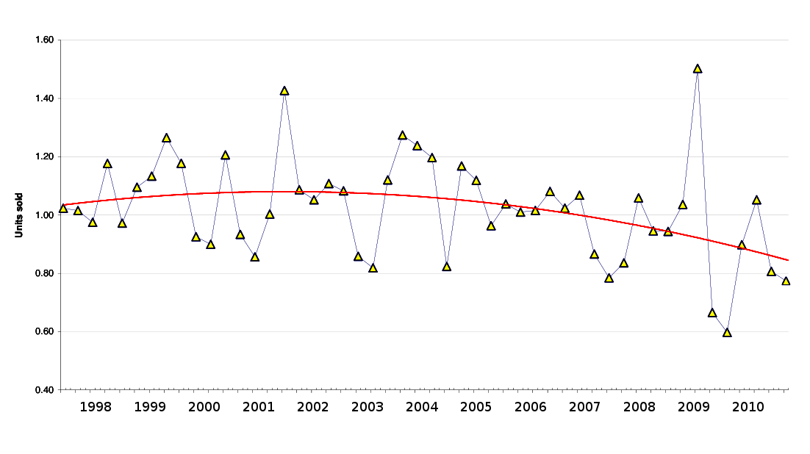
Book to Build Ratio
1998 – 2010
Book to Build = Sales / Shipped
Selling faster than we ship > 1
Shipping faster than we sell < 1
Generally, a business wants to maintain a figure slightly above 1.00
Trend line is a 2nd order polynomial

Slide 55
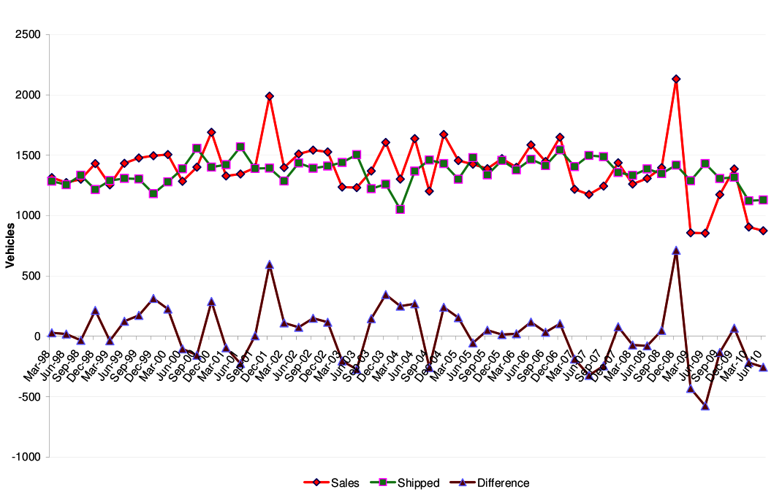
Sales vs. Shipped
1998 - 2010

Slide 56
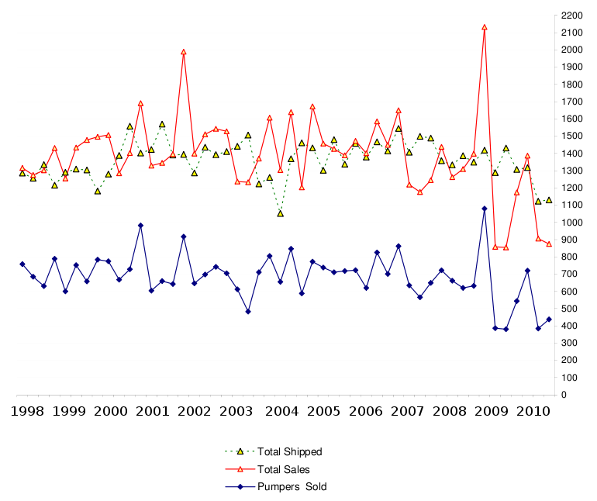
Historical Totals
1998 - 2010

Slide 57
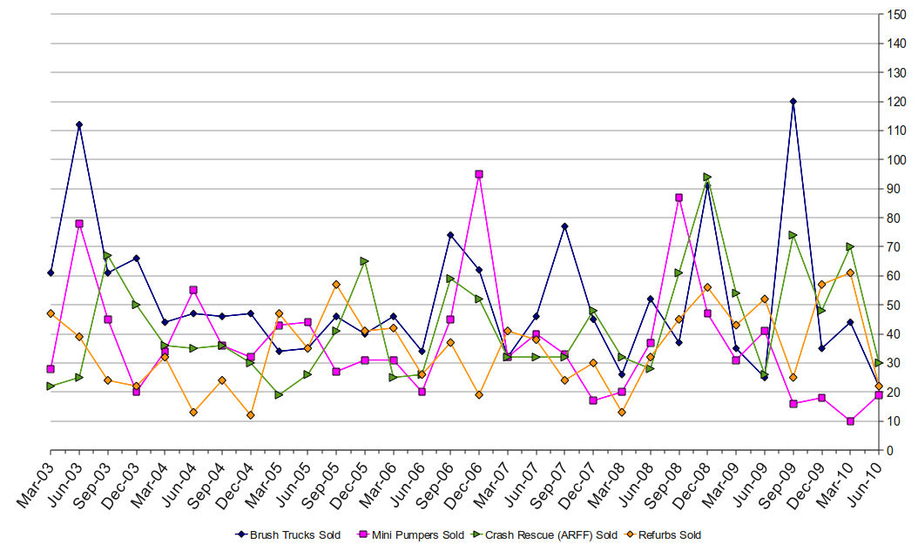
Minis, Brush, Crash, Refurb Totals, 2003 - 2010

Slide 58
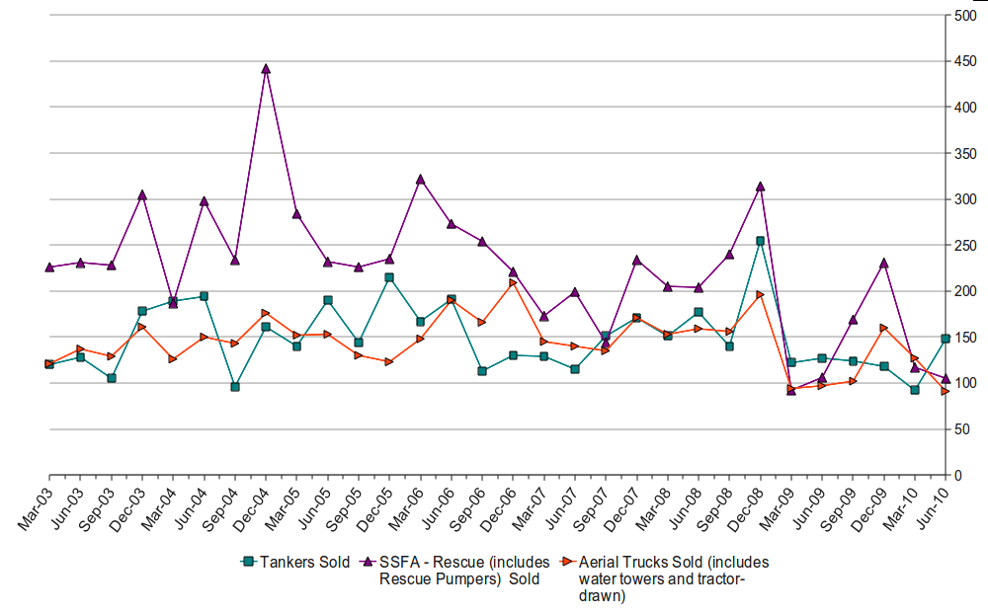
Tankers, SSFA, Aerials
Totals, 2003 - 2010

Slide 59
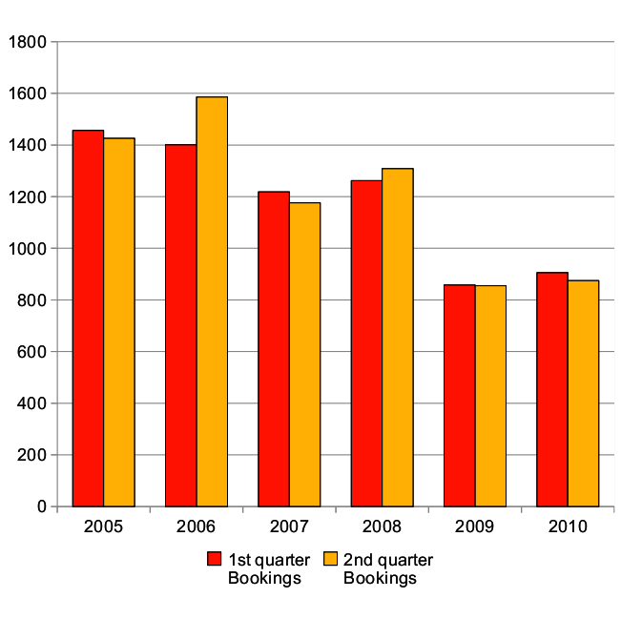
1st and 2nd Quarter Bookings
2005 - 2010

Slide 60
Dollar Amount Reporting
FAMA’s fire apparatus statistics are a key component of the organization. We have been collecting statistics since the 1960’s with electronic data available since 3rd quarter of 2003.
However, in today’s world raw volume numbers cannot provide all of the data needed.
Notes:
Imagine the value of having pricing to associate with the numbers presented on the 1st and 2nd Quarter Bookings Historical chart.

Slide 61
Fire Apparatus Prices
For 2010, the FAMA board initiated a price element to our statistics reporting. We believe the price data will be a valuable tool to help city and fire department budget planning and more importantly Federal Grant funding.
Price increases to the fire apparatus industry are driven by outside factors other than the increased cost of material and labor so it is difficult to apply a simple inflation factor to the price of new apparatus.

Slide 62
Fire Apparatus Prices
  NFPA standards add required components and testing.
  Federal safety and EPA requirements add cost to the chassis.
  Electronic systems must be updated and improved to meet customer expectations and compete in a worldwide market.
Notes:
I can think of a number of times when it would have been helpful to show the NFPA committee what the financial impact might have been looking back to each revision date (1999 and 2003) or when we were trying to get exemptions from the EPA for relaxed emission compliance for fire apparatus. It would be possible in the future to show prices geographically by state.

Slide 63
Fire Apparatus Cost
Price statistics would provide us with data on how much NFPA or Federal requirements impact our industry.
When NFPA 1901 went into effect in 2009, it would be very interesting to see what overall effect it had on the price of trucks.
When the 2007 and now the 2010 engine emissions requirements went into effect it would be helpful to know how pricing was impacted.
Members of our industry are the only ones that can provide accurate dollar amounts.

Slide 64
Reporting Prices - Security
FAMA contracts with Schenck Business Solutions to collect all data. No one in the FAMA organization (including board members) have access to the raw data from individual members. Schenck collects and organizes the raw data.
Only category totals are provided to the Statistics Committee who in turn create the reports you see.
Reporting prices is entirely optional and participants can always choose not to provide a price as desired – such as knowing you are the only one reporting in a certain category.

Slide 65
Reporting Prices - Participation
Currently we are only getting a small percentage (around 10%) of reported dollar amounts.
For second quarter shipments:
40 of 509 pumper deliveries had dollar amounts
24 of 172 rescue truck deliveries had dollar amounts
14 of 154 tankers had dollar amounts
16 categories had no dollar amounts listed

Slide 66
Reporting Prices
We prefer that reported prices do not include loose equipment. We also prefer that the reported price be what the end user paid. However, if dealer cost or some other pricing method is most readily available, it is acceptable as well.
Prices are averaged, so if everyone reported the price of the 509 pumpers delivered in the 2nd quarter, minor variations in the data will level out. In the end, trends may be more important than the actual dollar amount.
Please carry this message to whoever is responsible in your company for reporting statistics. If your organization needs assistance in making reports, the Statistics Committee is available for support.
Notes:
I am sure that most companies track orders with some type of dollar amount. We want to make this easy, so use the dollar figures that are most readily available.

Slide 67
Question
Would you like to see FAMA collect similar data on ambulances?
Notes:
I am sure that most companies track orders with some type of dollar amount. We want to make this easy, so use the dollar figures that are most readily available.

Slide 68
Education Committee
Education Committee Co-Chairs
Dave Reid, Tammy Laridaen

Slide 69
Education Committee
Dave Reid – Co-Chair
Tammy Laridaen – Co-Chair
George Logan – Vice Chair
Curt Ignacio
Eric Sauey
Rebecca Schenk
Jan Polka – FAMA Board Liaison

Slide 70
Education Committee Survey:
Objective & Outline
Objective: Identify key issues facing departments today and provide insight into what this may mean for FAMA members
Survey outline
  Type of organization
  Funding
  Economy
  Department changes made or anticipated
  Process changes made or anticipated
  Equipment changes made or anticipated
  Equipment needs / requirements that manufacturers should address

Slide 71
Education Committee Survey:
Schedule & Timing
Develop and review survey instrument (complete)
Committee feedback and Board review of survey (complete)
Conduct survey (Oct)
Identify method(s) of distributing information through FAMA (Oct)
Complete analysis and draft report (Dec)
Review report with FAMA Board (Dec)
Presentation at Spring Meeting

Slide 72
Scholarship
2010 Phillip L. Turner Fire Protection Scholarship
  Awarded to University of Maryland student Jonathan Worden, a senior from Franklin, NY, majoring in fire protection engineering, for his outstanding academic achievement and commitment to the fire service
  Special thanks to Akron Brass Company for sponsoring the $3,000 scholarship again this year

Slide 73
Meeting Planning
Committee
John Swanson

Slide 74
Members
John Swanson – Chairman
Mark Albright – Vice Chair
Grady North – Board VP
Ed Dobbs
Geary Roberts
Damon Lewis
Bob Grimaldi – Consultant

Slide 75
Responsibilities
Budget and plan for the General Membership Meetings
Select topics of interest and speakers for General Membership Meetings
Work with Marketing Committee to publicize and promote Spring and Fall meetings
Coordinate awards and acknowledgements at General Membership Meetings
Develop a schedule and budget for group and optional social activities in conjunction with the General Membership Meetings
Prepare survey for meeting evaluation
Hotel inspection/Site survey

Slide 76
Mission Statement
The mission of the Meeting Planning Committee shall be to strengthen the FAMA organization, enhance FAMA's service to its membership and the industry and further the goals and objectives of FAMA through coordinating the planning and implementation of the Spring and Fall Annual Meetings.

Slide 77
Meeting Site Criteria
Rate within the FAMA/FEMSA budget
Prefer to be largest group at hotel during stay (more attention from hotel staff)
Minimum 100 room property (FAMA requires average 85 rooms)
Four star property
Business hotel rather than leisure hotel property
Major hotel chain (National representatives are available)
Located within 1 hour drive from nearest airport
Direct flights from major cities such as NY, Chicago, Atlanta
Hotel features including internet access, restaurant and meeting rooms
Hospitality suite on ground floor with pool access

Slide 78
Fall Meeting Attendance
Year | Location | Room Rate | FAMA Members | FEMSA Members | Total Attendance | Room Nights
2002 | San Diego | $186 | 56 | 53 | 122 | 310
2003 | San Francisco | $189 | 61 | 75 | 195 | 453
2004 | Nashville | $225 | 67 | 93 | 178 | 378
2005 | San Antonio | $169 | 69 | 99 | 180 | 395
2006 | DC | $210 | 71 | 87 | 174 | 349
2007 | Monterey | $228 | 72 | 92 | 186 | 378
2008 | Tucson | $199 | 70 | 91 | 189 | 401
2009 | DC | $249 | 60 | 101 | 160 | 310
2010 | San Antonio | $199 | 45 | 71 | 164 | 407

Slide 79
San Antonio Corporate Sponsors
Fire Engineering Magazine – FAMA/FEMSA Hospitality Suite
Spartan Motors, Inc – FAMA Membership Breakfast
AMDOR & RealWheels (Joint) - FAMA/FEMSA Friday Banquet Open Bar
Firehouse Companies – FAMA/FEMSA Coffee Breaks
FireRescue1.com – FAMA/FEMSA Friday Reception
Fire Chief Magazine – FAMA/FEMSA Business Meeting

Slide 80
Fall 2011
FAMA/FEMSA Joint Meeting
Location: Washington DC
Date: Oct. 5-8, 2011
Hotel: Crystal City Marriot

Slide 81
Spring 2012
FAMA Meeting
Location: Fort Lauderdale, FL
Date: March 30-April 4, 2012
Hotel: Marriott Ft. Lauderdale

Slide 82
Fall 2012
FAMA/FEMSA Joint Meeting
Location: Scottsdale, AZ
Date: Sept. 26-29, 2012
Hotel: Renaissance Glendale

Slide 83
Spring 2013
FAMA Meeting
Location: Aruba
Date: March 15-20, 2013
Hotel: Aruba Marriott

Slide 84
Fall 2013
FAMA/FEMSA Joint Meeting
Location: Tampa, FL
Date: Oct. 9-12, 2013
Hotel: Renaissance Tampa

Slide 85
Spring 2011
FAMA Meeting
Location: San Juan, Puerto Rico
Date: March 11-16, 2011
Hotel: El San Juan

Slide 86
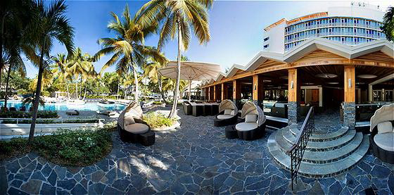
San Juan, Puerto Rico 2011

Slide 87
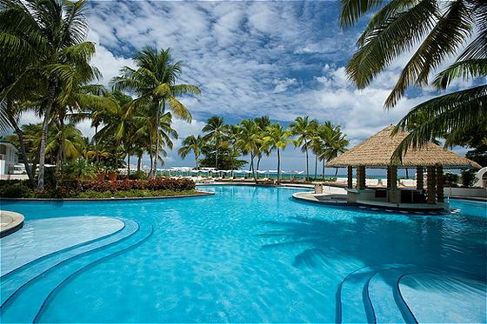
San Juan, Puerto Rico 2011

Slide 88
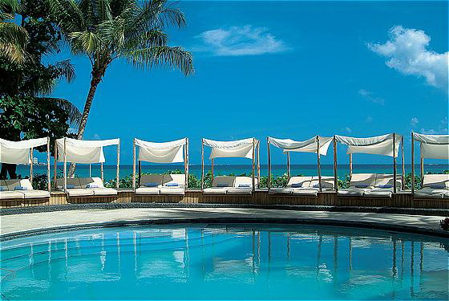
San Juan, Puerto Rico 2011

Slide 89
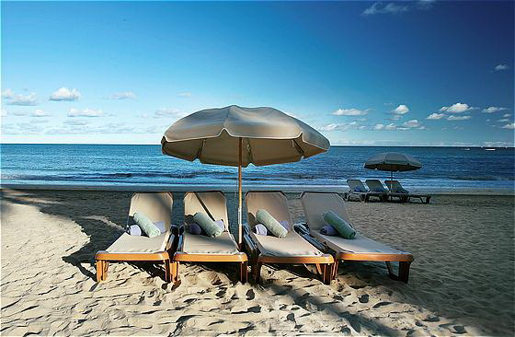
San Juan, Puerto Rico 2011

Slide 90
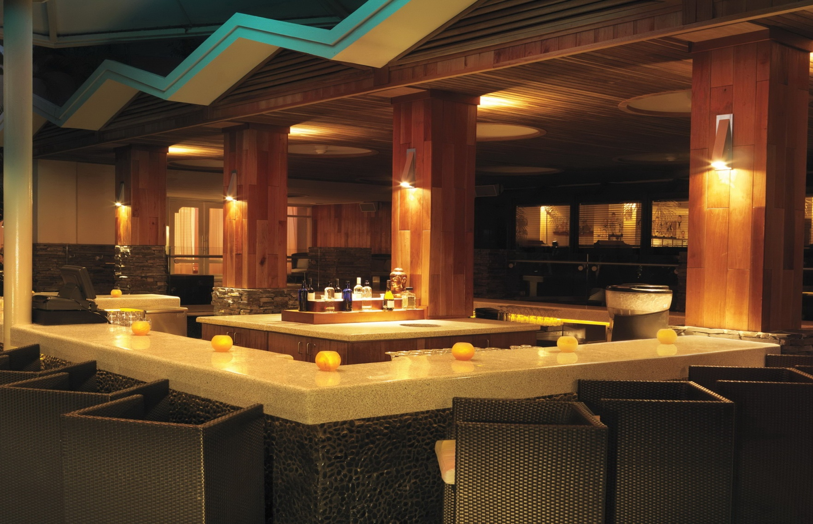
San Juan, Puerto Rico 2011
San Juan, Puerto Rico

Slide 91
THANK YOU
SEE YOU IN PUERTO RICO!!

Slide 92
Membership Committee
Presenter: Anthony M. Gonzalez
Committee Chairman
Notes:
92

Slide 93
Membership Committee
Committee Members
Larry Dodson, Allison Transmission
Gregg Geske, Waterous Company
David G. Rutterman, Eagle Compressors
Jim Simpson, Marion Body
Joe Bernert, Havis, Inc.
Board Liaison
Bruce Whitehouse, Amdor, Inc.

Slide 94
Membership Committee
Committee Objectives & Assignments
Grow Membership by 10%
The committee developed a potential target list of market companies qualified for membership. A regional contact plan was developed for committee members to call on these companies.
Year to date, the committee has recruited eight (8) new member companies which represents 67% of the membership growth objective.
Ambulance Expansion Initiative
The committee was tasked to identify ambulance manufacturers that could potentially qualify for membership in the initiative.
Year to date, the committee has identified a total of twenty-seven (27) potential ambulance manufacturers, 18 in the US and 9 in Canada.

Slide 95
Membership Committee
New Member Companies
Welcome To Our New FAMA Members
Hansen International, Inc.
Warn Industries
AWG Fittings
Lavasseur Fire Equipments
ICL Performance Products
5 Alarm Fire Apparatus
NEWMAR
Trident Emergency Products

Slide 96
FAMA Marketing Committee
Phil Gerace

Slide 97
Committee Members
Steve Cole Dave Durstine
Phil Gerace John Lund
Drew Sutphen John Weber

Slide 98
2010 Projects
Membership Committee--Redesigned 10 Reasons Brochure for Recruitment
FAMA Staff--Created new business cards
Tradeshows--Created FAMA FDIC material and coordinated new slogan with new graphics
Meeting Committee--Assisted Meeting Committee with Promotion & Sponsorships

Slide 99
2011 Projects
Press Release Support to FAMA Committees
Support Other Committees As Needed

Slide 100
Technical Committee
David Durstine

Slide 101
TECHNICAL COMMITTEE
Chairs
David Durstine
Aerial/Quint ARFF
Jim Salmi Grady North
Jeff Aiken Marty Huffman
Body Chassis
Keith Purdy Roger Lackore
Bill Proft Raff McDougall
Low Voltage Electrical High Voltage Electrical
John Doperalski Will Leach
Peter Luhrs Paul Newton
Foam Pumps & Plumbing
Dominic Colletti Doug Miller
John Lund Chad Trinkner
Ambulance
Steve Cole
Steve Rowland

Slide 102
TECHNICAL COMMITTEE
2010 Initiatives
Published a quarterly Technical Committee E‐Newsletter. (2 Quarters are Complete)
Created a Steering Committee being led by Steve Touchton and Tim Van Fleet developing a viable plan for the future in which and when technical meetings are held.
Developing a Technical Committee member contact database and communications clearinghouse.
Created a new Ambulance Sub-committee

Slide 103
TECHNICAL COMMITTEE
2010 Spring Tech Meeting
  Was held April 23rd, 2010
Special to Thanks to Spring Meeting Sponsor

Slide 104

TECHNICAL COMMITTEE
2010 Fall Tech Meeting
  Was held August 28th, 2010
Special to Thanks to Spring Meeting Sponsor

Slide 105
NFPA 1901
David Durstine

Slide 106
NFPA 1901 REPORT
Responsible Documents & Revision Cycles
  NFPA 1901 Standard for Automotive Fire Apparatus
    Fall 2013
    Revised Edition Date: 2014
  NFPA1906 Standard for Wildland Fire Apparatus
    Fall 2011 (Revised from Fall 2010)
    Revised Edition Date: 2012 (Revised from 2011)
  NFPA 1911 Standard for the Inspection, Maintenance, Testing, and Retirement of In-Service Automotive Fire Apparatus
    Fall 2011
    Revised Edition Date: 2012
  NFPA 1912 Standard for Fire Apparatus Refurbishing
    Fall 2010
    Revised Edition Date: 2011

Slide 107
NFPA 1901 REPORT
NFPA1906 Revision Update (Revised to 2012)
  “Report on Proposal” Posting December 22, 2010 (available for Comment for 60 Days)
    A copy of the proposal form is available on the NFPA web site at: http://www.nfpa.org/assets/files/PDF/ROP/1906-F2010-ROP.pdf
NFPA1911 Revision Update
  “Report on Proposal” Posting December 22, 2010 (available for Comment for 60 Days)
    A copy of the proposal form is available on the NFPA web site at: http://www.nfpa.org/aboutthecodes/AboutTheCodes.asp?DocNum=1911

Slide 108
NFPA 1500 & 18
Dominic Coletti(P); Leroy Coffman and Jerry Halpin (A)

Slide 109
NFPA 1500 & 18 Committees
FAMA representatives:
NFPA 1500 – Leroy Coffman (A) and Dominic Colletti (P)
NFPA 18 – Jerry Halpin (A) and Dominic Colletti (P)
Mission Statement: The mission of both committees is to represent the best interests of the FAMA group regarding providing input into proposed standard changes, with the end result of making conditions safer for firefighters and the public; and to provide feedback and report to the FAMA board and membership on items that may significantly impact the members of the association. Regarding significant issues, the FAMA board will review and direct committee voting activity.

Slide 110
NFPA 18 Committee
Technical Committee is responsible for two separate documents:
  NFPA 18 – Standard on Wetting Agents
  NFPA 18A –Standard on Water Additives For Fire Control and Vapor Mitigation
NFPA 18 is through cycle and complete.
NFPA 18A was just completed (Fall 2010 revision cycle) and the document has just been released by NFPA.
Next meeting for NFPA 18 will be the ROP meeting in the Fall if 2012.

Slide 111
NFPA 1500 Committee
NFPA 1500: Fire Department Occupational Safety and Health Program
    FAMA is on two NFPA 1500 document ‘work groups’:
        Accountability – including new technology – electronic tracking and locating systems
        Vehicle Operations – reducing vehicle crashes and apparatus incidents
  We have begun to position the intent of the “Annex D” language in the main body of the 1500 standard, specifically language to cover technological obsolescence of fire apparatus. First step toward this goal is to prevent tankers/tenders without Anti-Lock brakes from using “emergency speed.”

Slide 112
NFPA 1500 Committee
Fall 2010 Update:
      Last full committee meeting was held in May, 2010, in Baltimore, MD
NFPA 1500, 1521, 1581, 1582, and 1583 are currently in annual meeting 2012 revision cycle. NFPA 1561 and 1584 in annual meeting 2010 revision cycle.
NFPA 1500 committee discussion:
Request from NFPA 1901 committee member to include how and why to utilize information available from VDR
General discussion on revisions and/or additions included Vehicles/Water Tenders; Highway/Traffic Safety; Firefighter Tracking/Accountability; Quiet Responses; etc.

Slide 113
NFPA 1500 Committee
Fall 2010 Update:
Next planned 1500 technical committee meetings:
      October, 7 through 9, 2010, San Diego, Dominic Colletti attending.
      February, 2011, in the Las Vegas Area

Slide 114
2010 Objectives
Year 2010 and 2011 FAMA Committee NFPA 1500 and 18 Objectives:
Remain active with both NFPA technical committees and identify any areas of the proposed 1500 and 18 series of standards that could affect FAMA member companies.
Regarding the 1500 document, stay active with the NFPA technical committee and continually educate members on the safety impacts regarding changes in fire apparatus.
Further position the intent of existing “Annex D” language, now in the Annex of the existing 1500 document, by drafting new language on technological obsolescence of fire apparatus.

Slide 115
The Media Caucus
2010 Survey
on
NFPA Standards

Slide 116
Survey Concept
Survey the Fire Service
Non-Scientific, Non-Threatening
First Time for FEMSA/FAMA partnership
Drive Traffic to FAMA and FEMSA websites
Have Results by Annual Meeting
Entice with products from FEMSA and FAMA members ($5000 List, product value)

Slide 117
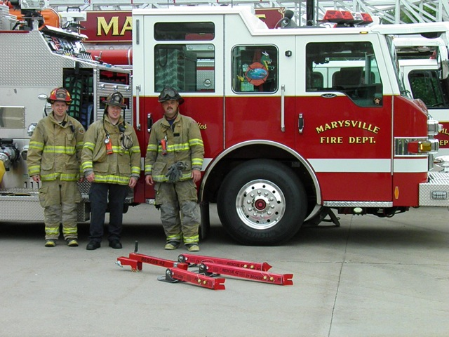
2009 Winners
Marysville Fire Department, Marysville, Michigan

Slide 118
2010 Survey
How Departments view NFPA Standards
Questions from FAMA and FEMSA
Run February through September
Magazine Ads, Web Banners, Equipment Stuffers and Email Blasts to drive firefighters to femsa.org and fama.org

Slide 119
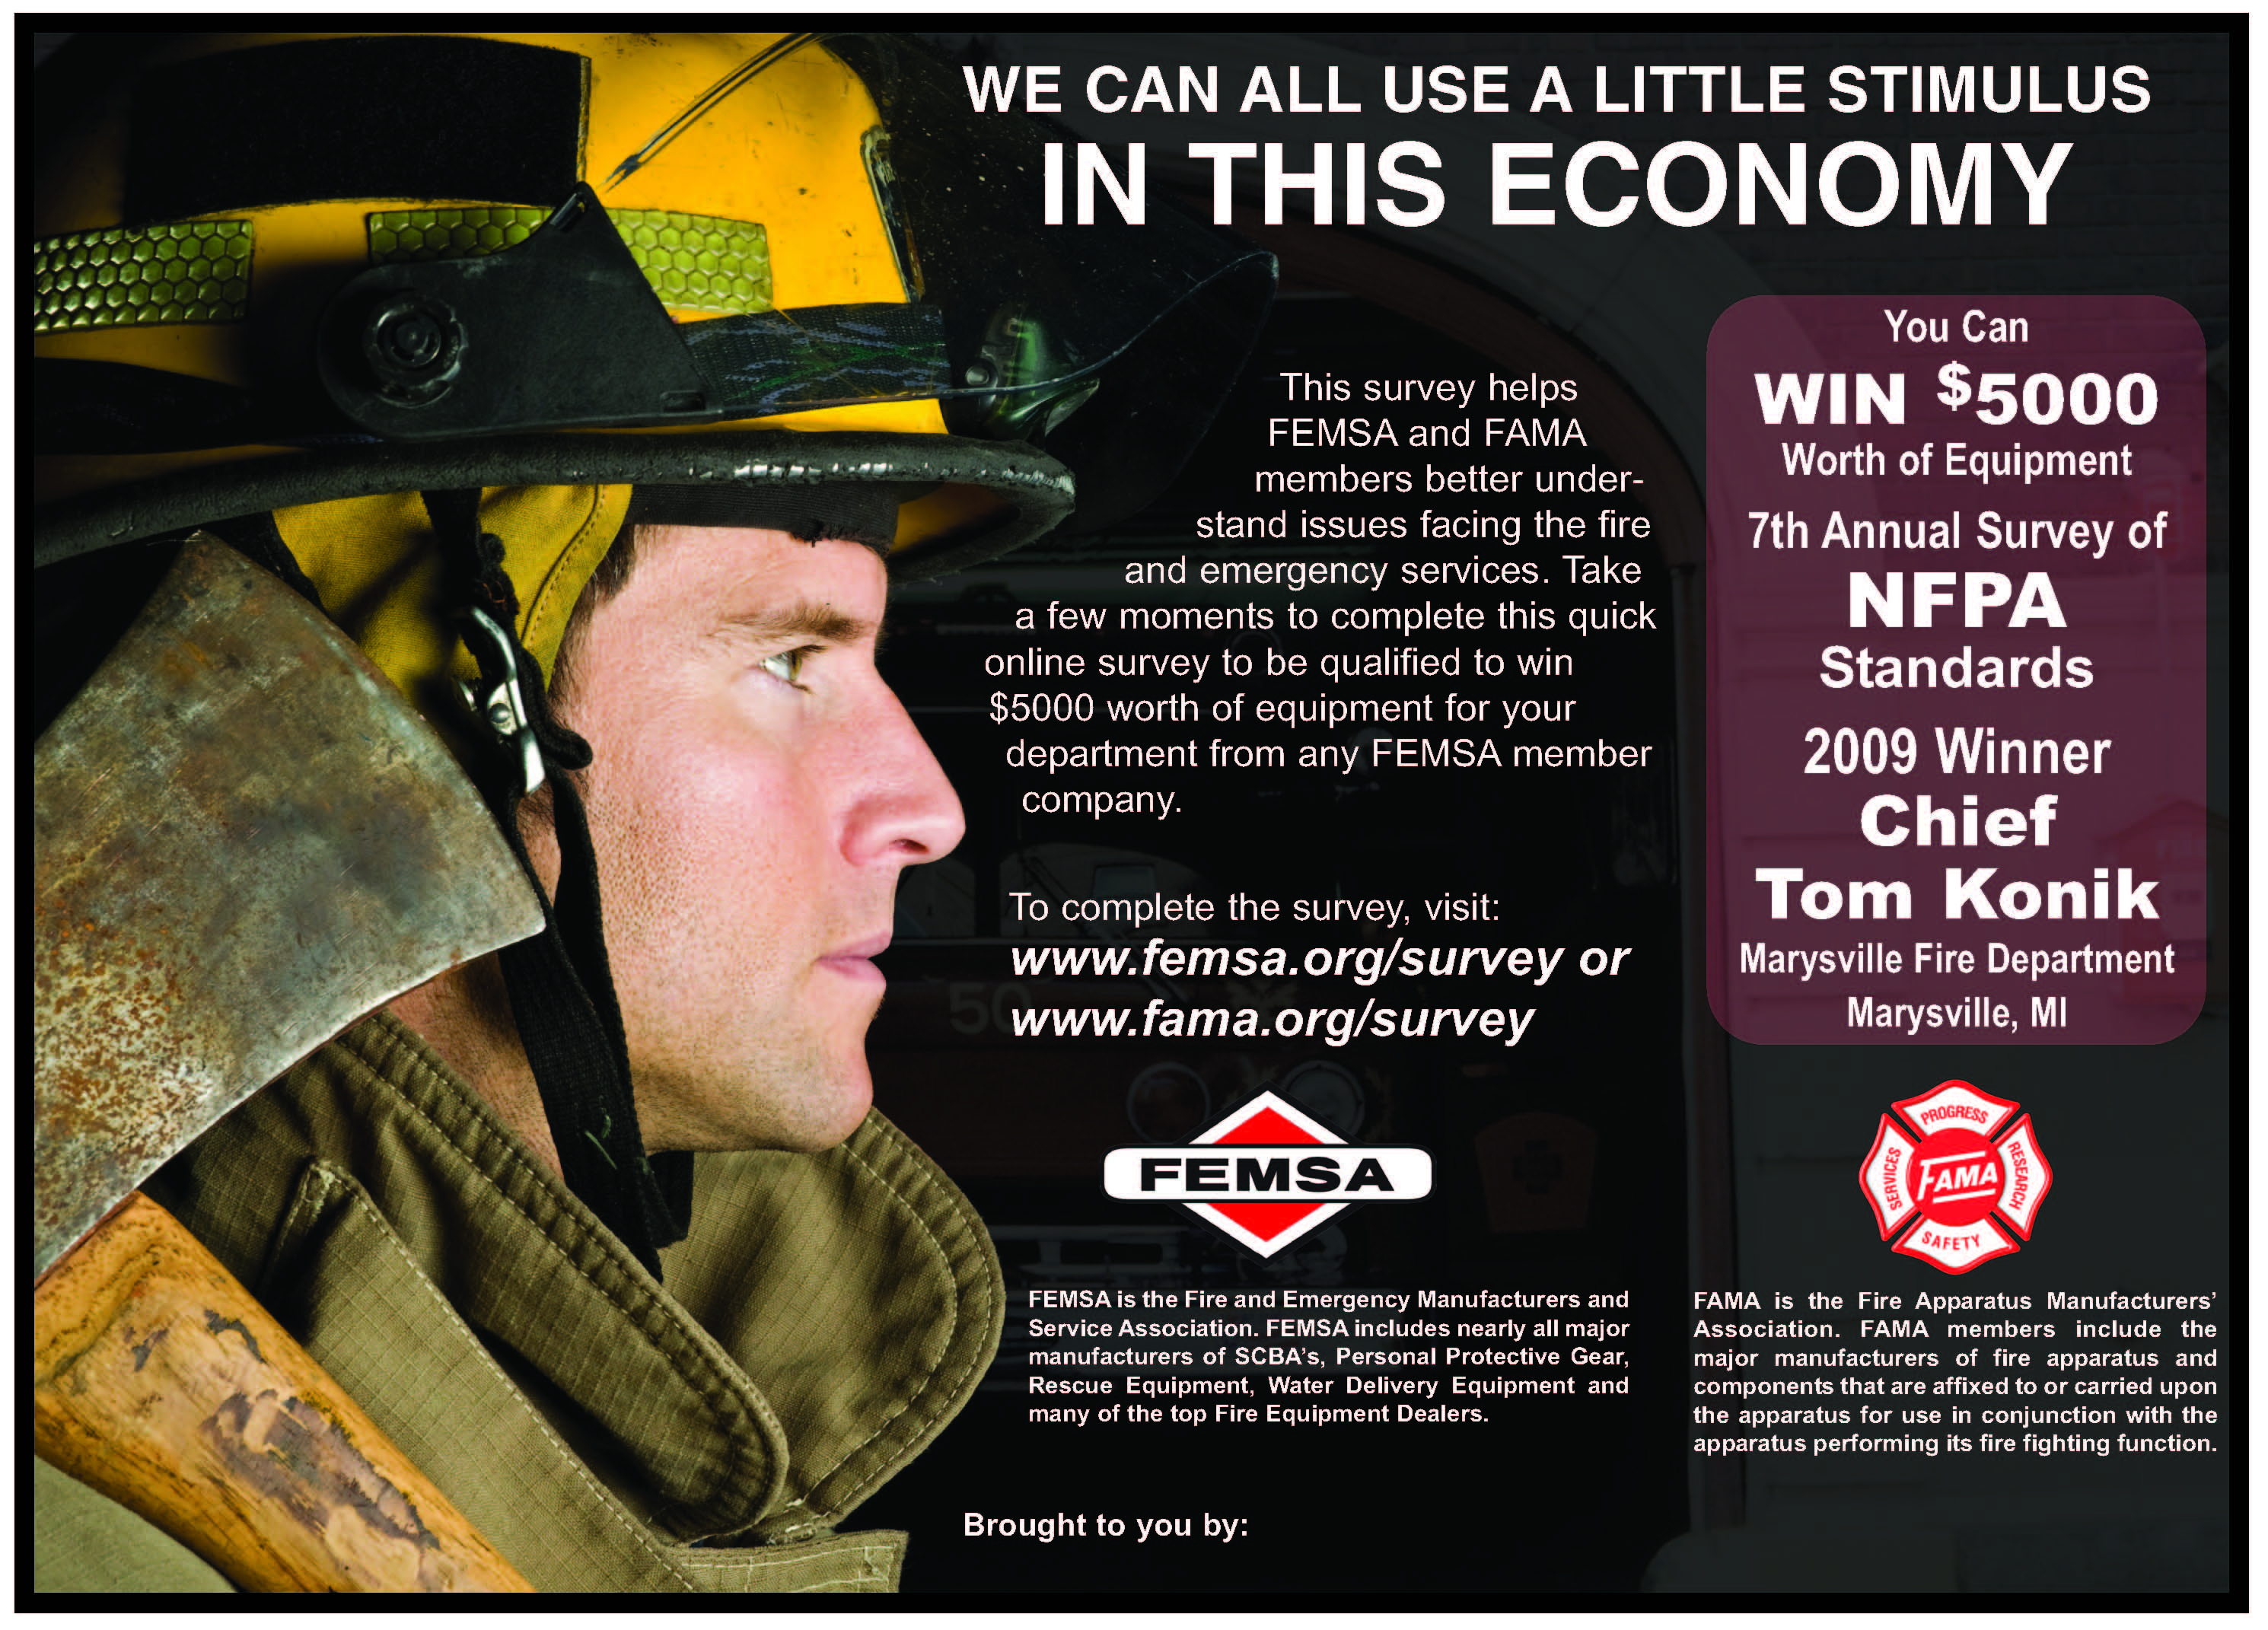

The Survey Was Advertised In Trade Publications and Websites

Slide 120
The Survey was also Advertised with product inserts
Special Thanks to Barbara Connolly and Fire News for 2010 Artwork

Slide 121
Media Caucus Members
EMS Today
FDIC
FDSOA
FRI
Fire Apparatus
Fire Chief
Fire Engineering
Firefighting in Canada
Firefighter.com
Firehouse
Fire News
Fire Rescue
FireRescue Magazine
Fire Shows Reno
GoForward Media
IAFC
Industrial Fire World
New York SAFC
Western Fire Chiefs

Slide 122
Recent Survey’s
2005 “Fire Ground Safety” 920
2006 “Large Scale Disasters” 868
2007 “Assistance to Firefighter Grants” 1822
2008 “Equipment and Supply Issues” 1406
2009 “The Economy” 2304
2010 “NFPA Standards” 1696

Slide 123
Results

Slide 124
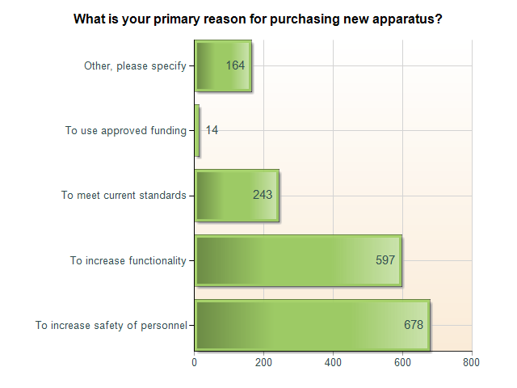

Slide 125
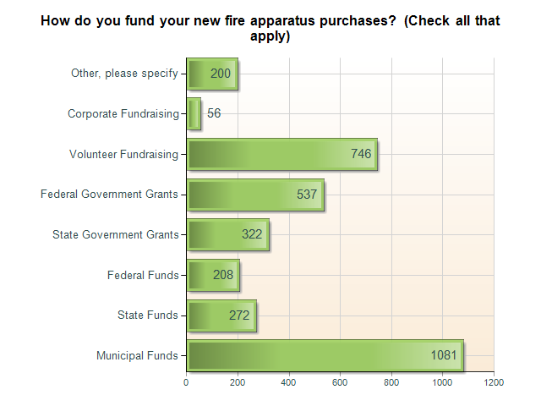

Slide 126
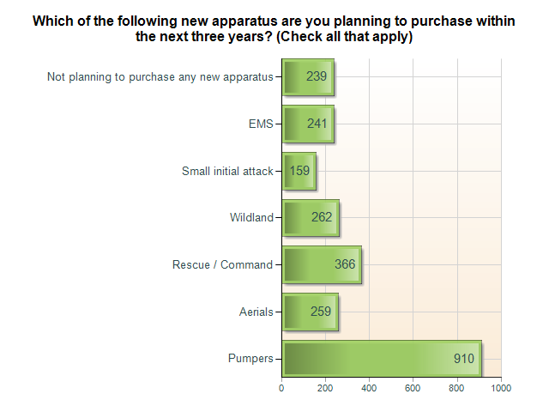

Slide 127
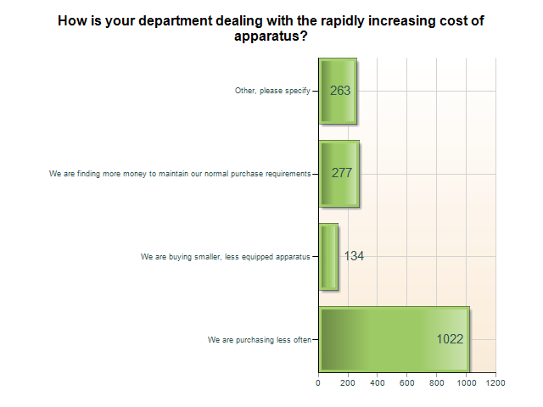

Slide 128
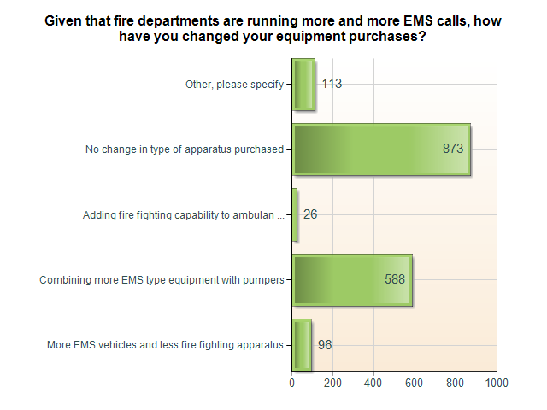

Slide 129
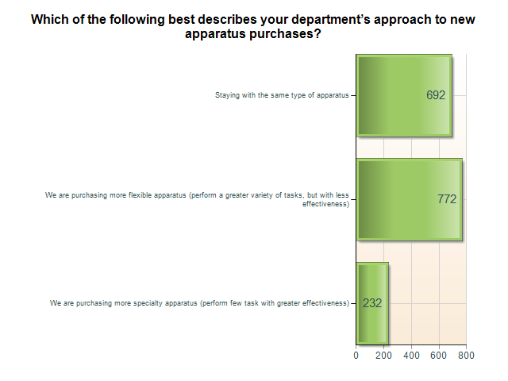

Slide 130
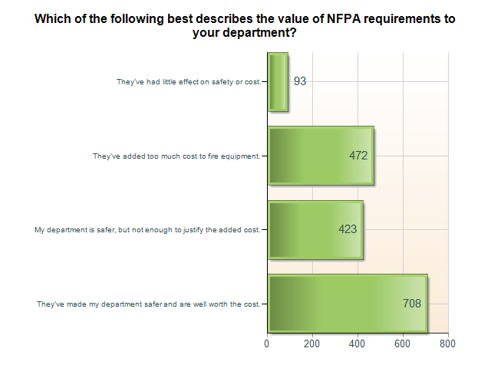

Slide 131
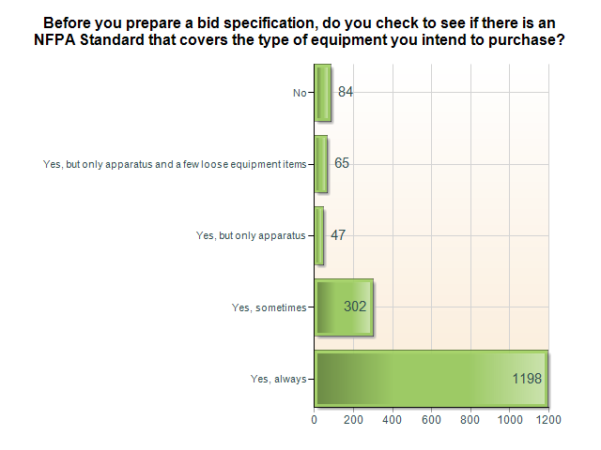

Slide 132
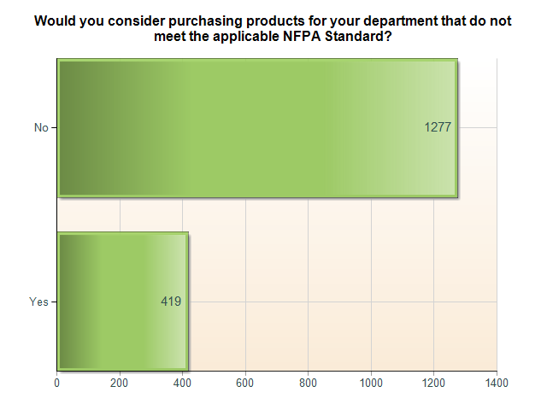

Slide 133
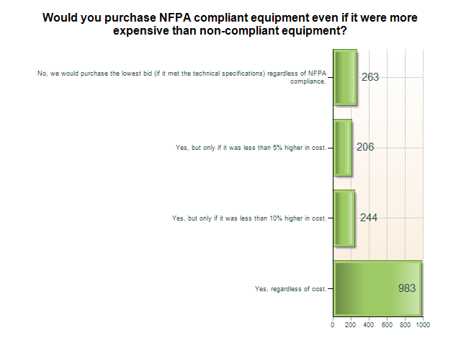

Slide 134
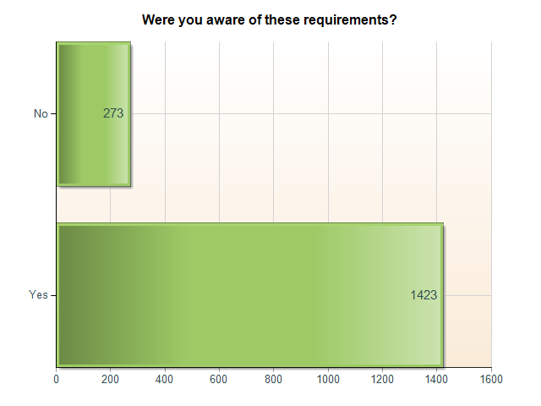
NFPA 1851, Standard on Structural Fire Fighting Protective Ensembles, specifies that all PPE items shall be retired following a maximum of 10 years of service.

Slide 135
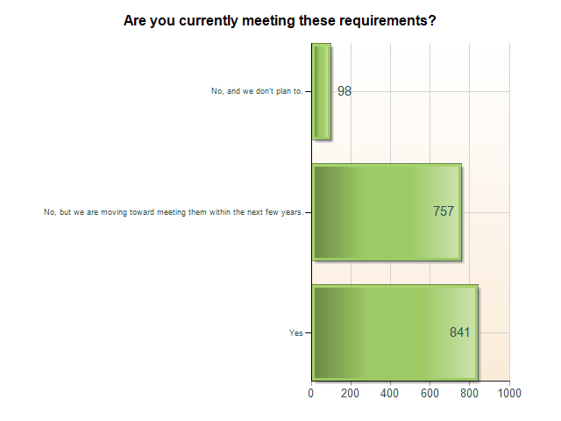

Slide 136
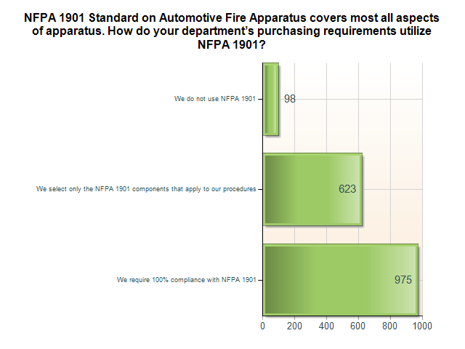

Slide 137
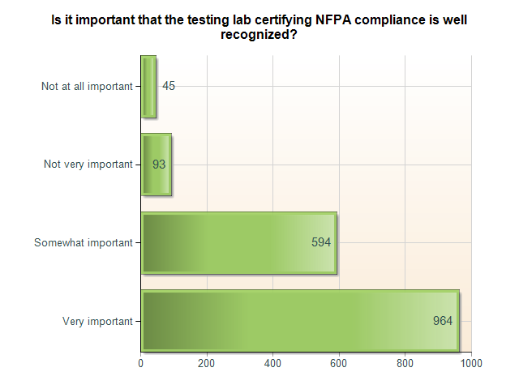

Slide 138
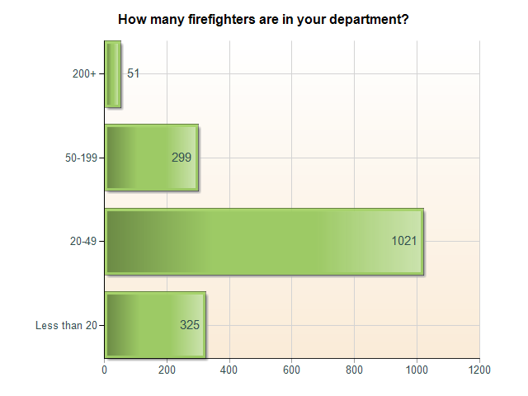

Slide 139
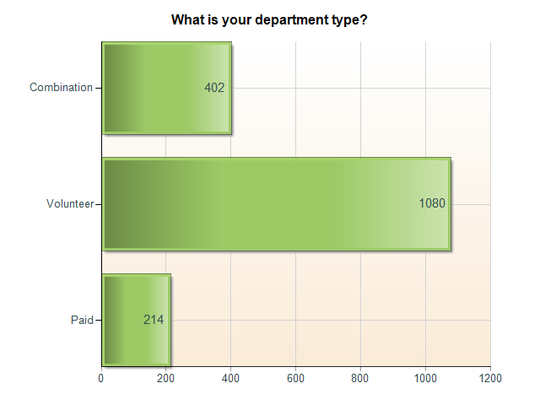

Slide 140
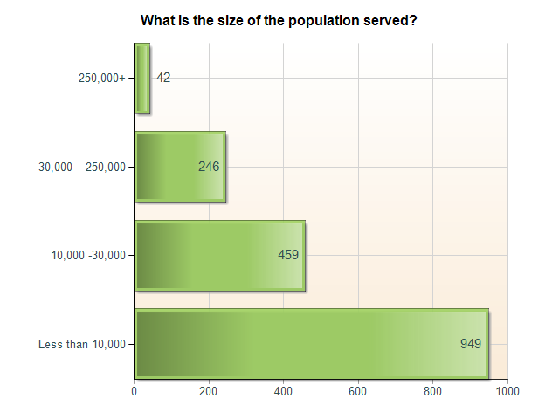

Slide 141
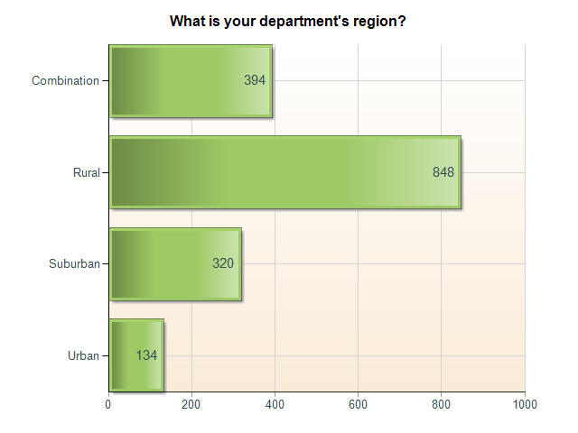

Slide 142
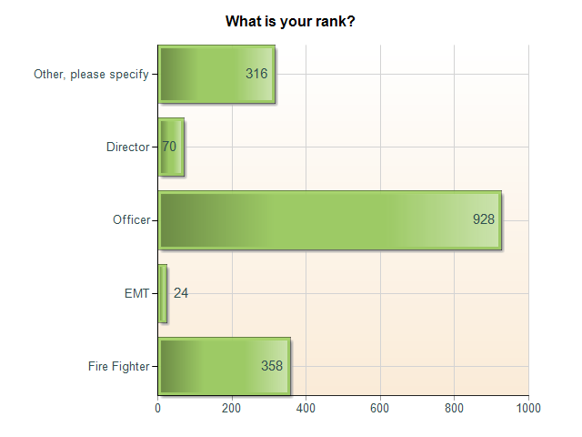

Slide 143
Results
There is huge support for NFPA and the Standards
There are a variety of means used to help fund apparatus purchases
Feel free to use results to benefit your company

Slide 144
Please Thank the Media Caucus Members for their donation of space.

Slide 145
Focus for 2011
Grady North
Continue with the positive momentum that has been created within the FAMA organization under the leadership of Peter Darley and past presidents.
  Membership is at an all time high
  Committees are more active and are working initiatives
  GAC, Hill Day and Home Day activities are having a positive influence on government funding
  Strong financial base
Improve our services to core membership (fire, rescue and command OEM’s and suppliers)
  Better statistics and surveys
  Better communication of technical and regulatory issues
  Create an environment where more companies will want to become active within FAMA
  Work with Federal, local and independent agencies to stimulate more apparatus purchases
Notes:
Hats off to the membership committee for growing our organization in this economy. FAMA has made significant steps towards smoother transition from one year to the next by creating ongoing initiatives within committees and planning sessions in November. You will note from the committee reports that some committees are already focusing on 2011. With the ongoing recession, FAMA can become a clearing house for up to date information on sales trends, regulations and government policy to help you make better business decisions.

Slide 146
Focus for 2011
Develop a long range strategy that will provide direction and targets for the future of FAMA
  Professional analysis of the industry
  Review of the changing role of first responders and how FAMA should be involved
  Develop a flexible road map that will allow FAMA to adapt and change as our industry evolves
  Closer alliances with other organizations that have common goals.
Notes:
For the past few months, the Long Range Planning Committee as taken a step back to look at the big picture for FAMA’s future – not just short term goals. The committee has been expanded to include industry leaders that have professional experience in strategic planning. Rick Morgan has been especially helpful in getting us started down a better path. FAMA has the resources to get professional assistance to better understand our industry and identify purchasing and operational changes that are taking place in the fire service. You have already gotten a hint of this from the Keynote address, Fire Grant and political landscape presentations and the fire chief’s roundtable. You will see more with next the joint FAMA/FEMSA program (Economy Insight, Vulnerability Assessment Project, Fire Drill, ISO and open mike sessions).

Slide 147
Unfinished Business
Peter Darley

Slide 148
New Business
Peter Darley

Slide 149
Closing Remarks
Peter Darley

Slide 150
Next Meeting Notice
Harold Boer

Slide 151
Adjournment
Peter Darley

Slide 152
Question 1
Based on the vulnerability assessment project report as presented by Ron Siarnicki, how do you feel that FAMA and/or FEMSA should support this project (for example, special financial contributions / allocate funds to outsource research for this project / new committees, etc.)?

Slide 153
Question 2
The US Fire Administration is considering preparing a report on the overall
effectiveness of the AFG Program. Do you feel FAMA and FEMSA should
try to support and provide input for this effort and if so, how?

Slide 154
Question 3
Are you happy with the current joint efforts, structure and overall relationship between the FAMA and FEMSA organizations?

Slide 155
Question 4
Are you satisfied with the size and overall structure of the FAMA and/or FEMSA
organization? Are you satisfied with the organizations’ involvement in the standards making process? Would you like to see more technical support for our members and/or member customers?

Slide 156
Question 5
Should FAMA and FEMSA try to provide more value to member companies? Should our organizations look to grow revenue to provide:
a. More joint and professional surveys or research projects to better understand our markets, and to better serve our customers (for example, the vulnerability assessment project).
b. More or different GAC support effort and involvement – the next level of lobbying support could add $150,000-$200,000 in additional annual costs.

Slide 157
Question 6
Does anyone have another topic to address for the good of both organizations at this time?

