Slide 2
Vulnerability Assessment Project
Phase I
Conclusions
July 2011

Slide 3
Background

Slide 4
Design a vulnerability assessment tool for evaluating exposures and risk control techniques in fire departments nationwide.
Concept initially developed by former U.S. Fire Administrator and current Fire Chief of Atlanta, Kelvin Cochran while serving as the fire chief in Shreveport, Louisiana.

Slide 5
Proposed Timeline

Slide 6
VAP Meetings
December 16, 2009 – Baltimore, Maryland – Planning Team
March 25, 2010 – Baltimore, Maryland – Planning Team
April 30, 2010 – Washington, DC - Stakeholders
November 5, 2010 – Baltimore, Maryland – Core Team
January 28, 2011 – Baltimore, Maryland – Stakeholders
April 6, 2011 – Washington, DC – Core Team
July 26, 2011 – Baltimore, Maryland - Stakeholders
6
Notes:
6

Slide 7
Phase I
Perform research and analysis of existing best practices, models, and tools for risk and vulnerability assessment (R/VA) with applicability for the U.S. fire service; develop preliminary R/VA framework.

Slide 8
Methodology

Slide 9
Literature Review
Reviewed 3,373 peer-reviewed academic journal articles
Selected 509 with potential VAP applicability from 78 journals with a median Impact Factor (IF) of 2.397

Slide 11
Literature Review (cont.)
Reviewed 513 relevant NIOSH reports, 24 NFPA reports, and 31 USFA reports

Slide 12
Literature Review (cont.)
Reviewed 137 doctoral dissertations and theses indexed by the National Fire Academy (NFA) Learning Resource Center (LRC)

Slide 13
Content Analysis
Performed content analyses using ATLAS.ti software package on selected:
NIOSH reports
NFPA reports
USFA reports

Slide 14
Other Sources
Society for Risk Analysis (SRA)
Public Entity Risk Institute (PERI)
Public Risk Management Association (PRIMA)
Partner Organizations
Stakeholders

Slide 15
Findings

Slide 16
1
Fatality
10,000
At Risk Behaviors
Safety Values and Beliefs
Management System/Behavioral Norms
10
Serious
Injuries
1,000
Near Misses
100
Minor Injuries
Cochran, K. (2010)

Slide 17
Contributing Factors

Slide 18
Lack of Effective Policies and Procedures
Unpredictable Events
Lack of Personal Responsibility.
Lack of Leadership.
Lack of Appropriate Decision Making.
Lack of preparedness.

Slide 19
Selected Variables
Monitored Radio
Elapsed Time
Emergency Traffic
Clear Text
Portable Radio
AED
SCBA Refill
PASS
Hose Test Safety
Hose Testing
SCBA Maintenance
Pressure
Smoking
Sprinklers
Smoke Detection
FD Physician

Slide 20
Selected Variables (cont.)
EAP
Medic Standby
Rehab SOP
Smoking Cessation
HSO
Wheels Right
Diesel Capture
Drive Through
Traffic Control
Backing SOP
Helicopters
Rail Crossings
Stop Signs
Out of Service Conditions
Aircraft
Seat Belt

Slide 21
Relationships
NEAR-MISS
SPEED
INJURY
SEAT BELT
STOP SIGN
FATALITY

Slide 22
Suggested Framework

Slide 23
Stakeholder Recommendations
“Keep the customer in mind, from rural to urban, make it simple and usable”
“Maybe room for an iphone or android app for individual firefighters as an add-on, opportunity to collect data from firefighters”
“Fire chief able to sit down and answer series of questions, spit out report with deficiencies, hot links, standards, SOPs”
“Tailor the tool to suit the needs of the jurisdiction”
“Don’t make it too simple – needs to be seen as useful and worth the time”
“Use standards where available”

Slide 24
Stake Holders
Barry Balliet Provident Agency
Dick Bauer Honeywell Fire Systems
Johnny Brewington IABPFF
Ricky N. Brockman Navy Fire and Emergency Services
Paul Brooks Center for Public Safety Excellence
Fred Brower Insurance Services Office, Inc.
Danielle Cagan Firemen’s Fund Insurance
Kelvin J. Cochran Atlanta (GA) Fire Rescue Department
Henry J. Costo Philadelphia (PA) Fire Department
Martha (Marty) Cropper NFFF Survivor Representative
Peter Darley Fire Apparatus Manufacturers’ Association
Charlie Dickinson National Fallen Firefighters Foundation
Steven T. Edwards North American Fire Training Directors
Allen Fritts Honeywell Fire Systems
Page 24
Notes:
24

Slide 25
Stake Holders
Glenn Gaines United States Fire Administration
William Goldfeder Loveland-Symmes (OH) Fire Department
John Granby LION
Mike Gurley Fire Department Safety Officers Association
Tricia Hurlbutt National Fallen Firefighters Foundation
William F. Jenaway, Ph.D. VFIS
JoEllen L. Kelly, Ph.D. NFFF Everyone Goes Home® program
Steven Kimple NFFF Everyone Goes Home® program
Cortez Lawrence, Ph.D. United States Fire Administration/NFFF
Victoria Lee International Association of Fire Chiefs
Ulrich Mauser Provident Agency
Lori Moore-Merrell International Association of Fire Fighters
Jeff Morris Honeywell First Responder Products
Michael Natchipolsky FEMSA
Catherine Patterson FEMA AFG Grant Program
Page 25
Notes:
25

Slide 26
Stake Holders
Vickie Pritchett Common Voices
John Proels National Fallen Firefighters Foundation LAST Program
Kevin D. Quinn National Volunteer Fire Council
Kevin Roche FACETS Consulting
Steven Sawyer National Fire Protection Association
Denise Smith Skidmore College
Victor Stagnaro National Fallen Firefighters Foundation
Tim Taylor National Fallen Firefighters Foundation
Adam Thiel FACETS Consulting
Katherine Thiel FACETS Consulting
Jim Tidwell Fort Worth (TX) Fire Department, retired
Tom Von Essen Honeywell Fire Systems
G. Crawford Wiestling International Association of Arson Investigators
Tony Wyman Honeywell First Responder Products
Page 26
Notes:
26

Slide 27
Endorsements
Resolutions of Support Center for Public Safety Excellence
Paul Brooks stated that the VAP fits well into CPSE’s credentialing process for fire officers. The CPSE has issued a formal resolution supporting the VAP, which once completed, will be incorporated into standards for model behavior.
United States Conference of Mayors
The United States Conference of Mayors, led by Mayor Joseph P. Riley, Jr. from Charleston, South Carolina has also issued a resolution of support for adoption of the VAP by its constituent municipalities.
Page 27
Notes:
27

Slide 28
Decision Support System
Organizational (fire department) level
Provide education
Prioritize needed changes
Prioritize corrective actions
Prioritize required investments
Frame public policy discussion

Slide 29
Educational Tool
Group (station, shift, company, or unit) level
Provide education
Prioritize needed changes
Prioritize corrective actions

Slide 30
Individual Application
Individual (firefighter and officer) level
Provide education
Prioritize needed changes
Prioritize corrective actions

Slide 31
Sample Questions
Does your department provide information to firefighters and fire officers related to the designation of collapse zones during structural fires?
Does your fire department coordinate the planning process for violent emergencies with local law enforcement agencies?
Do new firefighters receive a set amount of training prior to being allowed to respond to emergency incidents?
Does your fire department provide firefighters and fire officers with information about the behavior of lightweight engineered wood trusses under fire conditions?

Slide 32
Data Collection and Evaluation
Collect aggregate data on usage and results
Continually evaluate model, framework, and usability
Update application to reflect new research and technology
Support basic research to allow more detailed model specification in the future

Slide 33
Corrective Actions
NFPA standards
NFFF educational materials
USFA educational materials
Partner organizations' educational materials
Allied industries' educational materials
Inter-departmental networks
33
Notes:
33

Slide 34
Sample Web Application and Reports

Slide 35
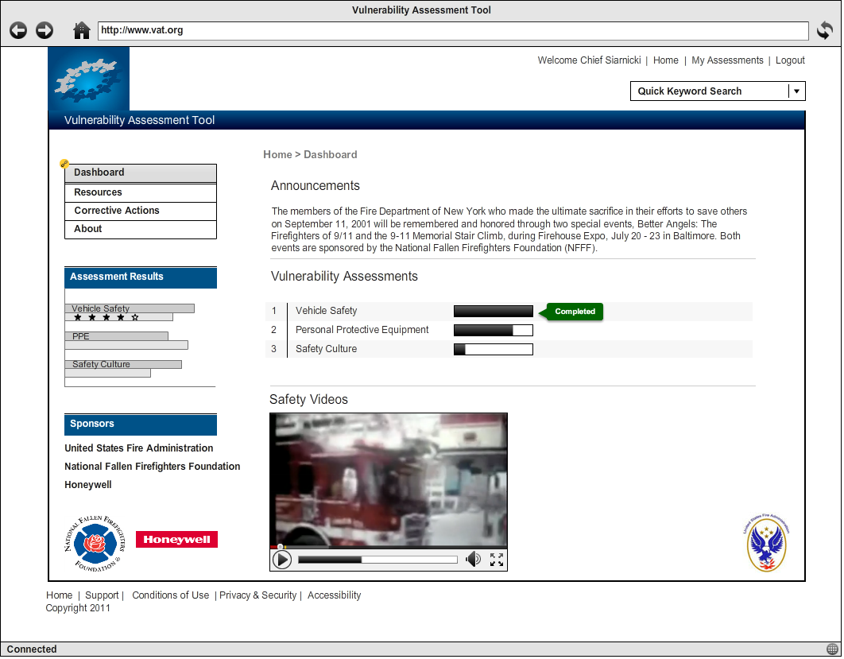
Notes:
35

Slide 36
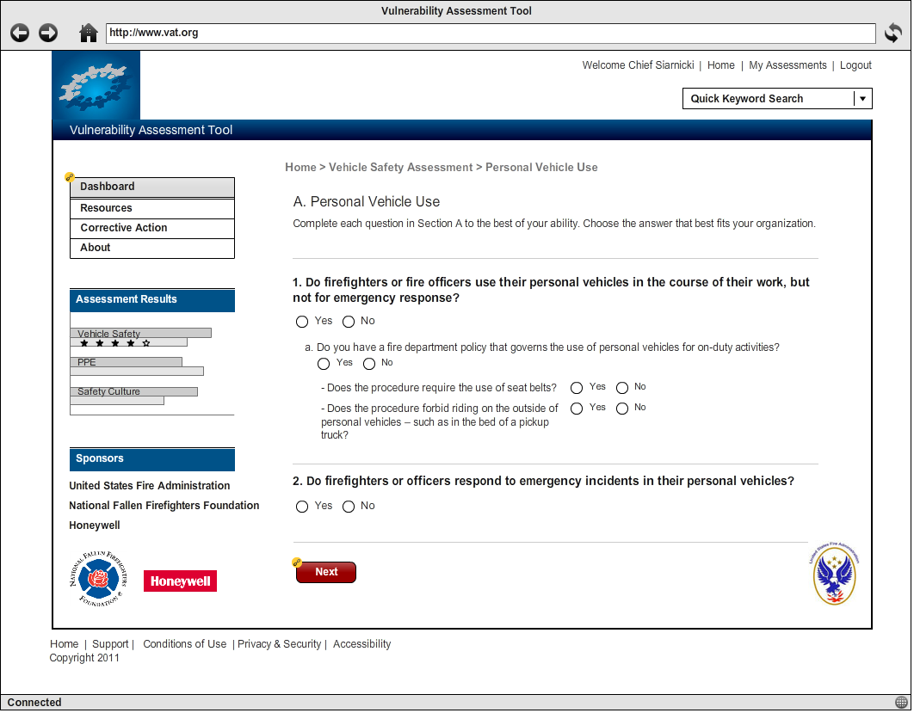
Notes:
36

Slide 37
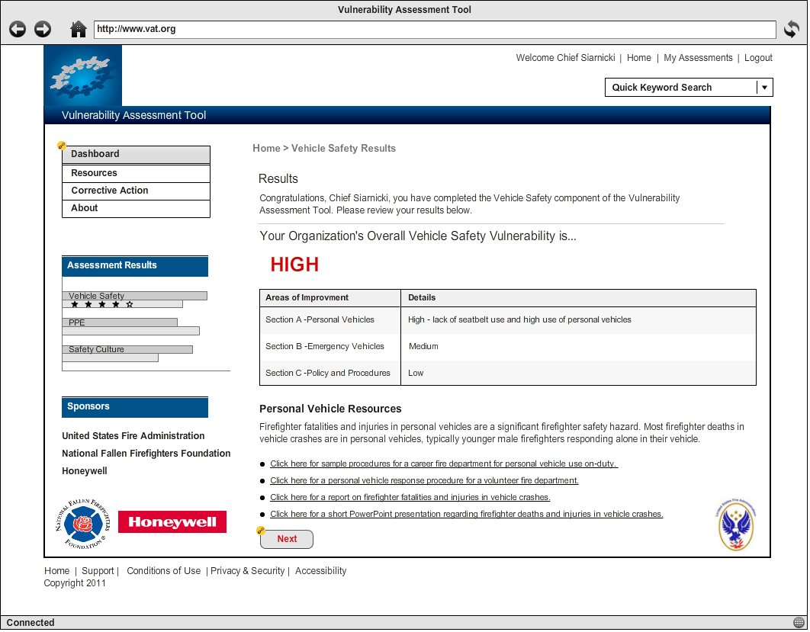
Notes:
37

Slide 38
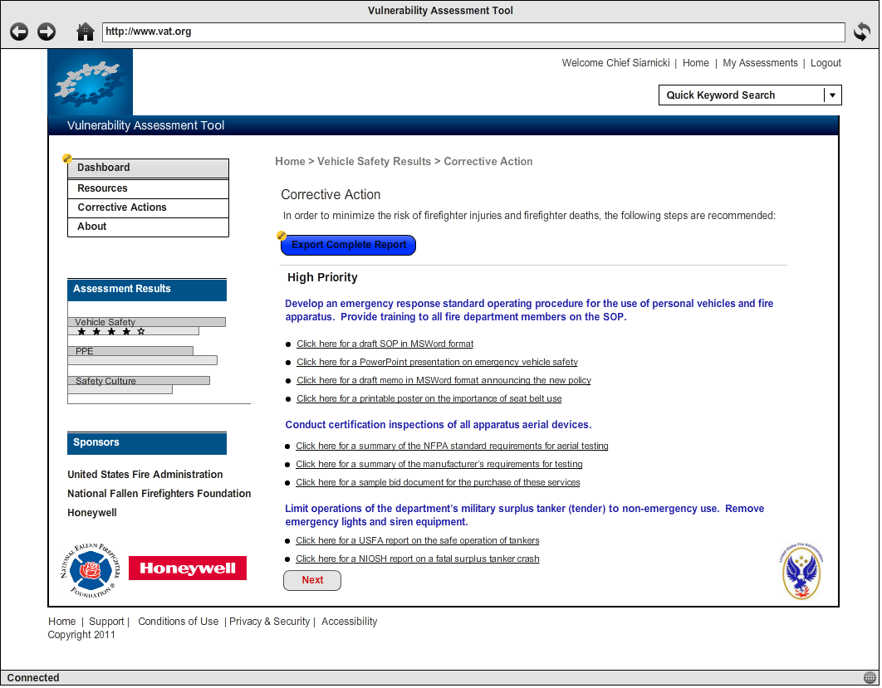
Notes:
38

Slide 39
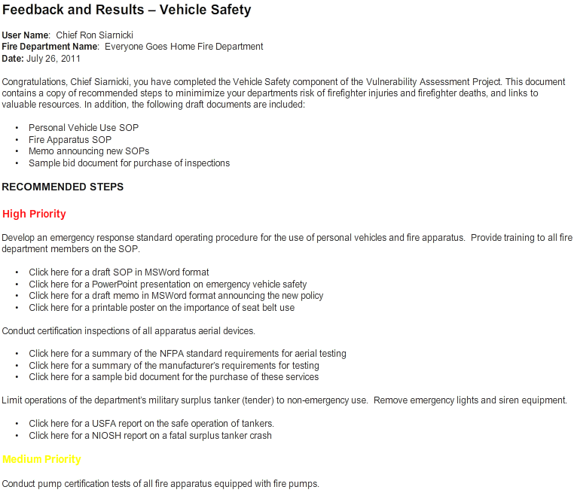
Notes:
39

Slide 40
Next Steps

Slide 41
Timeline

Slide 42
Next Phases
Phase II will extend this work by turning the Phase I frameworks into fully specified quantitative models suitable for use in developing the VAP software application (in Phase IV).
The selected vendor will be responsible for conducting expert elicitation to provide a theoretically defensible model informed by meaningful stakeholder input.

Slide 43
Next Phases Cont.
Phase II Major Tasks:
Design a valid and reliable process for eliciting subject matter expertise from the Steering Group and other potential sources.
Based on the VAP Phase I findings, specify factors contributing to fire departments' risk of experiencing firefighter near-misses, injuries, and deaths.
Vet contributing factors through the Steering Group.
Obtain/analyze feedback from the Steering Group on the relative importance of each contributing factor.
Draft questions for each contributing factor to assess user departments for organizational vulnerability.
Vet the questions for each contributing factor through the Steering Group.
Page 43
Notes:
43

Slide 44
Next Phases Cont.
Phase II Major Tasks Cont.:
Pilot-test questions for each contributing factor using a representative sample of potential end-users.
Design decision trees for each contributing factor that join the questions and follow-up questions into logical processes depending upon user input.
Obtain/analyze feedback from the Steering Group on the decision tree processes for each contributing factor.
Compile and index industry standards, best practices, and other resources to be provided to users at the conclusion of the VAP on-line assessment.
Obtain/analyze feedback from the Steering Group on the resources provided to users at the conclusion of the VAP on-line assessment.
Page 44
Notes:
44

Slide 45
Next Phases
Phase III, using the specified quantitative models and a traditional software development requirements effort will identify and develop system, functional, and user requirements essential for the success of the VAP Software Application.
These requirements will be used to create a comprehensive Request for Proposal (RFP) for the actual software development and implementation of the application into production.
Page 45
Notes:
45

Slide 46
Next Phases
Phase III Major Tasks:
Identify, through interviews, focus groups, SMEs, and research the requirements needed for the vulnerability assessment application
Document the requirements and prioritize
Vet and obtain approval of requirements with the Project Stakeholders
Create a Request for Proposal (RFP)
Send out RFP to identified vendor list
Review received proposals, pick finalists, check references, attend vendor demonstrations
Select winning proposal, negotiate and sign contract
Page 46
Notes:
46

Slide 47
Phase IV, using the specified quantitative models and a traditional software development requirements effort will identify and develop system, functional, and user requirements essential for the Vulnerability Assessment Tool
Next Phases Cont.

Slide 48
Next Phases Cont.
Phase IV Major Tasks:
Create a detailed project plan with assigned resources
Identify user input needs and obtain commitment from individuals
Review requirements for validity and team familiarization
Working with a graphic designer/usability expert, create wireframes to represent each major component of the application
Obtain wireframe approval
Working with a graphic designer/usability expert, create three different visual designs that meet requirements
Page 48
Notes:
48

Slide 49
Next Phases Cont.
Phase IV Major Tasks Cont.:
Obtain approval on one visual design from the Project Stakeholders
Define the architecture and technologies to be used for the application
Document approved wireframes, designs, and architecture
Set up a development environment
Create system content – system help, updated resources, supporting text, etc…
Code, Test, User Acceptance, and deploy based on project plan
Create hosting and maintenance plan
Create marketing materials
Release
Page 49
Notes:
49

Slide 50
Next Phases Cont.
Phase V -- Deploy VAP application and begin
data collection
Target Date – First Quarter 2013
Page 50
Notes:
50

Slide 51
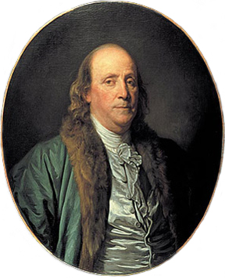
INSANITY
“The definition of insanity is doing the same thing over and over and expecting different results” Benjamin Franklin

Slide 52
Questions
and
Comments
Thank You!
www.firehero.org
52
Notes:
52
52
Please keep up with this project via our postings on the NFFF website.

