Slide 1
The Dog Ate My Home
On Behalf of
FEMSA
By: Anirban Basu
Sage Policy Group, Inc.
September 27, 2012
Notes:
Mission Impossible
Honey, We Shrunk Ourselves
Mixed Nuts
As Good as it Gets
Pay it forward
Reality Bites
Point Break
Deep Impact

Slide 2
Penny wise, Euro foolish

Slide 3
Historic and Projected World Output Growth 2004 through 2013*
Source: International Monetary Fund
*2012-2013 data are projections

Slide 4
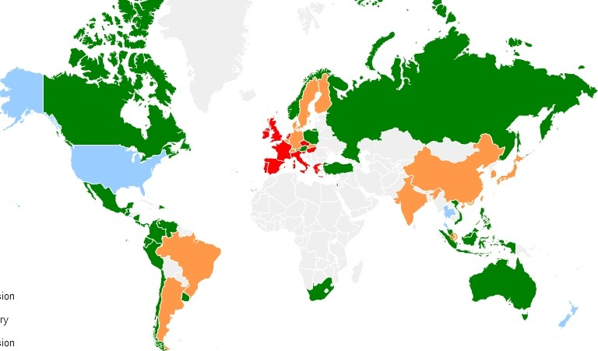
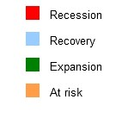
Global Recession Watch as of September 2012
Source: Moody’s Economy.com

Slide 5
Estimated Growth in Output by Select Global Areas 2011
Source: International Monetary Fund

Slide 6
Estimated Growth in Output by Select Global Areas 2012 Projected
Source: International Monetary Fund

Slide 7
Debt by Country 2011
Source: IMF; BIS; Bloomberg L.P.

Slide 8
Top 12 Stock Exchanges 2011 Growth
Rank | Exchange | Index | % Change
1 | NYSE Group | DJI A | 5.5%
2 | Nasdaq | NASDAQ Composite | -1.8%
3 | London SE | FTSE 100 | -5.6%
12 | Swiss Exchange | Swiss Market | -7.8%
9 | TSX Group | S&P TSX Composite | -9.2%
8 | Bolsa De Madrid | IGBM | -14.6%
6 | Frankfurt SE | DAX | -14.7%
5 | Euronext | CAC 40 | -17.0%
4 | Tokyo SE | Nikkei 225 | -17.3%
11 | Hong Kong Exchanges | Hang Seng Index | -20.0%
7 | Shanghai SE | Shanghai Composite | -21.7%
10 | Borsa Italiana | FTSE MIB | -25.2%
Source: Yahoo! Finance

Slide 9
Top 12 Stock Exchanges Year-to-date Growth through 9/21
Rank | Exchange | Index | % Change
6 | Frankfurt SE | DAX | 26.3%
2 | Nasdaq | NASDAQ Composite | 22.1%
11 | Hong Kong Exchanges | Hang Seng Index | 12.5%
5 | Euronext | CAC 40 | 11.7%
12 | Swiss Exchange | Swiss Market | 11.3%
1 | NYSE Group | DJI A | 11.1%
4 | Tokyo SE | Nikkei 225 | 7.7%
10 | Borsa Italiana | FTSE MIB | 6.0%
3 | London SE | FTSE 100 | 5.0%
9 | TSX Group | S&P TSX Composite | 3.6%
8 | Bolsa De Madrid | IBEX 35 | -3.9%
7 | Shanghai SE | Shanghai Composite | -7.9%
Source: Yahoo! Finance

Slide 10
S&P Select Sector Performance As of September 10, 2012
Sector | YTD Performance | Year-over-year Performance
Technology | 20.3% | 24.6%
Consumer Discretionary | 19.4% | 21.3%
Financial | 19.2% | 13.1%
Health Care | 13.1% | 16.2%
Consumer Staples | 9.3% | 15.1%
Industrial | 8.2% | 12.0%
Utilities | 0.7% | 7.2%
Energy | 5.4% | 4.1%
Materials | 9.5% | 0.9%
Source: Dow Jones, Standard & Poor’s

Slide 11
All dressed up with no place to go

Slide 12
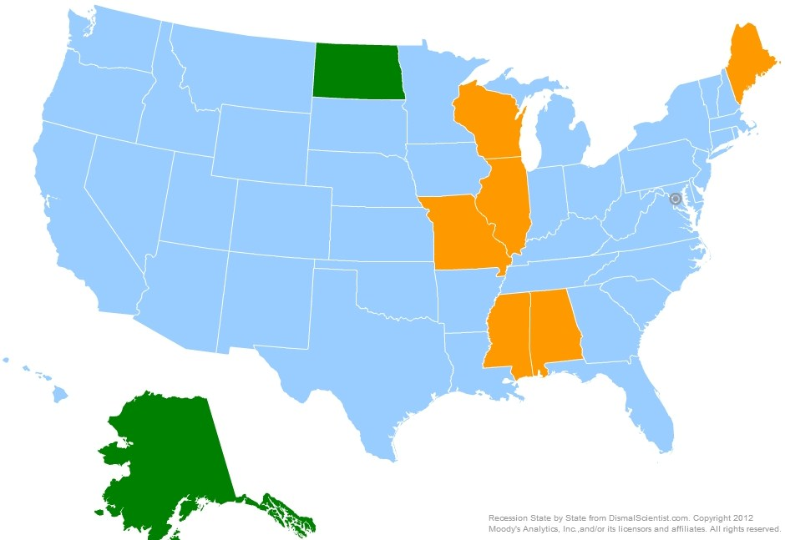
Recession Watch as of September 2012
Source: Moody’s Economy

Slide 13
Industrial Production February 2001 through August 2012
Source: Federal Reserve
The industrial production index measures the real output of the manufacturing, mining, and electric and gas utilities industries.

Slide 14
Gross Domestic Product 1990Q1 through 2012Q2
Source: Bureau of Economic Analysis

Slide 15
Net Change in U.S. Jobs, BLS January 2002 through August 2012
Aug. 2012: +96K
Between Aug. 2011 and Aug. 2012, the nation gained 1,808,000 jobs.
Source: Bureau of Labor Statistics

Slide 16
National Nonfarm Employment by Industry Sector August 2012 v. August 2011
All told 1,808K Jobs gained
Source: Bureau of Labor Statistics

Slide 17
Issues with the Federal Budget
The automatic sequestration mandated by the Budget Control Act of 2011 is set to begin in January 2013. Both defense and non-defense programs will be cut by $54.7 billion each year from 2013 through 2021 – a total of approximately $109.3 billion per year or $984 billion through 2021.
In addition, if Congress does not act by the end of the year, nearly 50 items in the tax code will expire. Among the most significant items are the “Bush tax cuts” and the payroll tax cut.
Bush Tax Cuts: If tax cuts are not extended, approximately 60 percent of taxpayers will see an increase in their tax rate between 3 and 5 percentage points (e.g. a couple that makes $90,000/year will pay an extra $2,700 in federal income taxes). Expiring tax cuts also mean reductions to investment income. If the current rates expire, the tax rate for capital gains would increase from 15 percent to 20 percent and dividends would be taxed as normal income, instead of at the current 15 percent rate.
Payroll Tax Cut: If allowed to expire, roughly 160 million workers will see a 2 percentage point tax increase in payroll taxes, or an average of $714 or more/year for each worker. The Joint Committee on Taxation reports that the payroll tax cut will save workers $114 billion in 2012.

Slide 18
Employment Growth, U.S. States (SA) August 2012 v. August 2011 Percent Change
Rank | State | % | Rank | State | % | Rank | State | %
1 | North Dakota | 6.7 | 18 | Georgia | 1.3 | 35 | Illinois | 0.7
2 | Oklahoma | 2.9 | 18 | Massachusetts | 1.3 | 35 | North Carolina | 0.7
3 | Texas | 2.5 | 18 | Montana | 1.3 | 37 | Alabama | 0.6
4 | Hawaii | 2.4 | 18 | Nebraska | 1.3 | 37 | South Dakota | 0.6
5 | Arizona | 2.3 | 18 | New Jersey | 1.3 | 39 | Nevada | 0.5
5 | Indiana | 2.3 | 23 | District of Columbia | 1.2 | 40 | Alaska | 0.4
7 | Louisiana | 2.2 | 23 | Michigan | 1.2 | 41 | Missouri | 0.3
8 | California | 2.1 | 23 | Vermont | 1.2 | 41 | Pennsylvania | 0.3
8 | Kentucky | 2.1 | 26 | Florida | 1.1 | 43 | Connecticut | 0.1
10 | Wyoming | 2.0 | 26 | Kansas | 1.1 | 44 | Delaware | -0.1
11 | Ohio | 1.9 | 28 | Arkansas | 0.9 | 44 | New Hampshire | -0.1
12 | Utah | 1.8 | 28 | Maryland | 0.9 | 46 | Maine | -0.2
13 | Idaho | 1.6 | 28 | Tennessee | 0.9 | 46 | Wisconsin | -0.2
14 | Colorado | 1.5 | 31 | Iowa | 0.8 | 48 | Mississippi | -0.4
14 | Washington | 1.5 | 31 | Minnesota | 0.8 | 49 | Rhode Island | -0.6
16 | New York | 1.4 | 31 | South Carolina | 0.8 | 50 | West Virginia | -0.7
16 | Oregon | 1.4 | 31 | Virginia | 0.8 | 51 | New Mexico | -1.7
Source: Bureau of Labor Statistics
U.S. Year-over-year Percent Change: 1.4%

Slide 19
Unemployment Rates, U.S. States (SA) August 2012
Rank | State | Rate | Rank | State | Rate | Rank | State | Rate
1 | North Dakota | 3.0 | 18 | Maryland | 7.1 | 33 | Tennessee | 8.5
2 | Nebraska | 4.0 | 18 | Texas | 7.1 | 36 | Washington | 8.6
3 | South Dakota | 4.5 | 20 | Missouri | 7.2 | 37 | District of Columbia | 8.8
4 | Oklahoma | 5.1 | 20 | Ohio | 7.2 | 37 | Florida | 8.8
5 | Vermont | 5.3 | 22 | Arkansas | 7.3 | 39 | Oregon | 8.9
6 | Iowa | 5.5 | 23 | Idaho | 7.4 | 40 | Connecticut | 9.0
7 | New Hampshire | 5.7 | 23 | Louisiana | 7.4 | 41 | Illinois | 9.1
7 | Wyoming | 5.7 | 25 | West Virginia | 7.5 | 41 | Mississippi | 9.1
9 | Utah | 5.8 | 25 | Wisconsin | 7.5 | 41 | New York | 9.1
10 | Minnesota | 5.9 | 27 | Maine | 7.6 | 44 | Georgia | 9.2
10 | Virginia | 5.9 | 28 | Alaska | 7.8 | 45 | Michigan | 9.4
12 | Hawaii | 6.1 | 29 | Pennsylvania | 8.1 | 46 | South Carolina | 9.6
13 | Kansas | 6.2 | 30 | Colorado | 8.2 | 47 | North Carolina | 9.7
14 | Massachusetts | 6.3 | 31 | Arizona | 8.3 | 48 | New Jersey | 9.9
14 | Montana | 6.3 | 31 | Indiana | 8.3 | 49 | California | 10.6
16 | New Mexico | 6.5 | 33 | Alabama | 8.5 | 50 | Rhode Island | 10.7
17 | Delaware | 6.9 | 33 | Kentucky | 8.5 | 51 | Nevada | 12.1
Source: Bureau of Labor Statistics
U.S. Unemployment Rate: 8.3%

Slide 20
Unemployment Rates, Selected Large Metros (NSA) July 2012
Rank | MSA | UR |  | Rank | MSA | UR
1 | Washington-Arlington-Alexandria, DC-VA-MD-WV | 5.6 |  | 11 | Chicago-Joliet-Naperville, IL-IN-WI | 9.1
2 | Minneapolis-St. Paul-Bloomington, MN-WI | 5.9 |  | 12 | Philadelphia-Camden-Wilmington, PA-NJ-DE-MD | 9.2
3 | Boston-Cambridge-Quincy, MA-NH | 6.1 |  | 12 | San Diego-Carlsbad-San Marcos, CA | 9.2
4 | San Antonio-New Braunfels, TX | 7.3 |  | 14 | Atlanta-Sandy Springs-Marietta, GA | 9.3
5 | Dallas-Fort Worth-Arlington, TX | 7.4 |  | 14 | Miami-Fort Lauderdale-Pompano Beach, FL | 9.3
6 | Houston-Sugar Land-Baytown, TX | 7.5 |  | 16 | Tampa-St. Petersburg-Clearwater, FL | 9.4
6 | Phoenix-Mesa-Glendale, AZ | 7.5 |  | 17 | New York-Northern New Jersey-Long Island, NY-NJ-PA | 9.5
8 | Baltimore-Towson, MD | 7.7 |  | 18 | Los Angeles-Long Beach-Santa Ana, CA | 10.9
9 | Seattle-Tacoma-Bellevue, WA | 8.3 |  | 19 | Detroit-Warren-Livonia, MI | 11.9
10 | San Francisco-Oakland-Fremont, CA | 8.5 |  | 20 | Riverside-San Bernardino-Ontario, CA | 12.7
Source: Bureau of Labor Statistics

Slide 21
It could be worse, right??

Slide 22
15-Year & 30-Year Fixed Mortgage Rates January 1995 through September 2012*
Source: Freddie Mac *Average rate through 9/27.

Slide 23
U.S. New Home Sales January 1999 through August 2012
Source: Economy.com, Census Bureau

Slide 24
U.S. Housing Starts February 1999 through August 2012
Source: Census Bureau

Slide 25
A penny saved is a penny earned

Slide 26
Conference Board Consumer Confidence 2005 – September 2012
Source: Conference Board

Slide 27
U.S. Retail and Food Service Sales January 2002 through August 2012
Source: Census Bureau

Slide 28
U.S. Chain Store Sales Growth by Type of Store August 2011 v. August 2012
Source: Economy.com

Slide 29
National Vehicle Sales June 2004 through August 2012 (SAAR)
Source: Autodata Corp.

Slide 30
Conference Board Leading Economic Indicators Index August 2007 through August 2012
Source: Conference Board

Slide 31
It’s difficult to forecast, particularly the future
Economy hit a soft patch;
Recession not imminent;
Black swan threats: (1) Iran (2) Israel/Iran (3) Europe;
2013 could be very different depending on…;
Many headwinds remain and the nascent recovery could easily falter; and
State and local budgets on the mend.

Slide 32
Thank You
You can always reach me at abasu@sagepolicy.com
Please look for updates of information at www.sagepolicy.com.
Also, if you need us in a hurry, we are at 410.522.7243 (410.522.SAGE)
Please contact us when you require economic research & policy analysis.

