Slide 1
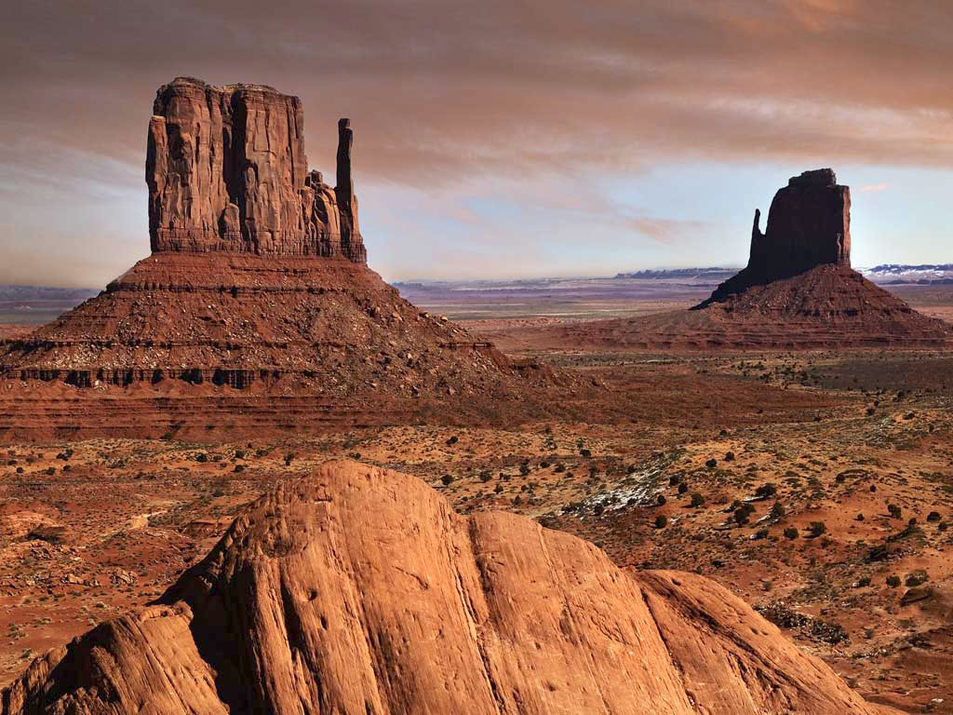
FAMA Fall Meeting
2012
Good Morning !!

Slide 2
FAMA Fall Meeting
2012
Welcome to beautiful
Glendale, AZ

Slide 3
FAMA Fall Meeting
2012
Call to Order

Slide 5


Slide 6
Opening Remarks

Slide 7
Sponsor Recognition

Slide 8
AMDOR
Fire Chief Publications
FIREHOUSE
Fire Rescue Magazine
FireRescue1.com
PennWell Emergency Services Group
Rosenbauer
Spartan

Slide 9
Introductions

Slide 10
FAMA Fall Meeting
2012
Roll Call

Slide 11
Important Stuff:
Proof of Notice
Review / Enter Minutes

Slide 12
Anti-Trust Guidelines

Slide 13
FAMA Fall Meeting
2012
Treasurer’s Report

Slide 14
Treasurer’s Report
We got money ….
Notes:
14

Slide 15
FAMA Fall Meeting
2012
Board of Directors’ Report

Slide 16
Board of Directors’ Report
Monthly meetings
Key Initiatives and Scorecard
Succession planning – Committees and Staff
Meeting content - Open Mike
FDSOA
Value to members
Notes:
16

Slide 17
FAMA Fall Meeting
2012
Nomination and Elections – 2013 Board of Directors

Slide 18
Nominating Committee's recommended slate of nominees for 2013 FAMA Board
Position
Member
President
Vice President
Treasurer
Secretary
Past President
Sr. Director-at-Large
Jr. Director-at-Large
Harold Boer
Bruce Whitehouse
Phil Gerace
David Durstine
Greg Kozey
Scott Edens
Steve Toren

Slide 19
FAMA Fall Meeting
2012
Committee Reports

Slide 20
FAMA Fall Meeting
2012
Statistics Committee
Notes:
20

Slide 21
Statistics Committee
Committee Members
Jack McLoughlin – Chair
Dave Drehobl – Vice Chair
Jim Otwell – Member
Bruce Whitehouse – Board Liaison
Notes:
21

Slide 22
Statistics Committee
2012 1st quarter
Bookings dropped to ~1000 unit floor back to 2009 numbers.
Slight increase in shipments reflects starting to clear out large bookings of 4th Qtr 2011
Notes:
22

Slide 23
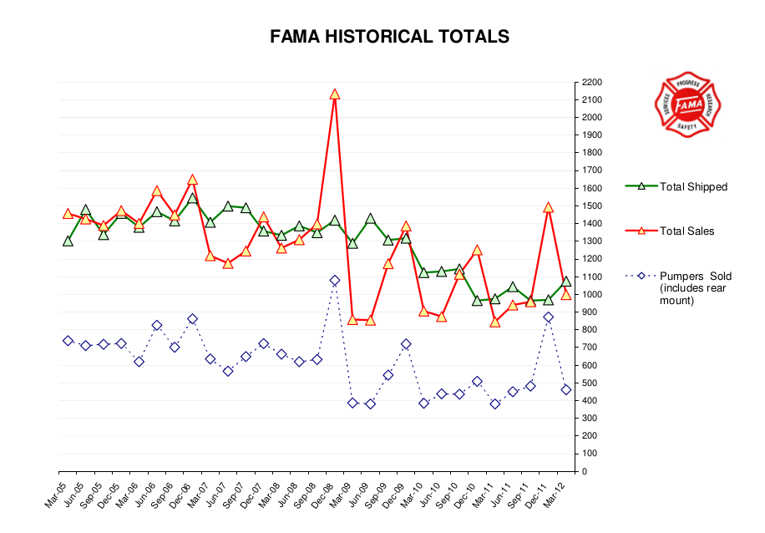

Statistics Committee
2012 1st quarter
Notes:
23

Slide 24
Statistics Committee
Changes to data collection
Some confusion over addition of “Rear Mount pumpers” as a separate vehicle class.
Suggest that we drop the class entirely
This info can be extracted from the Pump Type column as all pumps are classified as “front”, “mid”, “rear” (In Excel use Data | Advanced Filter)
Notes:
24

Slide 25
Statistics Committee
Improving Data Collection
A sub-committee was formed to discuss improvement to the data collection process.
Members:Peter Darley, Grady North, Phil Gerace, Nate Berry
Notes:
25

Slide 26
Statistics Committee
Improving Data Collection suggestions:
Add ability to upload a batch of trucks
Ability to map data by state and provinces in Canada
Divide Other category into Export and GSA (or “military”)
Notes:
26

Slide 27
Statistics Committee
Data investigation and tools
We now have a large database of data
Goal to provide tools to easily visualize this data to all members
Easily done with some free web tools
Fire Research created an example site:
Notes:
27

Slide 28
Statistics Committee
Statistics Shipped Data Tool
Prototype page with some limited tools
Password protected
fireresearch.com/fama
User: famastats Password: frc
Try it now!
Notes:
28

Slide 29
Statistics Committee
Statistics Shipped Data Tool
Nate Berry downloaded the data (like any FAMA member can do)
Built a database of shipped trucks
Put up a web form so members can do some investigations on their own without having to get IT folks involved.
Notes:
29

Slide 30
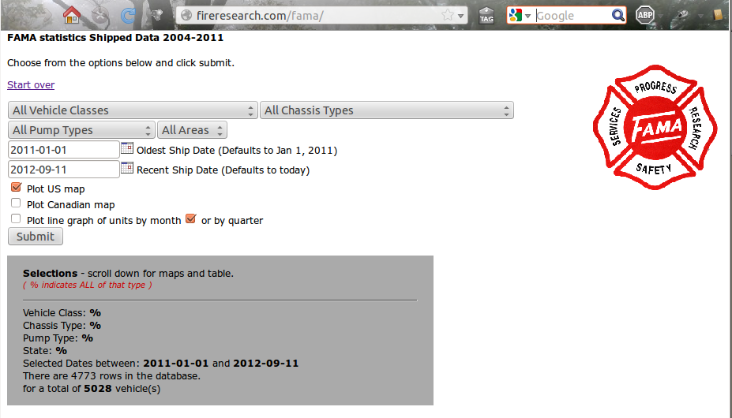
Statistics Committee
Slide Title
Content
Make selections
Pick one or more graphs to show
Your selections
shown here
(in case you forget!)
Graphs
Appear below
Notes:
30

Slide 31
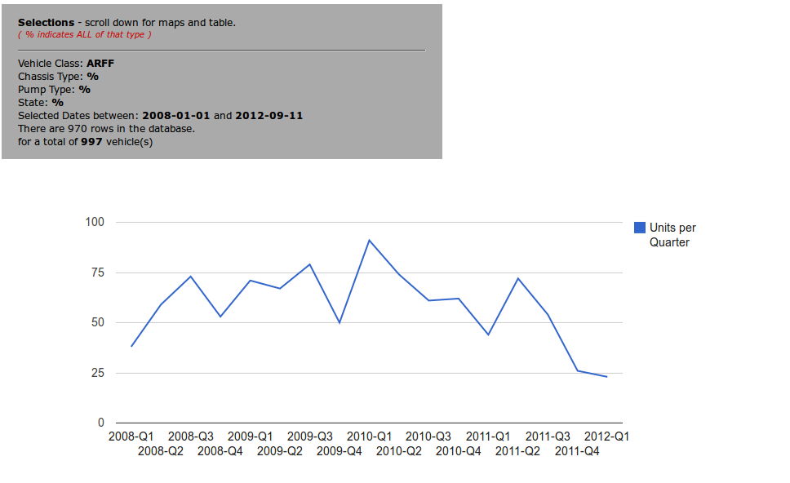
Statistics Committee
Slide Title
Content
This graph shows all
ARFF trucks shipped
by Quarter between
Jan 1, 2008
and present
Notes:
31

Slide 32
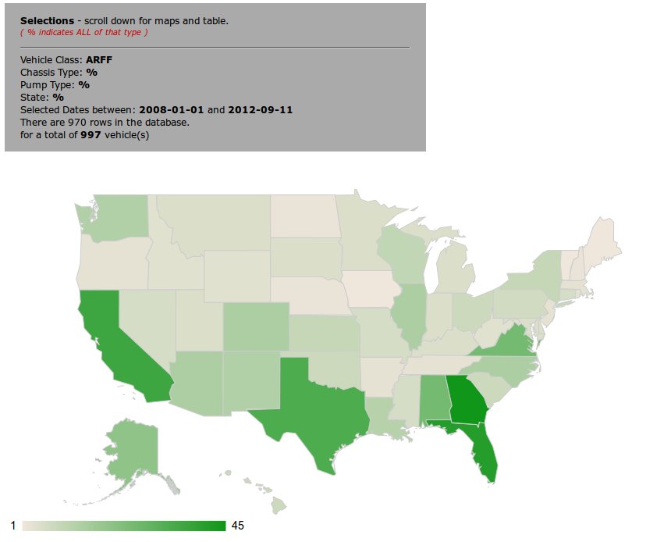
Statistics Committee
Slide Title
Content
Here’s the same
data plotted on a
map of the US.
Hover over a state
for the actual value.
Notes:
32

Slide 33
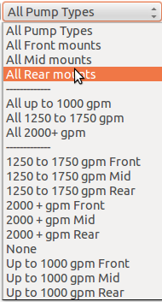
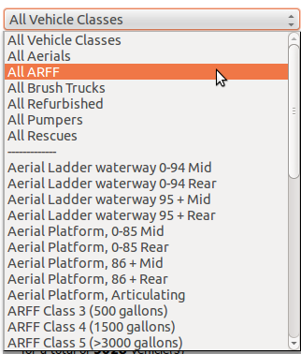
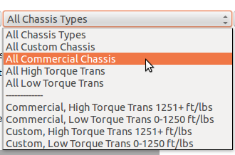
Statistics Committee
Search by groups of vehicle classes, chassis & pump types!
Notes:
33

Slide 34
FAMA Fall Meeting
2012
GAC
Governmental Affairs Committee

Slide 35
GOVERNMENTAL AFFAIRS COMMITTEE (GAC) MEMBERS
John Granby, Co–Chair
Bill Lawson
John W. McNulty,lll
Mike Natchipolsky
Craig Sharman
Rick Singer
Corey Carlson
Lee Morris, Co–Chair
Ken Creese
George Goros
Stewart McMillan
Steve Stein
Neil Chaney
Tim Dean

Slide 36
GAC Support
Dave Gatton – Washington Consultant
Richard Boyes - CGC Liaison
Peter Darley - FAMA Board Liaison

Slide 37
2012 Activity
Hill Day – CFSI combination
– 75 meetings, 28 companies participated (27% higher
company participation)
Home days – Task Force Tips and Illinois Fire Service
Alliance Lunch – October
Ongoing meetings with members, staff and committee
members
GAC alerts and newsletter to all members
Hosted spring Industry/FEMA grants office roundtable
discussion at FDIC

Slide 38
Hill Day Successes
Connected with CFSI week
Hill day, well organized and staged
High energy among attendees
75 meetings with Congressional offices
Well received by legislators & Alliance partners
Fire Caucus successful in continued funding for
both the AFG and SAFER programs in a very
difficult budget climate

Slide 39
2013 Legislative Agenda
Continue to push for continued even funding for
2013 AFG and SAFER programs
Federal Fire Act Grants Program Reauthorization
DHS Reauthorization
State/Federal fire truck weight laws (FAMA)

Slide 40
2013 Goals
Continue to promote our core initiatives
  ─ Full Funding for the Fire Act
  ─ Reauthorization and continued support for the program
  ─ Full funding for the U.S. Fire Administration
Greater member participation
  ─ Hill Day/CFSI
  ─ Home day
More targeted communications and timely information

Slide 41
GAC tasks to Members
IT HASN’T CHANGED
This is a Relationship Business!!
Call your Congressional Offices
  ─ Fire Act Funding Update
  ─ Election Outlook
Call Before and After Election Day
Report Back to GAC

Slide 42
FAMA Fall Meeting
2012
Tradeshow Advisory
Committee

Slide 43
Tradeshow Advisory Committee
2013 Fire Service
Events Calendar

Slide 44
Tradeshow Advisory Committee
2012 Tradeshow attendance
Firehouse World 4,850(a) / 1,596(e)
FDIC 24,707(a) / 4,703(e)
PA Fire Expo 15,991(a) / 2,627(e)
NY State Fire Chiefs 11,927(a) / 2,858(e)
Firehouse Expo 9,121(a) / 1,536(e)
FRI (IAFC) 6,636(a) / 2,881(e)

Slide 45
Tradeshow Advisory Committee
5-Year History
Firehouse World
  2008 – 7,484(a)
  2009 – 5,647(a) / 1,578(e)
  2010 – 5,916(a) / 1,607(e)
  2011 – 5,316(a) / 1,485(e)
  2012 – 4,850(a) / 1,596(e)

Slide 46
Tradeshow Advisory Committee
Firehouse World Steering Committee
Adding efforts to bring Battalion Chiefs, Deputy Chiefs, and other Chief positions that are responsible for spec writing
Working on new staging area for apparatus and POV’s

Slide 47
Tradeshow Advisory Committee
5-Year History
FDIC
  2008 – 23,861(a) / 4,716(e)
  2009 – 22,918(a) / 4,477(e)
  2010 – 22,802(a) / 4,670(e)
  2011 – 24,119(a) / 4,599(e)
  2012 – 24,707(a) / 4,703(e)

Slide 48
Tradeshow Advisory Committee
FDIC Exhibitor Roundtable
New sponsorship opportunities
New registration features, including allowing controlled self-registration of booth staff
Jefferson Davis held a session about shifting tradeshow thinking from an expense to an investment and true calculations of ROI based on that thinking

Slide 49
Tradeshow Advisory Committee
5-Year History
PA Fire Expo
  2008 – 18,000’s(a) / 3,000’s(e)
  2009 – 15,000’s(a) / 2,500’s(e)
  2010 – 16,500’s(a) / 2,500’s(e)
  2011 – 16,000’s(a) / 2,000’s(e)
  2012 – 15,991(a) / 2,647(e)

Slide 50
Tradeshow Advisory Committee
PA Fire Expo Show update
With the passing of Tina Alexander, her husband John Alexander is now the show manager
All contact information stays the same
Show will go on

Slide 51
Tradeshow Advisory Committee
5-Year History
NY State Chiefs
  2008 (Lake George) – 9,045(a) / 2,414(e)
  2009 (Verona) – 10,786(a) / 2,426(e)
  2010 (Verona) – 10,855(a) / 2,761(e)
  2011 (Verona) – 11,028(a) / 2,938(e)
  2012 (Verona) – 11,927(a) / 2,858(e)

Slide 52
Tradeshow Advisory Committee
FIRE Exhibitor Advisory Committee
Possible Construction of large exhibition area is just rumor
Looking at changing hours for first day to run later than usual, until 7pm instead of 5pm

Slide 53
Tradeshow Advisory Committee
5-Year History
Firehouse Expo
  2008 – 17,007(a)
  2009 – 15,068(a)
  2010 – 14,991(a)
  2011 – 9,968(a)
  2012 – 9,121(a) / 1,596(e)

Slide 54
Tradeshow Advisory Committee
Firehouse Expo Steering Committee
Baltimore CVB working to make the entire city and event to welcome the fire service
Show is adding after hours events to add draw, and is working to promote existing events (like FOOL’s) rather than competing with them
Show is continuing to improve staging area

Slide 55
Tradeshow Advisory Committee
5-Year History
FRI (IAFC)
  2008 (Denver) – 7,459(a) / 5,742(e)
  2009 (Dallas) – 7,650(a) / 4,291(e)
  2010 (Chicago) – 6,077(a) / 5,070(e)
  2011 (Atlanta) – 5,347(a) / 7,032(e)
  2012 (Denver) – 6,636(a) / 2,882(e)

Slide 56
Tradeshow Advisory Committee
Future Dates/Locations
2013 Chicago 8/13-8/17
2014 Dallas (not Philadelphia) 8/12-8/16
2015 Atlanta 8/25-8/29

Slide 57
Tradeshow Advisory Committee
IAFC Site Selection Task Force
Currently in process of selecting future locations for FRI 2018-2022
Began with 25 cities (new and existing)
Down to 10 (6 new, 2 existing, 2 backups)

Slide 58
Tradeshow Advisory Committee

Slide 59
FAMA Fall Meeting
2012
Technical Committee
Notes:
59

Slide 60
Technical Committee
Co-Chairs
David Durstine
Mike Moore
Subcommittee (Co-Chairs)
Aerial/Quint ARFF Ambulance
Jim Salmi Grady North Steve Rowland
Jeff Aiken Marty Huffman TBD
Body Chassis Electrical
Bill Proft Roger Lackore John Doperalski
Mike Lemieux Tim Johnson Peter Luhrs
Foam Pumps & Plumbing Tech Education
Dominic Colletti Doug Miller Dan Veselsky
Gregg Geske Chad Trinkner TBD

Slide 61
Technical Committee
2012 Initiatives
Published quarterly Technical Committee E‐Newsletter.
Promote Communications and Committee Work outside the 2 Technical Meeting Held (Spring & Fall)
  Web Portal Project is on Track and with Beta Testing and Training currently in process.
  Subcommittee Chair Training Followed by full release in early October

Slide 62
Technical Committee
2012 Initiatives
Apparatus Safety Sign Task Force
  Developed in conjunction with NFPA 170 Standard for Fire Safety & Emergency Symbols
  White Paper has been created and is awaiting approvals
  Once approved it will be published on fama.org
  Thanks to the Team
  Roger Lackore Wes Chestnut Tim Johnson
  Dale Katz Joe Hedges Jim Garver
  Reid Wissler Jeff Davis Eric Pitchford
  Michael Michna Greg Bronkema

Slide 63


Technical Committee
2012 Spring Tech Meeting
  Was held in conjunction with FDIC (Indianapolis, IN)
Special to Thanks to Spring Meeting Sponsors

Slide 64


Technical Committee
2012 Fall Tech Meeting
  Was held in Conjunction with FRI (Denver, CO)
Special to Thanks to the 2012 Fall Meeting Co-Sponsors

Slide 65
Technical Committee
Chassis Sub-Committee Report
  Met yesterday
More to come during Open Mike

Slide 66
FAMA Fall Meeting
2012
Meeting Planning Committee

Slide 67
Meeting Planning
Committee Members
John Swanson – Chairman
Mark Albright – Vice Chair
Harold Boer – Board Liaison
Ed Dobbs
Damon Lewis
Bob Grimaldi – Travel Agent/Consultant

Slide 68
Meeting Planning
Corporate Sponsors
PennWell Emergency Services Group – Hospitality
Firehouse – Networking
Fire Chief – Business Speaker
FireRescue & FirefighterNation.com – Reception
FireRescue1.com – Banquet Open Bar
Spartan – FAMA Breakfast
AMDOR & Rosenbauer - Roundtable

Slide 69
Meeting Planning
FAMA Spring Meeting 2013
Location: Rancho Mirage, CA
Date: March 16 - 19, 2013
Hotel: Rancho Las Palmas
Base Rate: $255.00 per night

Slide 70
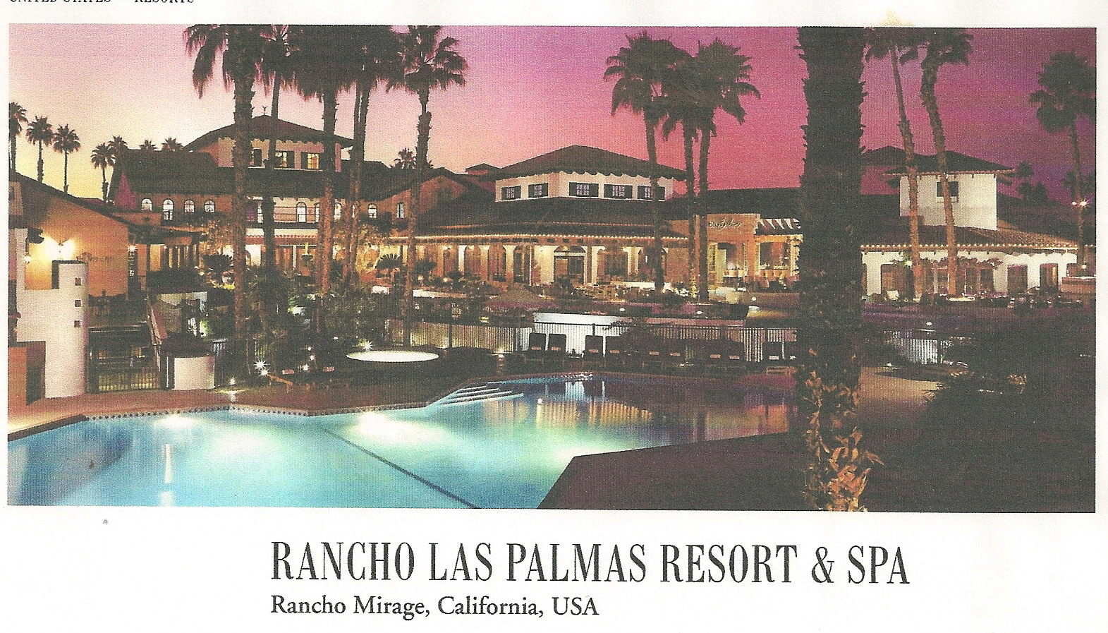
Meeting Planning
Spring 2013

Slide 71
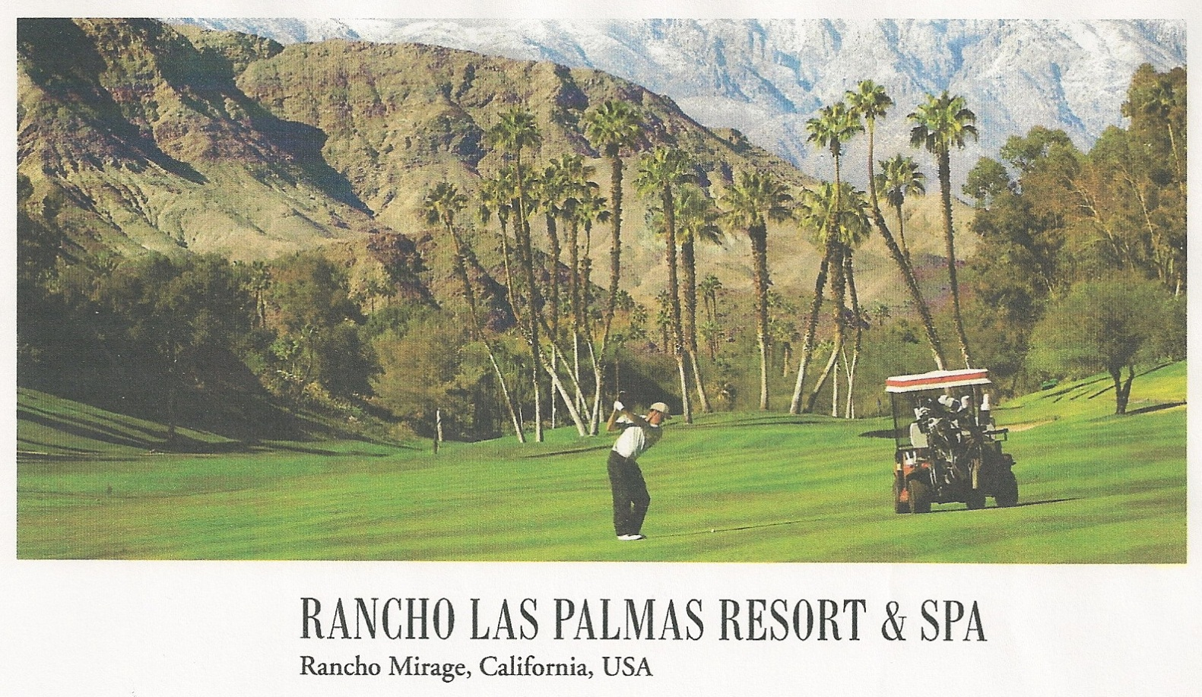
Meeting Planning
Spring 2013

Slide 72
Meeting Planning
FAMA/FEMSA Fall Meeting 2013
Location: Tampa, FL
Date: Sept. 25 – 27, 2013
Hotel: Renaissance Tampa
Base Rate: $159.00 per night

Slide 73
Meeting Planning
FAMA Spring Meeting 2014
Location: Orlando, FL
Date: March 15 – 18, 2014
Hotel: Wyndham – Lake Buena Vista Resort
Base Rate: $125.00 per night

Slide 74
Meeting Planning
FAMA/FEMSA Fall Meeting 2014
Location: San Antonio, TX
Date: October 8 – 10, 2014
Hotel: Plaza Marriott
Base Rate: $199.00 per night

Slide 75
Meeting Planning
Save these dates:
Spring 2015: March 21 – 24, St. Augustine, FL
Fall 2015: October 7 – 9
Spring 2016: April 2 – 5
Fall 2016: October 5 – 7
Spring 2017: March 18 – 21
Fall 2017: October 4 - 6

Slide 76
Meeting Planning
Meeting Survey
After the meeting, please go to the link below to access the on-line survey. Your input is important in the planning of future meetings.
http://www.zoomerang.com/Survey/WEB22GM644XMAX

Slide 77
FAMA Fall Meeting
2012
FAMA / FEMSA Survey Results

Slide 78
FEMSA/FAMA State of the Fire Service (1,500 + respondents)
Summary Comments
Almost 1,100 attended one or zero tradeshows
Departments feel that state trade shows provide more value than regional shows, 41% to 28%
Over 70% of respondents feel that web-based training or product videos do not reduce trade show attendance
FDIC (41%), Firehouse World (30%) and Harrisburg (25%) were the top three shows – by attendance

Slide 79
FEMSA/FAMA State of the Fire Service (1,500 + respondents)
Summary Comments
Attendees at trade shows are most seeking:
  New Product Info (91%)
  Hands on Training (68%)
  Exhibits (68%)
  Product Specs (to structure bids accordingly) (52%)

Slide 80
FEMSA/FAMA State of the Fire Service (1,500 + respondents)
Summary Comments
Most important trade show factors:
  Distance from your location (61%)
  Travel Costs (49%)
  Training program offered (39%)
  Registration cost (39%)

Slide 81

FAMA Fall Meeting
2012
Open Mike

Slide 82
Open Mike
NFPA 1500 – need Alternate Rep
NFPA 1901 / 1906
Dave Durstine and Mike Moore

Slide 83
Open Mike
EPA / DPF
Roger Lackore, Tim Johnson & Wes Chestnut

Slide 84
FAMA Chassis Engine DPF Troubleshooting Guideline Initiative
Roger Lackore - Oshkosh
Tim Johnson - Rosenbauer

Slide 85
History
2007 – Engines require DPF regeneration
2010 – Engines add SCR
2012 – Fire Chief Complaints of Frequent Regeneration or Related Issues
  San Diego
  SEAFC
  Congressmen complaint to EPA
EPA Regulations Revised
  Allows Manual Regens Anytime
  Eliminates SCR Driver Inducements

Slide 86
FAMA Actions
Customer Survey thru SEAFC
Trouble-shooting Guideline Document
  Dave Drehobl – Cummins
  Brian Chaput - DDC
  Jason Davis - KME
  James Ham - Navistar
  Dirk Steyn – E-One
  Rand Smith – Sutphen
  Neil Bjornstad – Pierce
  Tim Johnson – Rosenbauer
  Roger Lackore - Oshkosh

Slide 87
Trouble-shooting Guide
Introduction to emissions systems
How to identify your system
2007 Engine guidance (15 topics)
2010 Engine guidance (7 topics)
Appendix
  Training Checklist
  Contacts for each engine OEM
  Contacts for each chassis OEM
  Links or URLs to reference documents
  Chassis-Specific information on switch locations

Slide 88
Timeline
Complete draft document – 2 weeks
Committee review - 1 week
Final editing – 1 week
FAMA board approval – 1 week
Publication in early November, 2012

Slide 89
Open Mike
Statistics – Q & A
Peter Darley and Phil Gerace

Slide 90
Open Mike
FDSAO Update

Slide 91
FAMA Fall Meeting
2012
2013 Focus

Slide 92
Focus on 2013
Purpose of most trade organizations is to improve the business conditions and profitability of its members.

Slide 93
Focus on 2013
Networking with other members:
Ranks very high in all surveys
FAMA Spring and Fall Meetings
  Allows suppliers, customers, and competitors to know each other in a relaxed setting
  Work closely w/ Bruce and meeting planning committee on enhancing next year’s meetings
  Get information out to members early and often

Slide 94
Focus on 2013
Government Affairs Committee (GAC)
Becoming more important
  Hill Day
  AFG
  Weight Issues
  EPA Issues
  Very informative newsletter

Slide 95
Focus on 2013
Statistics
  Working to enhance information
  Encourage members to
  report quicker

Slide 96
Focus on 2013
Technical Information
  NFPA
  Keep members updated on proposed changes
  Encourage members to be part of process
  Encourage members to review and make proposals

Slide 97
Focus on 2013
Technical Committees
  Very busy
  Many issues are also GAC
  Make sure information gets to members thru e-mail blasts, the quarterly Technical e-Newsletter, and postings on web site.

Slide 98
Focus on 2013
THANK YOU

Slide 99
FAMA Fall Meeting
2012
In Closing …

Slide 100
Next Meeting Notice
Spring 2013 - March 16 - 19

Slide 101
FAMA Spring Meeting
2013
See you in
Rancho Mirage !!
Notes:
101

