Slide 1
The Fire and Emergency Service Outlook in the New Economy
Over the Fiscal Cliff
Mark W. Light, CAE
Chief Executive Officer and Executive Director
International Association of Fire Chiefs

Slide 2
On the Other Side
“…as mayors you can appreciate there's only so much blood you can squeeze out of a turnip. And our turnip is pretty dry”
Secretary Janet Napolitano,
U.S. Department of Homeland Security in remarks to the
National League of Cities Conference
Notes:
federal dollars accounting for more than a third of total state spending
State and Local government continue to struggle.
National government making increasing cuts in effort to trim back the deficit.

Slide 3
The Other Side:
One Option
Move forward

Slide 4
The Other Side:
Many Unknowns
The scoop on sequestration
  Real or just politics?
National outlook for fire department budgets
  Anecdotal information
How will popular reforms impact departments?
  Federal health care
  Federal budget deficit reduction
  Local pensions
Will the recovery continue as projected
Notes:
Have we hit bottom yet?

Slide 5
The Other Side:
What We Know
PHMSA’s Hazardous Materials Safety account
  $2 Million
Hazardous Materials Emergency Preparedness grants
   $1 Million
Medicare reimbursements to providers
   by 2% starting on April 1, and there may be a delay in receiving reimbursements
Notes:
Cuts to Medicare reimbursement will start on April 1. Providers were also notified that their may be a delay in receiving reimbursements.

Slide 6
The Other Side:
What We Know
USFA
   $2 Million
Federal wildland fire management accounts
  $163 Million
DHS state and local programs (including the FIRE and SAFER grant programs)
  $117 Million
USAR and UASI
  $7.5 Million and $15 Million
Notes:
Wildland Fire management accounts:
U.S. Forest Service’s ($125 million cut)
US. DOI ($38 million cut)
US&R
For FY 2012, Congress appropriation $41.25 million.
For FY 2013, the House and Senate have appropriated approximately $35.18 million. After the 5% sequester, this amount would be $33.421 million.
So, the total cut for US&R looks like it will be $7.829 million.
UASI
For FY 2012, the final funding level for the UASI grant program was $490.376 million,
For FY 2013, the House just put together a pool of $1.35 billion to fund all of the DHS grant programs and the let the Secretary figure out how to fund the various grant programs (FIRE and SAFER are funded independently and are not part of this $1.35 billion pot).
For FY 2013, the Senate appropriated approximately $500.376 million for UASI. After the 5% sequester, that might be about $475.357 million. That would mean a cut from FY 2012 of roughly $15 million.

Slide 7
The Other Side:
Glass Half Full
Currently:
  No surprises in sequestration
  Federal programs are still in place and funded
  Support in Washington
Still have a seat at the policy table
Schizophrenic - Want low taxes, but taxes is what pays for public safety

Slide 8

National Economic Environment

Slide 9
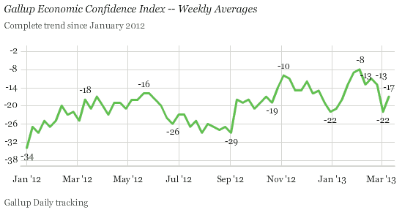
Economic Confidence
Notes:
Americans' confidence in the economy improved last week after it was shaken during the debate in Washington about the budget sequestration. Gallup's Economic Confidence Index improved to -17 from -22 the prior week, when the budget sequestration took effect. Still, last week's score is nine percentage points lower than the five-year high reached in early February.

Slide 10
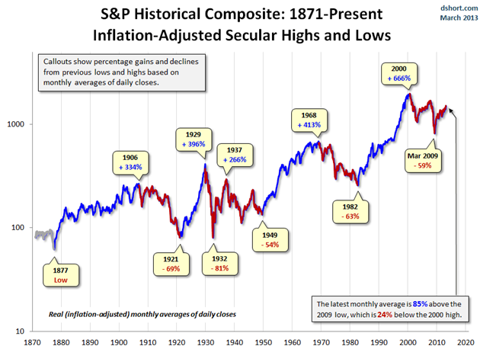
Leading Indicator
Notes:
Stocks down on Friday, after longest winning streak in 17 yeaars. Dow was up over 14,500. 10 day winning streak, longest since 1996. Up due to spike in gas prices… bad for economy, but good for stock market.
Leading indicators are indicators that usually change before the economy as a whole changes.[1] They are therefore useful as short-term predictors of the economy. Stock market returns are a leading indicator: the stock market usually begins to decline before the economy as a whole declines and usually begins to improve before the general economy begins to recover from a slump. Other leading indicators include the index of consumer expectations, building permits, and the money supply
5.Manufacturers' new orders for non-defense capital goods — As stated above, new orders lead the business cycle because increases in orders usually mean positive changes in actual production and perhaps rising demand. This measure is the producer's counterpart of new orders for consumer goods/materials component (#3).

Slide 11
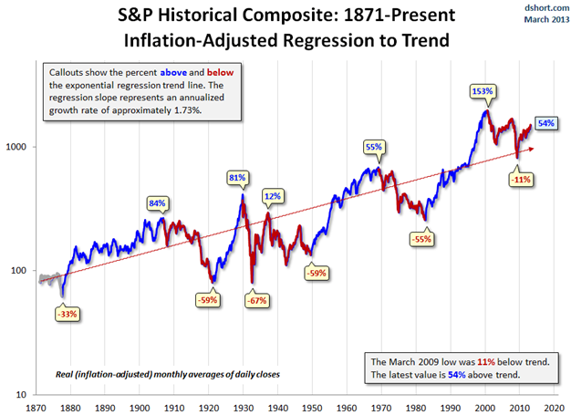
Leading Indicator
Notes:
Local governments often need to project future tax revenues. The city of San Francisco, for example, uses the price of a one-bedroom apartment on Craigslist, weekend subway ridership numbers, parking garage usage, and monthly reports on passenger landings at the city's airport

Slide 12
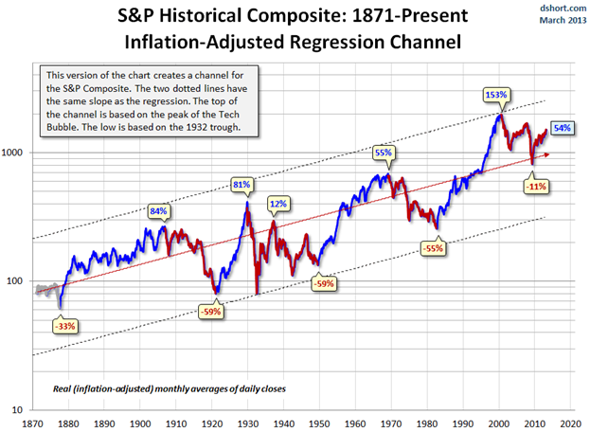
Leading Indicator
Notes:
The latest monthly average of daily closes is 54% above trend after having fallen only 11% below trend in March of 2009. Previous bottoms were considerably further below trend.
The two dotted lines have the same slope as the trend line, with the top of the channel based on the peak of the Tech Bubble and the low is based on the 1932 trough.
http://advisorperspectives.com/dshort/updates/Secular-Bull-and-Bear-Markets.php?SP-Composite-secular-trends

Slide 13
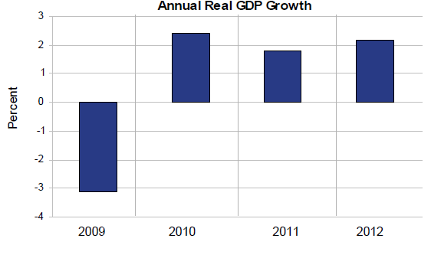
Gross Domestic Product
U.S. Bureau of Economic Analysis
Notes:
Real GDP increased 2.2 percent in 2012 after increasing 1.8 percent in 2011.
The pickup in growth in 2012 mainly reflected:
• A smaller decrease in state and local government spending.
• An upturn in residential housing.
A deceleration in imports
• An upturn in inventory investment.

Slide 14
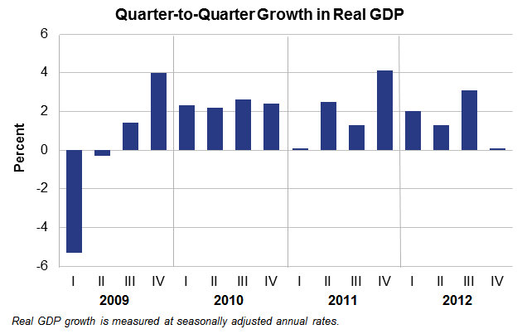
Gross Domestic Product
(Real Time)
U.S. Bureau of Economic Analysis
Notes:
Coincident indicators change at approximately the same time as the whole economy, thereby providing information about the current state of the economy. There are many coincident economic indicators, such as Gross Domestic Product, industrial production, personal income and retail sales (up 1.1% in Feb). A coincident index may be used to identify, after the fact, the dates of peaks and troughs in the business cycle
Industrial production is a measure of output of the industrial sector of the economy. The industrial sector includes manufacturing, mining, and utilities.[1] Although these sectors contribute only a small portion of GDP (Gross Domestic Product), they are highly sensitive to interest rates and consumer demand.[citation needed] This makes Industrial Production an important tool for forecasting future GDP and economic performance. Industrial Production figures are also used by central banks to measure inflation, as high levels of industrial production can lead to uncontrolled levels of consumption and rapid inflation.

Slide 15
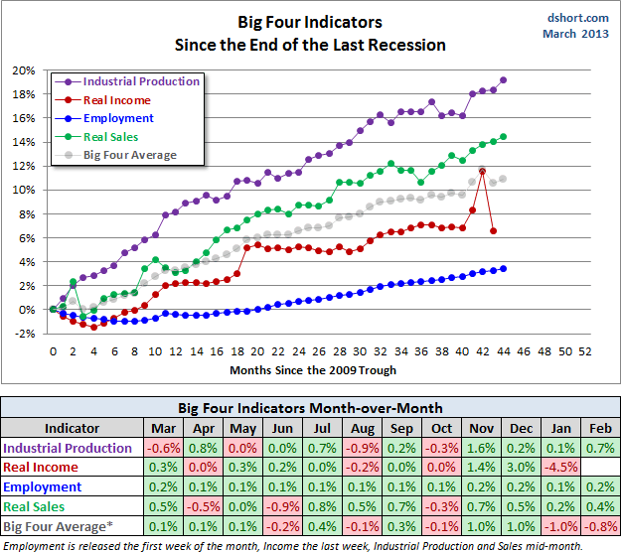
Current Indicators
Notes:
The February Industrial Production data, with revisions for the previous five months, has risen for four consecutive months and is now 19.2% above its June 2009 recession trough. The Real Retail Sales indicator has also risen for four consecutive months, the last three of which have been all-time highs.
The chart and table below illustrate the performance of the Big Four and simple average of the four since the end of the Great Recession.
The February Industrial Production data, with revisions for the previous five months, has risen for four consecutive months and is now 19.2% above its June 2009 recession trough. The Real Retail Sales indicator has also risen for four consecutive months, the last three of which have been all-time highs.
The chart and table below illustrate the performance of the Big Four and simple average of the four since the end of the Great Recession.

Slide 16
Signs of Improvement – Private Sector
Employment Trends Index
Help Wanted Online
Measure of CEO Confidence
Consumer Confidence
Notes:
Source: Conference Board… these are some of their leading indices but reflect the private sector
Employment Trends Index Up 1.2% (March Report) over last month. Up 3.2% over last year at this time.
Help Wanted Online (March report)
Took a drop in February after strong growth in December and January.
In February, online labor demand dipped in 40 of the 50 States in the U.S., but Forty-four of the 50 States are above February 2012’s levels
Professional job listing are trending upward, but service/production jobs still low. Estimated that there are 4 people unemployed for each advertised vacancy in service/production jobs
Measure of CEO Confidence – (January report) saw a small increase to complete 2012, after a downturn in the third quarter
15 percent (up 5%) say general conditions are better compared to six months ago
13 percent (down 1%) say their industry specific conditions have improved

Slide 17
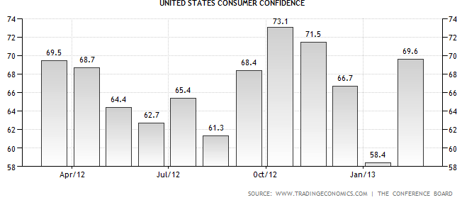
A Year in Consumer Confidence
Notes:
Conference Board Consumer Confidence Index®, rebounded in February after a significant drop in January which analysts contributed to the end of year uncertainty created by the financial cliff and payroll tax cuts.
While reported consumer outlook was high, last months report may indicated a another possible dip in March now that sequestration has taken effect. February is at 71.8

Slide 18
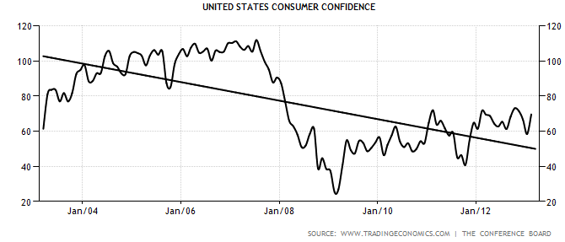
10 Years in Consumer Confidence
Notes:
Previous chart looks great…but looking at the bigger picture we are still a long way from where we were.
The Conference Board Consumer Research Center said consumers are more positive about the economy and their income prospects, but feel somewhat mixed about employment conditions.

Slide 19
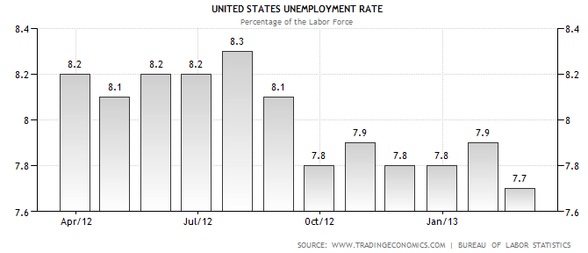
Unemployment: One Year
(Lagging Indicator)
Notes:
The number of long-term unemployed (those jobless for 27 weeks or more) was about unchanged at 4.8 million. These individuals accounted for 40.2 percent of the unemployed
Job gains were in professional and business services, construction, and health care.
Lagging indicators are indicators that usually change after the economy as a whole does. Typically the lag is a few quarters of a year. The unemployment rate is a lagging indicator: employment tends to increase two or three quarters after an upturn in the general economy[citation needed]. In finance, Bollinger bands are one of various lagging indicators in frequent use. In a performance measuring system, profit earned by a business is a lagging indicator as it reflects a historical performance; similarly, improved customer satisfaction is the result of initiatives taken in the past

Slide 20
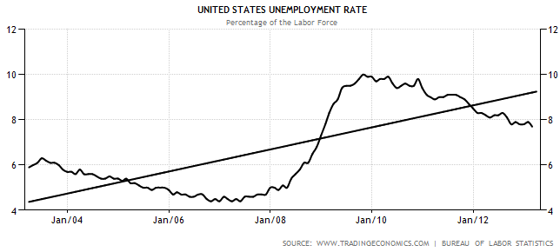
Unemployment: 10 Years
(Lagging Indicator)
Notes:
Overall unemployment continues a slow decrease from the highs of 2010, but has largely remained steady over past year.
Trend is still an upward tajectory

Slide 21
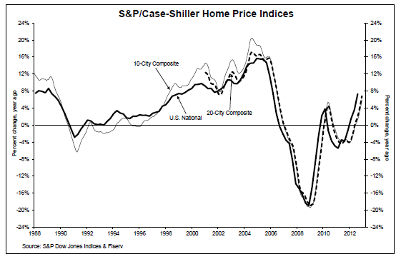
Housing Market
Notes:
The chart above depicts the annual returns of the U.S. National, the 10-City Composite and the 20-City Composite Home Price Indices.
The S&P/Case-Shiller U.S. National Home Price Index recorded a 7.3% gain in 2012 over 2011.
Nationally, and in both composites, the data shows the majority of home prices at their 2003 levels. However, some places continue to struggle.
Atlanta and Detroit posted their largest year-over-year increase since the index began in 1991. However, they still have yet to reach back to their year-2000 levels. Detroit is still 20% behind where they were in 2000.
Note: When you started doing this presentation you noted a “five year trough” in the houseing market ending in: 2013!

Slide 22
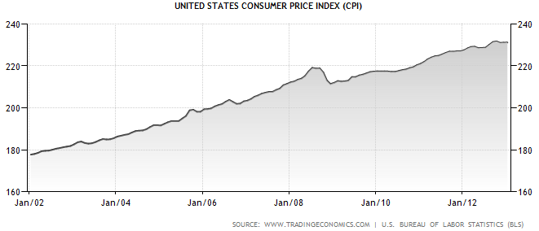
Consumer Price Index
Notes:
BASED ON FEB Report (report due on March 15). The CPI reported no change in January CPI on a seasonally adjusted basis.
Over the last 12 months, the all items index increased 1.6 percent before seasonal adjustment. Up .7 for month, and right at 2% for the year

Slide 23
Consumer Price Index
Down/Up: Gas and fuel
No Change Food at home
Increase: Apparel
Increase: Shelter
Increase: Transportation services
Increase: Medical services
Increase: New vehicles and used cars and trucks
Notes:
Changes in most categories are were minimal offsetting each other to make a neutral net affect.
Areas leading increases included critical personal expenses: clothes, shelter and medical care.
As the fire service has largely be subject to wage freezes and loss or reduction of benefits, these are areas they will be very much concerned about.
Also included airline fares which can further complicate travel to professional development restrictions currently imposed on many departments.
Gas up 8 cents over month
Since the recession ended in mid-2009, the index is up 8.4 percent.
Price gains over that time have been larger in some areas, notably gas (55 percent), air fares (24 percent), milk (22 percent), used cars (21 percent), college tuition and fees (19 percent), and medical services (12 percent).
Some major components of the index have had smaller gains (housing and rent, clothing, electricity), while other components have seen prices fall since mid-2009 (toys, furniture, major appliances).

Slide 24

State and Local Economic Environment

Slide 25
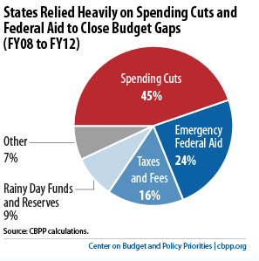
Tax Revenue:
Filling a Large Hole
Improving, but slowly
Inflation (even minimal) causes disconnect
Service demands continue to increase
Even pre-recession federal aid is drying up

Slide 26
Tax Revenue:
Filling a Large Hole
Filling service needs:
  Cut during the recession
    e.g. services
  Put on hold during recession
    e.g. Apparatus and infrastructure improvements
  Created by community need during recession
    e.g. services to unemployed

Slide 27
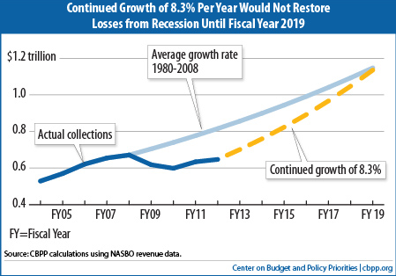
Filling a Large Hole
Notes:
This shows how much states would be collecting if revenues had not dropped sharply due to the recession but instead had continued to grow at their historical rate of 5 percent. (The 5 percent rate is based on actual collections between 1980 and 2008, with adjustments for projected inflation and GDP growth.)
It also shows that, at the 2011 rate of 8.3 percent, revenues wouldn’t get back on a normal track until 2019. State tax collections typically grow faster than normal after a recession as they recover from a reduced base. But states haven’t seen sustained growth at an 8.3 percent level since the 1960s. Already, revenue growth for 2012 has slowed compared to 2011. Preliminary figures show growth of about 4 percent for the most recent quarter.

Slide 28

Local Weaknesses
Tax Base
  Devaluation of Assessed Property Values (property tax)
  Unemployment (income tax)
  Low consumer spending (sales tax)
  Loss/Profit Loss of Industry/Commerce (corporate income tax; employment, property tax)
  Housing – 5-year trough 2008-2013
    Must build new buildings to get new revenue
Notes:
Typically, housing prices hit bottom and begin to trend upward 5 years after the bottom of for investment in real estate. We saw the bottom of spending in real estate as and investment late in 2008. As with historical patterns we are starting to see some improvement, but are likely not see significant increases in housing prices until 2013 or so.

Slide 29
Local Weaknesses
29
Legislative Assessment Caps
Sources of Revenue
  General Fund: competition for scarce resources
  Special Revenue Fund: inability to shift financial resources
  Sales Tax: highly elastic; consumer confidence down
Recent dependency on federal aid
Notes:
Monday, March 25, 13
Copyright 2009. All Rights Reserved. Logos and images are protected trademarks of the IAFC.
29

Slide 30
So What?
Pent up demand for apparatus and equipment
Questioning of replacement schedules and NFPA requirements
Longer life from vehicles, with higher maintenance cost accepted
  Problems documenting service interruptions
No plans to catch up

Slide 31
So What?
Questioning specifications committees
  Looking for widely used specifications
  Looking at commercial options
Great interest in General Purchasing Organizations (GPO)
Large vehicles vs smaller response vehicles
Heavy involvement by non fire department officials
  Chiefs are getting directly involved in process

Slide 32
Use of Analytical Tools
Risk analysis for program prioritization
Multi-year revenue and expenditure projections
  Forecasting
Strategic planning
Family of performance measures
  Program dashboards
Decision-making matrices
32
Notes:
Monday, March 25, 13
Copyright 2009. All Rights Reserved. Logos and images are protected trademarks of the IAFC.
32

Slide 33
Gaining Efficiencies
Program management efficiencies:
  What programs are necessary to address the threats in specific communities?
  Alternative staffing models to keep programs alive
  Leveraging technology support department goals
33
Notes:
Monday, March 25, 13
Copyright 2009. All Rights Reserved. Logos and images are protected trademarks of the IAFC.
33

Slide 34
Good News, Bad News
Recovery is underway,
but will be a long and difficult road.
We have an opportunity to come out stronger,
if we take the time and energy to shape our future now.
Will the fire service step-up to the opportunity?

Slide 35
The Fire and Emergency Service Outlook in the New Economy
Over the Fiscal Cliff
Mark W. Light, CAE
Chief Executive Officer and Executive Director
International Association of Fire Chiefs

Slide 36


The Fire Service Image:
Unraveling our World
Hard times
Budget scrutiny
Education cuts
Misinformation
Negative dialog
Fewer champions
Pay/benefits scrutiny
Lashing out
Fewer champions, more cuts and more scrutiny

Slide 37
Is Fire a Federal Problem?
PD, County Sheriff, State Police, Highway Patrol, ABC Officer, FBI, DEA, ATF, Customs and Border Patrol, Secret Service, Federal Protective Service, U.S. Marshals, Federal Air Marshals, ICE, U.S. Forest Service Law Enforcement, Bureau of Indian Affairs, Bureau of Land Management, U.S. Park Service
  18 different agencies that can enforce laws
Local FD
  1 agency from local to federal to suppress fires

Slide 38
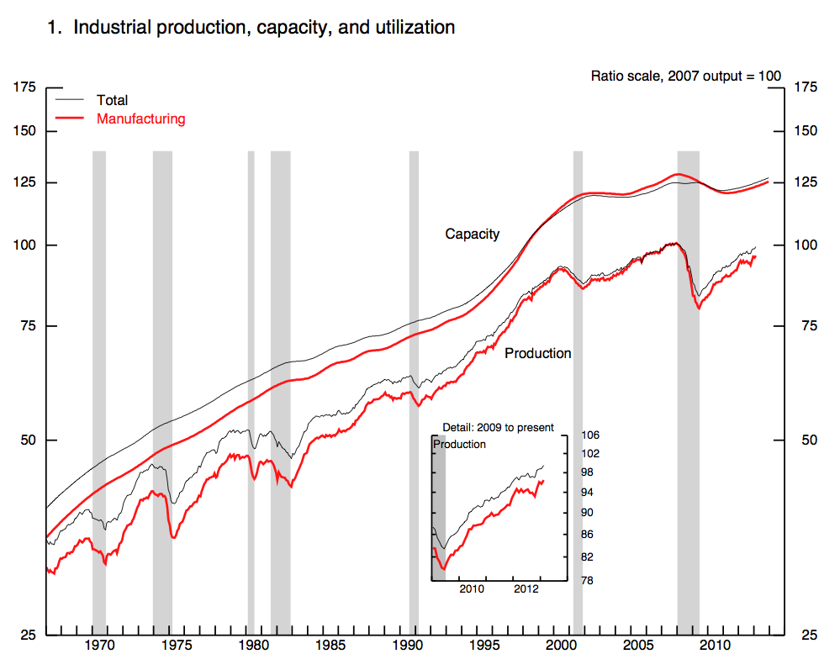
Industrial Production
(Real Time)
Notes:
Industrial production is a measure of output of the industrial sector of the economy. The industrial sector includes manufacturing, mining, and utilities.[1] Although these sectors contribute only a small portion of GDP (Gross Domestic Product), they are highly sensitive to interest rates and consumer demand.[citation needed] This makes Industrial Production an important tool for forecasting future GDP and economic performance. Industrial Production figures are also used by central banks to measure inflation, as high levels of industrial production can lead to uncontrolled levels of consumption and rapid inflation.

Slide 39
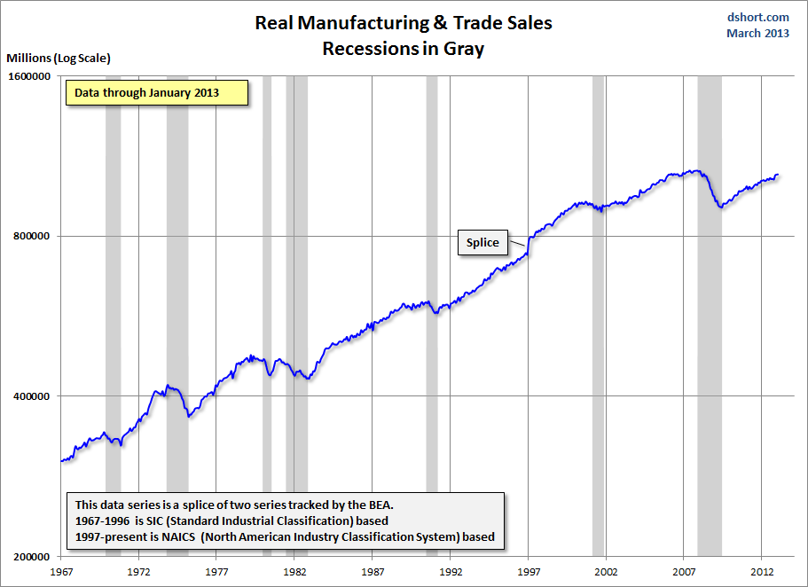
Manufacturing and Trade Sales

Slide 40
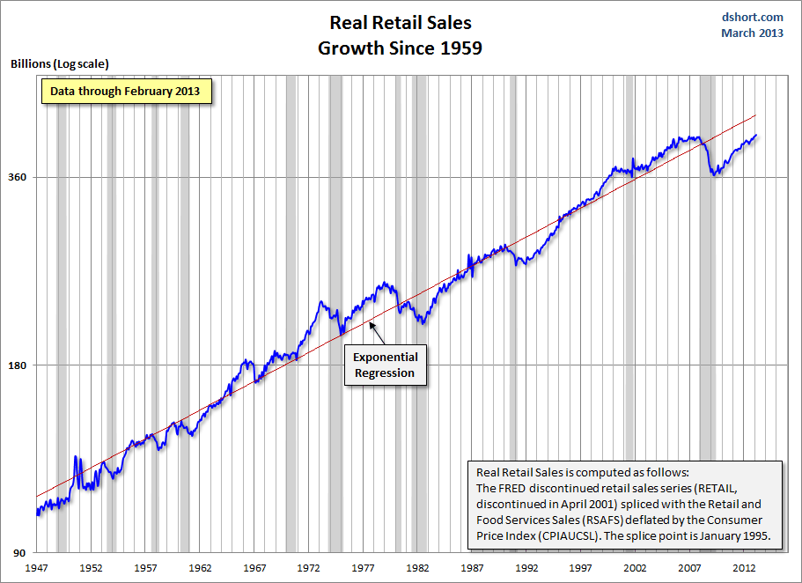
Retail Sales

Slide 41

The Other Side:
Panic or Dive In?
Danger is a certainty
Strategic risk is necessary
Planning is essential
Proper execution is critical
Confidence increases the more you work at it
Will end stronger than when you leaped

Slide 42
Strategies for Gaining Efficiencies
Budget scrubbing
Revenue enhancements or diversification
  Fee for service – partial to full cost recovery
  Proffers for new development
  Leasing space on station property
  Fire levy funds (special taxing)
Fire service consolidation/partnerships
  Internal to local government
  Regionalization
42
Notes:
Budget scrubbing is purely technical
First two are short-term to “get through” the tough times, need to focus on long-term strategies for building new reality.
Monday, March 25, 13
Copyright 2009. All Rights Reserved. Logos and images are protected trademarks of the IAFC.
42

Slide 43
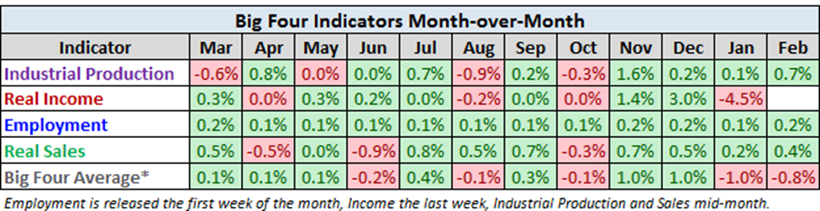

Slide 44
Backlash: Pensions
More than 80% of the U.S.’ 27 million state and local government workers/retirees are covered by public pensions
Taxpayers face as much as $3 TRILLION in unfunded workers retirement liabilities at the state level alone
Chicago’s system will be broke by 2020
Disparity in retirement contribution
  Private sector average: $0.92
  Public sector average: $3.04
Notes:
The fire service takes a good amount of the heat as many opponents point to overtime calculations, salaries and benefits obtained from working second jobs, and the ability to retire relatively young and collect full-salary benefits while working full time jobs in new industries.

Slide 45
Backlash: Pensions
Election results highlight issue
  Six newly-elected governors are looking at 401(k)-style retirement plans
  Eight of nine California cities and counties approved ballot measures slashing public pension benefits
  More than 40 suburban Chicago communities approved a ballot question demanding that the Illinois legislature lower benefits for future state workers, targeting public safety officers and firefighters
Notes:
The fire service takes a good amount of the heat as many opponents point to overtime calculations, salaries and benefits obtained from working second jobs, and the ability to retire relatively young and collect full-salary benefits while working full time jobs in new industries.

Slide 46
Pension Debate
Personal
  Everyone is worried; looking out to get their “fair share”
Political
  Misunderstood; often mischaracterized
  Easy to manipulate message to play on fears
Polarizing
  Rhetoric furthers the divide
Notes:
Everyone is worried, many in public sector getting cut, looking at “fair share”
The Center on Budget and Policy Priorities issued a report on Misunderstandings Regarding State Debt, Pensions, and Retiree Health Costs Create Unnecessary Alarm which talks about the differences between short-term or cyclical deficits and long-term cost issues. The report notes that while reforms may be needed in some areas, the mischaracterization as a short-term threat (or fix) promotes extreme actions rather than appropriate solutions.
Easy to manipulate message to play on fears, not just for current economy but fears about the rising cost of retirement, health care, etc.
Little real discussion: mostly extreme rhetoric and finger pointing. To truly understand how scary this issue is read the to newspaper articles on the subjects. Majority of comments – from either side – will likely be hateful and ignorant. Anyone with a rational point to make is typically shot down.

