Slide 1
Going Up for the Rebound
On Behalf of
Fire Apparatus Manufacturers' Association
By: Anirban Basu
Sage Policy Group, Inc.
March 18, 2013
Notes:
Mission Impossible
Honey, We Shrunk Ourselves
Mixed Nuts
As Good as it Gets
Pay it forward
Reality Bites
Point Break
Deep Impact

Slide 2
First Pitch

Slide 3
Historic and Projected World Output Growth 2004 through 2014*
Source: International Monetary Fund
*2013-2014 data are projections

Slide 4
Estimated Growth in Output by Select Global Areas 2013 Projected
Source: International Monetary Fund

Slide 5
Debt by Country 2011
Source: IMF; BIS; Bloomberg L.P.

Slide 6
Top 12 Stock Exchanges 2011 Growth
Rank | Exchange | Index | % Change
1 | NYSE Group | DJI A | 5.5%
2 | Nasdaq | NASDAQ Composite | -1.8%
3 | London SE | FTSE 100 | -5.6%
12 | Swiss Exchange | Swiss Market | -7.8%
9 | TSX Group | S&P TSX Composite | -9.2%
8 | Bolsa De Medrid | IGBM | -14.6%
6 | Frankfurt SE | DAX | -14.7%
5 | Euronext | CAC 40 | -17.0%
4 | Tokyo SE | Nikkei 225 | -17.3%
11 | Hong Kong Exchanges | Hang Seng Index | -20.0%
7 | Shanghai SE | Shanghai Composite | -21.7%
10 | Borsa Italiana | FTSE MIB | -25.2%
Source: Yahoo! Finance

Slide 7
Top 12 Stock Exchanges 2012 Growth
Rank | Exchange | Index | % Change
6 | Frankfurt SE | DAX | 29.1%
11 | Hong Kong Exchanges | Hang Seng Index | 22.9%
4 | Tokyo SE | Nikkei 225 | 22.9%
2 | Nasdaq | NASDAQ Composite | 15.9%
5 | Euronext | CAC 40 | 15.2%
12 | Swiss Exchange | Swiss Market | 14.9%
10 | Borsa Italiana | FTSE MIB | 7.8%
1 | NYSE Group | DJI A | 7.3%
3 | London SE | FTSE 100 | 5.8%
9 | TSX Group | S&P TSX Composite | 4.0%
7 | Shanghai SE | Shanghai Composite | 3.2%
8 | Bolsa De Madrid | IBEX 35 | -4.7%
Source: Yahoo! Finance

Slide 8
S&P Select Sector Performance 2012
Source: Dow Jones, Standard & Poor’s

Slide 9
Third Quarter Earnings for Select Corporations Earnings per Share
Symbol | 3Q 2011 | 3Q 2012 Estimated | 3Q 2012 Reported | Surprise |  | Symbol | 3Q 2011 | 3Q 2012 Estimated | 3Q 2012 Reported | Surprise
COF | $1.77 | $1.66 | $2.01 | $0.35 |  | MMM | $1.52 | $1.65 | $1.65 | $0.00
UTX | $1.47 | $1.18 | $1.37 | $0.19 |  | XRX | $0.26 | $0.25 | $0.25 | $0.00
BTU | $0.87 | $0.33 | $0.51 | $0.18 |  | GE | $0.31 | $0.36 | $0.36 | $0.00
YHOO | $0.23 | $0.25 | $0.35 | $0.10 |  | STI | $0.39 | $1.99 | $1.98 | -$0.01
HON | $1.10 | $1.14 | $1.20 | $0.06 |  | CMG | $1.90 | $2.30 | $2.27 | -$0.03
TXN | $0.61 | $0.46 | $0.52 | $0.06 |  | MSFT | $0.68 | $0.56 | $0.53 | -$0.03
CAT | $1.71 | $2.22 | $2.26 | $0.04 |  | MCD | $1.45 | $1.47 | $1.43 | -$0.04
VFC | $2.87 | $3.49 | $3.52 | $0.03 |  | FCX | $1.10 | $0.73 | $0.68 | -$0.05
COH | $0.73 | $0.76 | $0.77 | $0.01 |  | AMD | $0.15 | -$0.15 | -$0.20 | -$0.05
UPS | $1.06 | $1.06 | $1.06 | $0.00 |  | DD | $0.60 | $0.46 | $0.32 | -$0.14
Source: Dow Jones, Standard & Poor’s

Slide 10
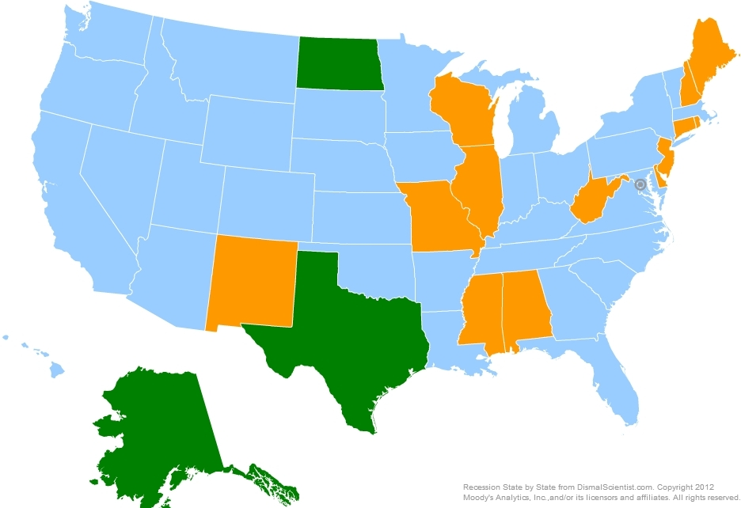
Recession Watch as of February 2013
Source: Moody’s Economy

Slide 11
Industrial Production February 2001 through January 2013
Source: Federal Reserve
The industrial production index measures the real output of the manufacturing, mining, and electric and gas utilities industries.

Slide 12
Gross Domestic Product 1990Q1 through 2012Q4
Source: Bureau of Economic Analysis

Slide 13
Red Card/ Pink Slip

Slide 14
Net Change in U.S. Jobs, BLS January 2002 through February 2013
Feb. 2013: +236K
Between Feb. 2012 and Feb. 2013, the nation gained 1,966,000 jobs.
Source: Bureau of Labor Statistics

Slide 15
National Nonfarm Employment by Industry Sector February 2013 v. February 2012
All told 1,966K Jobs gained
Source: Bureau of Labor Statistics

Slide 16
Employment Growth, U.S. States (SA) December 2012 v. December 2011 Percent Change
Rank | State | % | Rank | State | % | Rank | State | %
1 | North Dakota | 3.6 | 18 | California | 1.6 | 32 | Pennsylvania | 0.7
2 | Utah | 3.0 | 18 | Kentucky | 1.6 | 36 | Alaska | 0.6
3 | Arizona | 2.7 | 18 | Massachusetts | 1.6 | 36 | Nebraska | 0.6
4 | Montana | 2.6 | 21 | Missouri | 1.5 | 38 | Alabama | 0.5
5 | Texas | 2.5 | 22 | New York | 1.4 | 39 | Delaware | 0.4
6 | Colorado | 2.3 | 22 | Tennessee | 1.4 | 40 | Michigan | 0.3
7 | Idaho | 2.2 | 24 | Louisiana | 1.2 | 40 | Mississippi | 0.3
7 | Oklahoma | 2.2 | 24 | New Jersey | 1.2 | 40 | South Dakota | 0.3
9 | South Carolina | 2.1 | 24 | Oregon | 1.2 | 40 | Wisconsin | 0.3
10 | Hawaii | 2.0 | 27 | Kansas | 1.1 | 44 | Rhode Island | 0.2
10 | Indiana | 2.0 | 27 | Vermont | 1.1 | 45 | Connecticut | 0.0
12 | Georgia | 1.9 | 29 | Iowa | 1.0 | 45 | Maine | 0.0
12 | Minnesota | 1.9 | 30 | Maryland | 0.8 | 45 | New Hampshire | 0.0
14 | North Carolina | 1.8 | 30 | Virginia | 0.8 | 48 | Wyoming | -0.2
14 | Ohio | 1.8 | 32 | Arkansas | 0.7 | 49 | District of Columbia | -0.3
14 | Washington | 1.8 | 32 | Florida | 0.7 | 50 | New Mexico | -0.4
17 | Nevada | 1.7 | 32 | Illinois | 0.7 | 51 | West Virginia | -1.8
Source: Bureau of Labor Statistics
U.S. Year-over-year Percent Change: 1.5%

Slide 17
Unemployment Rates, U.S. States (SA) December 2012
Rank | State | Rate | Rank | State | Rate | Rank | State | Rate
1 | North Dakota | 3.2 | 18 | Alaska | 6.6 | 35 | Florida | 8.0
2 | Nebraska | 3.7 | 18 | Idaho | 6.6 | 36 | Kentucky | 8.1
3 | South Dakota | 4.4 | 18 | Maryland | 6.6 | 37 | Indiana | 8.2
4 | Iowa | 4.9 | 18 | Wisconsin | 6.6 | 37 | New York | 8.2
4 | Wyoming | 4.9 | 22 | Massachusetts | 6.7 | 39 | Oregon | 8.4
6 | Oklahoma | 5.1 | 22 | Missouri | 6.7 | 39 | South Carolina | 8.4
6 | Vermont | 5.1 | 22 | Ohio | 6.7 | 41 | District of Columbia | 8.5
8 | Hawaii | 5.2 | 25 | Delaware | 6.9 | 42 | Connecticut | 8.6
8 | Utah | 5.2 | 26 | Alabama | 7.1 | 42 | Georgia | 8.6
10 | Kansas | 5.4 | 26 | Arkansas | 7.1 | 42 | Mississippi | 8.6
11 | Louisiana | 5.5 | 28 | Maine | 7.3 | 45 | Illinois | 8.7
11 | Minnesota | 5.5 | 29 | West Virginia | 7.5 | 46 | Michigan | 8.9
11 | Virginia | 5.5 | 30 | Colorado | 7.6 | 47 | North Carolina | 9.2
14 | Montana | 5.7 | 30 | Tennessee | 7.6 | 48 | New Jersey | 9.6
14 | New Hampshire | 5.7 | 30 | Washington | 7.6 | 49 | California | 9.8
16 | Texas | 6.1 | 33 | Arizona | 7.9 | 50 | Nevada | 10.2
17 | New Mexico | 6.4 | 33 | Pennsylvania | 7.9 | 50 | Rhode Island | 10.2
Source: Bureau of Labor Statistics
U.S. Unemployment Rate: 7.9%

Slide 18
Unemployment Rates, 20 Largest Metros (NSA) December 2012
Rank | MSA | UR |  | Rank | MSA | UR
1 | Minneapolis-St. Paul-Bloomington, MN-WI | 5.1 |  | 11 | Tampa-St. Petersburg-Clearwater, FL | 7.9
2 | Washington-Arlington-Alexandria, DC-VA-MD-WV | 5.2 |  | 12 | Miami-Fort Lauderdale-Pompano Beach, FL | 8.1
3 | Boston-Cambridge-Quincy, MA-NH | 5.9 |  | 12 | San Diego-Carlsbad-San Marcos, CA | 8.1
3 | Dallas-Fort Worth-Arlington, TX | 5.9 |  | 14 | Atlanta-Sandy Springs-Marietta, GA | 8.4
5 | Houston-Sugar Land-Baytown, TX | 6.0 |  | 14 | Philadelphia-Camden-Wilmington, PA-NJ-DE-MD | 8.4
6 | Phoenix-Mesa-Glendale, AZ | 6.7 |  | 16 | New York-Northern New Jersey-Long Island, NY-NJ-PA | 8.5
6 | Seattle-Tacoma-Bellevue, WA | 6.7 |  | 17 | Chicago-Joliet-Naperville, IL-IN-WI | 8.6
8 | Baltimore-Towson, MD | 7.0 |  | 18 | Los Angeles-Long Beach-Santa Ana, CA | 9.3
8 | St. Louis, MO-IL | 7.0 |  | 19 | Detroit-Warren-Livonia, MI | 10.2
10 | San Francisco-Oakland-Fremont, CA | 7.3 |  | 20 | Riverside-San Bernardino-Ontario, CA | 10.9
Source: Bureau of Labor Statistics

Slide 19
U.S. Firefighter Employment*, 2000 - 2011
Source: Bureau of Labor Statistics (BLS), Occupational Employment Statistics
*Excludes those firefighters working on a voluntary basis.

Slide 20
U.S. Federal Budget Deficit 1995-2013*
Source: Congressional Budget Office
*2013 data are projections

Slide 21
Projected State Budget Shortfalls for FY 2012 As Percent of FY 2012 Budget
Rank | State | % | Rank | State | % | Rank | State | %
1 | New Jersey | 37.5 | 16 | Florida | 15.8 | 30 | Missouri | 8.8
2 | Nevada | 37.0 |  | States Total | 15.5 | 31 | New Mexico | 8.3
3 | California | 27.8 | 17 | Vermont | 14.2 | 32 | Utah | 8.2
4 | Louisiana | 25.1 | 18 | Mississippi | 13.7 | 33 | Kansas | 8.1
5 | Oregon | 24.0 | 19 | Pennsylvania | 13.5 | 34 | Georgia | 7.6
6 | Minnesota | 22.4 | 20 | North Carolina | 12.2 | 35 | Rhode Island | 6.9
7 | Texas | 20.4 | 21 | Virginia | 12.2 | 36 | Colorado | 6.3
8 | New Hampshire | 20.0 | 22 | Wisconsin | 11.3 | 37 | Massachusetts | 5.5
9 | Illinois | 18.5 | 23 | South Carolina | 11.1 | 38 | District of Columbia | 5.0
10 | Arizona | 18.2 | 24 | South Dakota | 11.0 | 39 | Nebraska | 4.8
11 | New York | 18.2 | 25 | Ohio | 10.8 | 40 | Idaho | 3.6
12 | Connecticut | 17.1 | 26 | Kentucky | 10.5 | 41 | Michigan | 3.5
13 | Washington | 16.9 | 27 | Hawaii | 9.6 | 42 | Iowa | 2.5
14 | Maine | 16.6 | 28 | Maryland | 9.5 | 43 | Tennessee (DK) | NA
15 | Alabama | 15.9 | 29 | Oklahoma | 9.0
Source: Center on Budget and Policy Priorities
Combined gaps of $107 billion for 2012.
DK means that a state is projecting a shortfall but its size is unknown.

Slide 22
Pad Save

Slide 23
15-Year & 30-Year Fixed Mortgage Rates January 1995 through January 2013
Source: Freddie Mac

Slide 24
U.S. New Home Sales January 1999 through January 2013
Source: Census Bureau

Slide 25
U.S. Housing Starts January 1999 through January 2013
Source: Census Bureau

Slide 26
Put me in, Coach

Slide 27
Conference Board Consumer Confidence Index 2005 – February 2013
Source: Conference Board

Slide 28
U.S. Retail and Food Service Sales January 2002 through February 2013
Source: Census Bureau

Slide 29
U.S. Chain Store Sales Growth by Type of Store December 2012 v. December 2011
Source: International Council of Shopping Centers

Slide 30
National Vehicle Sales June 2004 through February 2013 (SAAR)
Source: Autodata Corp.

Slide 31
Conference Board Leading Economic Indicators Index August 2007 through January 2013
Source: Conference Board

Slide 32
Fourth Quarter
Economy slowed markedly during last year’s fourth quarter;
First half of 2013 also shaping up to be quite soft, with recessionary risks elevated over the next several weeks (though many economists have become more upbeat);
Black swan threats: (1) Iran (2) Israel/Iran (3) Europe;
Many headwinds remain and the recovery could easily falter;
One of the greatest sources of concern is the growing divergence between financial market performance and economic performance; and
Trajectory of paid firefighter employment is less certain that it once was.

Slide 33
Thank You
You can always reach me at abasu@sagepolicy.com
If you are interested in up-to-date data, please visit our website at www.sagepolicy.com
Also, if you need us in a hurry, we are at 410.522.7243 (410.522.SAGE)
Please contact us when you require economic research & policy analysis.

