Slide 1
Going Up for the Rebound
On Behalf of
FEMSA/FAMA
By: Anirban Basu
Sage Policy Group, Inc.
September 26, 2013
Notes:
No case shiller slide??
Mission Impossible
Honey, We Shrunk Ourselves
Mixed Nuts
As Good as it Gets
Pay it forward
Reality Bites
Point Break
Deep Impact

Slide 2
First Pitch

Slide 3
Historic and Projected World Output Growth 2004 through 2014*
Source: International Monetary Fund
*2012-2013 data are projections

Slide 4
Real GDP Growth, 20 Fastest and Slowest Growing Countries Estimated 2013, Annual Percent Change (for available nations)
Rank | Country | Region | % |  | Rank | Country | Region | %
1 | South Sudan | Africa | 32.1 |  | 166 | Barbados | Caribbean | 0.5
2 | Libya | Middle East | 20.2 |  | 167 | Bosnia and Herzegovina | Eastern Europe | 0.5
3 | Sierra Leone | Africa | 17.1 |  | 168 | Grenada | Caribbean | 0.5
4 | Mongolia | Asia | 14.0 |  | 169 | Czech Republic | Europe | 0.3
5 | Paraguay | South America | 11.0 |  | 170 | Belgium | Europe | 0.2
6 | Timor-Leste | Southeast Asia | 10.0 |  | 171 | Venezuela | South America | 0.1
7 | Iraq | Middle East | 9.0 |  | 172 | Luxembourg | Europe | 0.1
7 | Panama | Central America | 9.0 |  | 173 | Swaziland | Africa | 0.0
9 | The Gambia | Africa | 8.9 |  | 174 | Hungary | Europe | 0.0
10 | Mozambique | Africa | 8.4 |  | 175 | France | Europe | -0.1
11 | Dem. Rep. of the Congo | Africa | 8.3 |  | 176 | Croatia | Eastern Europe | -0.2
12 | Chad | Africa | 8.1 |  | 177 | Netherlands | Europe | -0.5
13 | China | Asia | 8.0 |  | 178 | Islamic Republic of Iran | Middle East | -1.3
13 | Lao P.D.R. | Southeast Asia | 8.0 |  | 179 | Italy | Europe | -1.5
13 | Côte d'Ivoire | Africa | 8.0 |  | 180 | Spain | Europe | -1.6
16 | Zambia | Africa | 7.8 |  | 181 | Slovenia | Eastern Europe | -2.0
17 | Turkmenistan | Central Asia | 7.7 |  | 182 | Equatorial Guinea | Africa | -2.1
18 | Rwanda | Africa | 7.6 |  | 183 | Portugal | Europe | -2.3
19 | Liberia | Africa | 7.5 |  | 184 | San Marino | Europe | -3.5
20 | Kyrgyz Republic | Central Asia | 7.4 |  | 185 | Greece | Europe | -4.2
Source: IMF
Notes:
April 2013 updates

Slide 5
Estimated Growth in Output by Select Global Areas 2013 Projected
Source: International Monetary Fund

Slide 6
Debt by Selected Country 2012
Source: IMF

Slide 7
Top 12 Stock Exchanges 2011 Growth
Rank | Exchange | Index | % Change
1 | NYSE Group | DJI A | 5.5%
2 | Nasdaq | NASDAQ Composite | -1.8%
3 | London SE | FTSE 100 | -5.6%
12 | Swiss Exchange | Swiss Market | -7.8%
9 | TSX Group | S&P TSX Composite | -9.2%
8 | Bolsa De Madrid | IGBM | -14.6%
6 | Frankfurt SE | DAX | -14.7%
5 | Euronext | CAC 40 | -17.0%
4 | Tokyo SE | Nikkei 225 | -17.3%
11 | Hong Kong Exchanges | Hang Seng Index | -20.0%
7 | Shanghai SE | Shanghai Composite | -21.7%
10 | Borsa Italiana | FTSE MIB | -25.2%
Source: Yahoo! Finance

Slide 8
Top 12 Stock Exchanges 2012 Growth
Rank | Exchange | Index | % Change
6 | Frankfurt SE | DAX | 29.1%
11 | Hong Kong Exchanges | Hang Seng Index | 22.9%
4 | Tokyo SE | Nikkei 225 | 22.9%
2 | Nasdaq | NASDAQ Composite | 15.9%
5 | Euronext | CAC 40 | 15.2%
12 | Swiss Exchange | Swiss Market Index | 14.9%
10 | Borsa Italiana | FTSE MIB | 7.8%
1 | NYSE Group | DJI A | 7.3%
3 | London SE | FTSE 100 | 5.8%
9 | TSX Group | S&P TSX Composite | 4.0%
7 | Shanghai SE | Shanghai Composite | 3.2%
8 | Bolsa De Madrid | IBEX 35 | -4.7%
Source: Yahoo! Finance

Slide 9
Top 12 Stock Exchanges Year to date Growth Thru 9/19/13
Rank | Exchange | Index | % Change
4 | Tokyo SE | Nikkei 225 | 36.2%
2 | Nasdaq | NASDAQ Composite | 21.8%
12 | Swiss Exchange | Swiss Market | 18.6%
1 | NYSE Group | DJI A | 16.6%
5 | Euronext | CAC 40 | 12.6%
6 | Frankfurt SE | DAX | 11.8%
3 | London SE | FTSE 100 | 9.9%
10 | BorsaItaliana | FTSE MIB | 6.9%
8 | Bolsa De Madrid | Madrid General | 8.4%
9 | TSX Group | S&P TSX Composite | 3.1%
11 | Hong Kong Exchanges | Hang Seng Index | 0.8%
7 | Shanghai SE | Shanghai Composite | -3.8%

Slide 10
S&P Select Sector Performance July 2013
Source: Dow Jones, Standard & Poor’s

Slide 11
Federal Reserve Balance Sheet v. S&P 500 Index April 2008 – September 2013
Source: Federal Reserve Bank; Yahoo Finance
S&P 500 index depicted in orange
Notes:
Through 9/18/2013
Should we convert this to a line graph?
Fed balance-weekly-wednesdays
Reserve Bank credit is the sum of securities held outright, repurchase agreements, term auction credit, other loans, net portfolio holdings of Commercial Paper Funding Facility LLC, net portfolio holdings of LLCs funded through the Money Market Investor Funding Facility, net portfolio holdings of Maiden Lane LLC, net portfolio holdings of Maiden Lane II LLC, net portfolio holdings of Maiden Lane III LLC, float, central bank liquidity swaps, and other Federal Reserve assets.

Slide 12
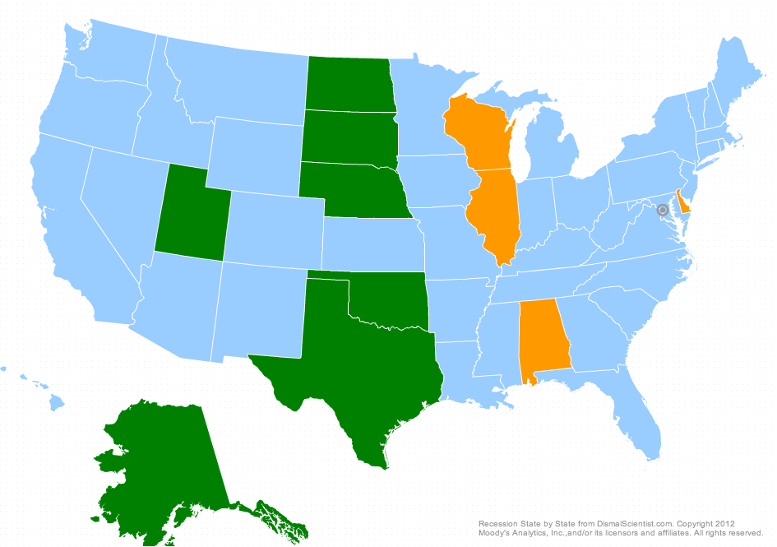
Recession Watch as of September 2013
Source: Moody’s Economy

Slide 13
Industrial Production March 2001 through August 2013
The industrial production index measures the real output of the manufacturing, mining, and electric and gas utilities industries.
Source: Federal Reserve

Slide 14
Gross Domestic Product 1990Q1 through 2013Q2
Source: Bureau of Economic Analysis

Slide 15
Red Card/ Pink Slip

Slide 16
Net Change in U.S. Jobs, BLS January 2002 through August 2013
August 2013: +169K
Source: Bureau of Labor Statistics

Slide 17
National Nonfarm Employment by Industry Sector August 2012 v. August 2013
All told 2,206 K Jobs gained
Source: Bureau of Labor Statistics

Slide 18
Employment Growth, U.S. States (SA) August 2012 v. August 2013 Percent Change
Rank | State | % | Rank | State | % | Rank | State | %
1 | North Dakota | 3.0 | 16 | Michigan | 1.7 | 34 | Illinois | 1.0
2 | Idaho | 2.8 | 16 | New Jersey | 1.7 | 34 | Kansas | 1.0
3 | Utah | 2.6 | 16 | North Carolina | 1.7 | 34 | Nebraska | 1.0
4 | Colorado | 2.5 | 16 | Oregon | 1.7 | 34 | New York | 1.0
4 | Texas | 2.5 | 22 | Delaware | 1.6 | 34 | West Virginia | 1.0
6 | Georgia | 2.3 | 23 | California | 1.5 | 40 | Connecticut | 0.9
7 | Nevada | 2.2 | 23 | Vermont | 1.5 | 40 | Virginia | 0.9
7 | Washington | 2.2 | 25 | Massachusetts | 1.4 | 42 | New Hampshire | 0.8
9 | Minnesota | 2.1 | 25 | Missouri | 1.4 | 43 | Alabama | 0.7
10 | Arizona | 2.0 | 25 | South Dakota | 1.4 | 43 | Maine | 0.7
10 | Louisiana | 2.0 | 28 | Iowa | 1.3 | 43 | Pennsylvania | 0.7
12 | Mississippi | 1.9 | 28 | Wisconsin | 1.3 | 46 | Ohio | 0.6
12 | Montana | 1.9 | 30 | Kentucky | 1.2 | 46 | Oklahoma | 0.6
12 | South Carolina | 1.9 | 30 | Tennessee | 1.2 | 48 | Hawaii | 0.4
15 | Florida | 1.8 | 32 | New Mexico | 1.1 | 48 | Rhode Island | 0.4
16 | Indiana | 1.7 | 32 | Wyoming | 1.1 | 50 | District of Columbia | 0.2
16 | Maryland | 1.7 | 34 | Arkansas | 1.0 | 51 | Alaska | -0.5
Source: Bureau of Labor Statistics
U.S. Year-over-year Percent Change: 1.6%
Notes:
SMS01000000000000001
SMS02000000000000001
SMS04000000000000001
SMS05000000000000001
SMS06000000000000001
SMS08000000000000001
SMS09000000000000001
SMS10000000000000001
SMS11000000000000001
SMS12000000000000001
SMS13000000000000001
SMS15000000000000001
SMS16000000000000001
SMS17000000000000001
SMS18000000000000001
SMS19000000000000001
SMS20000000000000001
SMS21000000000000001
SMS22000000000000001
SMS23000000000000001
SMS24000000000000001
SMS25000000000000001
SMS26000000000000001
SMS27000000000000001
SMS28000000000000001
SMS29000000000000001
SMS30000000000000001
SMS31000000000000001
SMS32000000000000001
SMS33000000000000001
SMS34000000000000001
SMS35000000000000001
SMS36000000000000001
SMS37000000000000001
SMS38000000000000001
SMS39000000000000001
SMS40000000000000001
SMS41000000000000001
SMS42000000000000001
SMS44000000000000001
SMS45000000000000001
SMS46000000000000001
SMS47000000000000001
SMS48000000000000001
SMS49000000000000001
SMS50000000000000001
SMS51000000000000001
SMS53000000000000001
SMS54000000000000001
SMS55000000000000001
SMS56000000000000001

Slide 19
Unemployment Rates, U.S. States (SA) August 2013
Rank | State | % | Rank | State | % | Rank | State | %
1 | North Dakota | 3.0 | 18 | Alaska | 6.5 | 35 | Connecticut | 8.1
2 | South Dakota | 3.8 | 19 | Wisconsin | 6.7 | 35 | Indiana | 8.1
3 | Nebraska | 4.2 | 20 | Idaho | 6.8 | 35 | Oregon | 8.1
4 | Hawaii | 4.3 | 20 | New Mexico | 6.8 | 35 | South Carolina | 8.1
5 | Vermont | 4.6 | 22 | Colorado | 7.0 | 39 | Arizona | 8.3
5 | Wyoming | 4.6 | 22 | Florida | 7.0 | 40 | Kentucky | 8.4
7 | Utah | 4.7 | 22 | Louisiana | 7.0 | 41 | Mississippi | 8.5
8 | Iowa | 4.9 | 22 | Maine | 7.0 | 41 | New Jersey | 8.5
9 | New Hampshire | 5.0 | 22 | Maryland | 7.0 | 41 | Tennessee | 8.5
10 | Minnesota | 5.1 | 22 | Washington | 7.0 | 44 | District of Columbia | 8.7
11 | Montana | 5.3 | 28 | Massachusetts | 7.2 | 44 | Georgia | 8.7
11 | Oklahoma | 5.3 | 28 | Missouri | 7.2 | 44 | North Carolina | 8.7
13 | Virginia | 5.8 | 30 | Delaware | 7.3 | 47 | California | 8.9
14 | Kansas | 5.9 | 30 | Ohio | 7.3 | 48 | Michigan | 9.0
15 | Alabama | 6.3 | 32 | Arkansas | 7.4 | 49 | Rhode Island | 9.1
15 | West Virginia | 6.3 | 33 | New York | 7.6 | 50 | Illinois | 9.2
17 | Texas | 6.4 | 34 | Pennsylvania | 7.7 | 51 | Nevada | 9.5
Source: Bureau of Labor Statistics
U.S. Unemployment Rate: 7.3%
Notes:
August 2013 preliminary
LASST01000003
LASST02000003
LASST04000003
LASST05000003
LASST06000003
LASST08000003
LASST09000003
LASST10000003
LASST11000003
LASST12000003
LASST13000003
LASST15000003
LASST16000003
LASST17000003
LASST18000003
LASST19000003
LASST20000003
LASST21000003
LASST22000003
LASST23000003
LASST24000003
LASST25000003
LASST26000003
LASST27000003
LASST28000003
LASST29000003
LASST30000003
LASST31000003
LASST32000003
LASST33000003
LASST34000003
LASST35000003
LASST36000003
LASST37000003
LASST38000003
LASST39000003
LASST40000003
LASST41000003
LASST42000003
LASST44000003
LASST45000003
LASST46000003
LASST47000003
LASST48000003
LASST49000003
LASST50000003
LASST51000003
LASST53000003
LASST54000003
LASST55000003
LASST56000003

Slide 20
Unemployment Rates, 20 Largest Metros (NSA) July 2013
Rank | MSA | UR |  | Rank | MSA | UR
1 | Minneapolis-St. Paul-Bloomington, MN-WI Metropolitan Statistical Area | 4.9 |  | 10 | Baltimore-Towson, MD Metropolitan Statistical Area | 7.5
2 | Washington-Arlington-Alexandria, DC-VA-MD-WV Metropolitan Statistical Area | 5.7 |  | 12 | San Diego-Carlsbad-San Marcos, CA Metropolitan Statistical Area | 7.8
3 | Seattle-Tacoma-Bellevue, WA Metropolitan Statistical Area | 5.8 |  | 13 | St. Louis, MO-IL Metropolitan Statistical Area1 | 7.9
4 | Dallas-Fort Worth-Arlington, TX Metropolitan Statistical Area | 6.4 |  | 14 | New York-Northern New Jersey-Long Island, NY-NJ-PA Metropolitan Statistical Area | 8.0
5 | Houston-Sugar Land-Baytown, TX Metropolitan Statistical Area | 6.5 |  | 15 | Philadelphia-Camden-Wilmington, PA-NJ-DE-MD Metropolitan Statistical Area | 8.4
6 | Boston-Cambridge-Quincy, MA-NH Metropolitan NECTA | 6.6 |  | 16 | Atlanta-Sandy Springs-Marietta, GA Metropolitan Statistical Area | 8.6
7 | San Francisco-Oakland-Fremont, CA Metropolitan Statistical Area | 6.9 |  | 17 | Chicago-Joliet-Naperville, IL-IN-WI Metropolitan Statistical Area | 9.6
7 | Phoenix-Mesa-Glendale, AZ Metropolitan Statistical Area | 6.9 |  | 18 | Los Angeles-Long Beach-Santa Ana, CA Metropolitan Statistical Area | 9.8
9 | Tampa-St. Petersburg-Clearwater, FL Metropolitan Statistical Area | 7.3 |  | 19 | Detroit-Warren-Livonia, MI Metropolitan Statistical Area | 10.4
10 | Miami-Fort Lauderdale-Pompano Beach, FL Metropolitan Statistical Area | 7.5 |  | 20 | Riverside-San Bernardino-Ontario, CA Metropolitan Statistical Area | 11.0
Source: Bureau of Labor Statistics

Slide 21
Pad Save

Slide 22
15-Year & 30-Year Fixed Mortgage Rates January 1995 through August 2013
Source: Freddie Mac
Notes:
August:
30-year: 4.46%
15-year: 3.49%

Slide 23
U.S. New Home Sales January 1999 through August 2013
Source: Economy.com, Census Bureau

Slide 24
U.S. Housing Starts January 1999 through August 2013
Source: Census Bureau

Slide 25
S&P/Case-Shiller Home Price Indices for Select Metros July 2013, 12-Month Percentage Change
Source: Standard & Poor’s
Notes:
http://www.spindices.com/index-family/real-estate/sp-case-shiller

Slide 26
Put me in, Coach

Slide 27
Conference Board Consumer Confidence Index 2005 – September 2013
Source: Conference Board
Notes:
http://www.conference-board.org/data/consumerconfidence.cfm

Slide 28
U.S. Retail and Food Service Sales January 2002 through August 2013
Source: Census Bureau

Slide 29
Sales Growth by Type of Business August 2012 v. August 2013*
Source: Census Bureau
*August 2013 advanced estimate

Slide 30
National Vehicle Sales June 2004 through August 2013 (SAAR)
Source: Autodata Corp.

Slide 31
Conference Board Leading Economic Indicators Index August 2007 through August 2013
Source: Conference Board

Slide 32
Final, Period.
As predicted, first half of year was quite soft in terms of economic expansion as sequestration and tax hikes make their mark;
Second half of year should feel better, with growth likely to average a shade above 2 percent;.
Many headwinds remain and the recovery could easily falter – the Federal Reserve understands this well;
Black swan threats: (1) Iran (2) Israel/Iran (3) Europe (4) cyber (5) contagion (6) EMP;
We are an increasingly part-time nation – that looks like a problem;
Detroit– that didn’t help. Is Chicago next and what does this all mean for state/local capital budgeting?

Slide 33
Thank You
You can always reach me at abasu@sagepolicy.com
Please look for updates of information at www.sagepolicy.com.
Also, if you need us in a hurry, we are at 410.522.7243 (410.522.SAGE)
Please contact us when you require economic research & policy analysis.

