Slide 1
NFPA 1901 – 1906 Revision Cycle Update

Slide 2
San Diego Meetings
Sept 9-12
Agenda and Info at NFPA.org

Slide 3
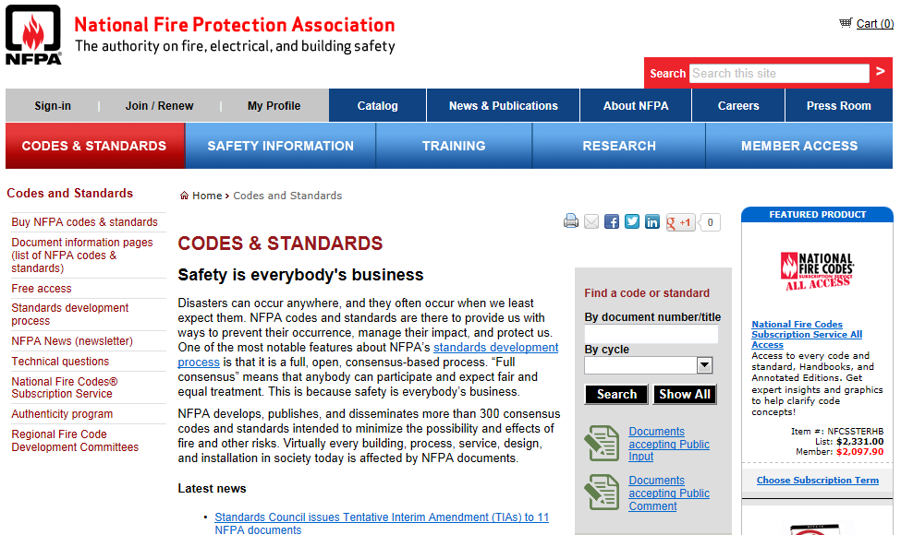

Slide 4
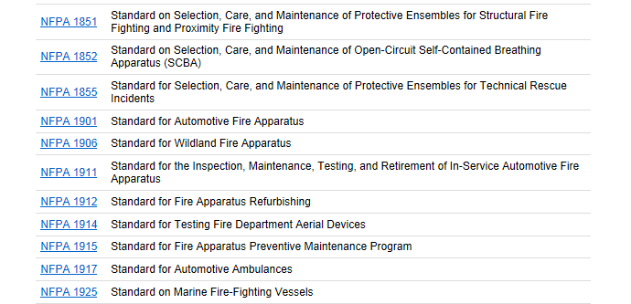

Slide 5
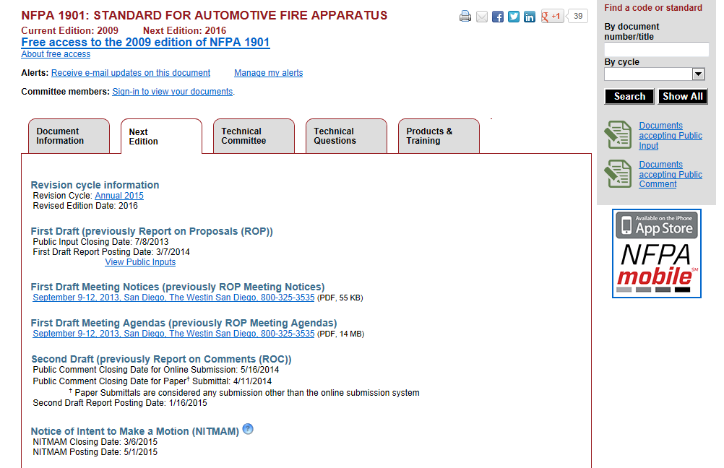

Slide 6
NFPA 1901-1906 Public Comments on BaseCamp

Slide 7
NFPA 1901
Public Comment Proposal Summary

Slide 8
Safety Signs
Use FAMA safety signs.

Slide 9
VDR
Move to Annex

Slide 10
Vehicle Stability
ESC on All Apparatus

Slide 11
Top Speed
Increase top speed

Slide 12
Misc Equipment
Reduce amount of equipment specified and let the fire department decide what it needs.
Reduce amount of equipment on tankers/tenders

Slide 13
Lighting
Flashing Brake Lights
Yellow not allowed for emergency lighting
Specific criteria for light coverage testing

Slide 14
Seat Belts
Orange only
Eliminate Seat Belt warning

Slide 15
Seating
Wider seat clearance
Current: 22.0 at shoulder
Proposed 31.3 at shoulder
Wider Cushions and Backs
Current: 18 inches
Proposed 19.6 Inches
Cushion height between 14.6 and 18.9
Headrest height not less than 31.3 (NEW)

Slide 16
SCBA Seat Brackets
Proposals to accommodate auto-locking devices

Slide 17
Steps and Walking Surfaces
Additional step load test criteria
Replaceable slip resistant surfaces
Hand-rail illumination

Slide 18
Conspicuity
Chevron color alternatives

Slide 19
Ultra High Pressure Chapter
New proposed chapter fore Ultra-High Pressure Fire Pumps and Associated Equipment.
FAMA pump and plumbing subcommitee
Bill Ballantyne - Pyrolance
Discharge pressures over 1200 psi

Slide 20
Pumps and Plumbing
Multiple small revisions proposed by Gary Handwerk and Tom Stalnaker.
Revisions concerning pump test conditions proposed by Waterous.
Small pump chapter proposed by Gary Handwerk

Slide 21
Aerial Platform
Railing strength criteria
Gate strength criteria
Fall protection
System to limit stabilizer pad pressure

Slide 22
Aerial Device
Overhead Electrical wire contact alarm

Slide 23
Foam
Require foam on all pumping apparatus

Slide 24
Line Voltage
GFCI on all outlets

Slide 25
1906 Standard for Wildland Fire Apparatus

Slide 26
Wheel Chocks
Hold on a 30% Grade
Solid Bottom Required

Slide 27
Misc Equip
Move traffic cones, vests, fire extinguisher, and first aid kit to the annex.

Slide 28
Crew Carrier
New chapter describing requirements for a wildland crew carrier.

Slide 29
Misc Equipment Allowance
Revert back to old 1906 higher allowances for misc equipment weights.

Slide 30
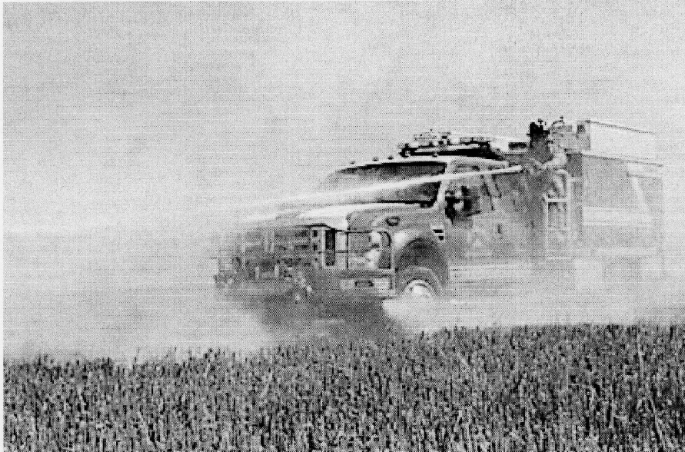
Riding on Apparatus
Allow riding on apparatus for pump and roll.
Define exterior attack position

Slide 31
Human Physical Dimensions
SAE J833, Human Physical Dimensions
ISO 3411. Earth moving machinery -- Physical dimensions of operators and minimum operator space envelope .

Slide 32
Pump Chapter 16 Tank Chapter 18
Numerous miscellaneous proposals
Ultra High Pressure

