Slide 1




Technical Committee
2013 Fall Tech Meeting
Special to Thanks our Meeting Sponsors

Slide 2
2013 Technical Committee Update
August 15, 2013
FRI Chicago

Slide 3
Sub Committee Chairs
Aerial/Quint Jim Salmi / Jeff Aiken
Ambulance Steve Rowland / Mike Franckowiak
ARFF Grady North / Marty Huffman
Body Bill Proft / Mike Lemieux
Chassis Tim Johnson / Wes Chestnut
Electrical John Doperalski / Peter Lurhs
Foam Greg Geske / Mike Dupay
Pumps/Plumbing Doug Miller / Chad Trinkner
Tech-Ed – FAMA Dan Veselsky / ????
Tech-Ed – FDSOA Dan Veselsky / Co-Chairs

Slide 4
Technical Committee
2013 Initiatives
NFPA 1901/1906 Participation
Support FDSOA Apparatus Symposium
Develop a Fire Apparatus Safety Manual
Fire Apparatus & Emergency Equipment Magazine Articles
Publish Quarterly E‐Newsletter.
Increase use of Basecamp
White-Paper Organization on Website

Slide 5
NFPA 1901 - 1906

Slide 6
NFPA 2014 Conference Call for Papers
NFPA is seeking presentations that address the purchasing, maintaining, refurbishing, and retiring of automotive fire apparatus. Please consider submitting a topic to present at the 2014 NFPA Conference and Expo. by the submission deadline, September 16, 2013. Also, please let me know if you plan to submit. Thank you for your consideration.
Ryan Depew FF/EMT-B
National Fire Protection Association
617-984-7485- Office

Slide 7
FAMA Forum Articles

Slide 8

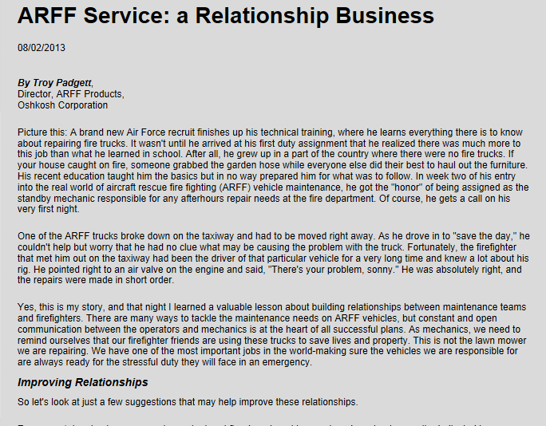
FAMA Forum – August Article

Slide 9
Fire Apparatus & Emergency Equipment Magazine Articles
Aug ARFF Topic – Troy Pagget
Sep VDR Success Story – Dave Durstine
Oct Ambulance Topic – Steve Roland
Nov 2014 Engines – Dave Drehobel
Dec Fire Service Forecast – Paul Darley
Jan Safe Apparatus Access Methods – Lackore
Feb Rescue
Mar Aerials
Apr Apparatus Components
May Fire Suppression Moving Water
Need Authors and Ideas

Slide 10
Fire Apparatus Safety Manual

Slide 11

Fire Apparatus Safety Manual
DRAFT Complete and Ready for Review
Will Post on Basecamp This Week

Slide 12
FDSOA Support

Slide 13
Support FDSOA Apparatus Symposium
FAMA Tech Committee members met with FDSOA officials to plan FDSOA 2014
A draft schedule of presentations has been developed
FAMA provides Recommendations – it is still an FDSOA controlled event.
Jan 19 – 22, 2014 Orlando

Slide 14
FAMA Supported Presentations

Slide 15
FAMA Supported Presentations

Slide 16
FAMA Website
Resource Library

Slide 17
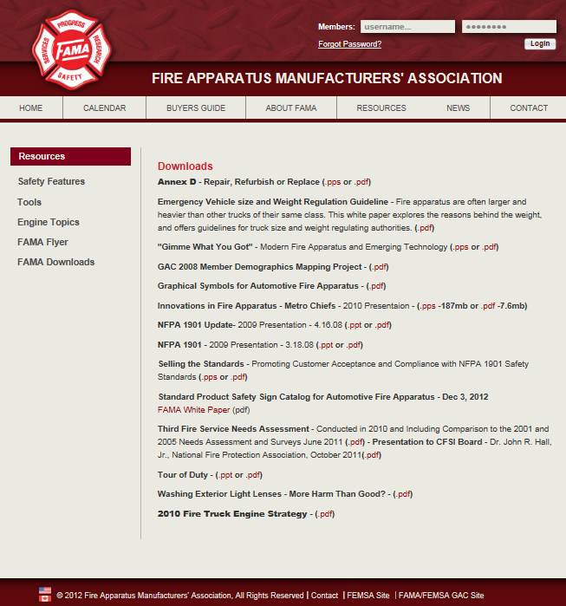
Current Resource Page

Slide 18
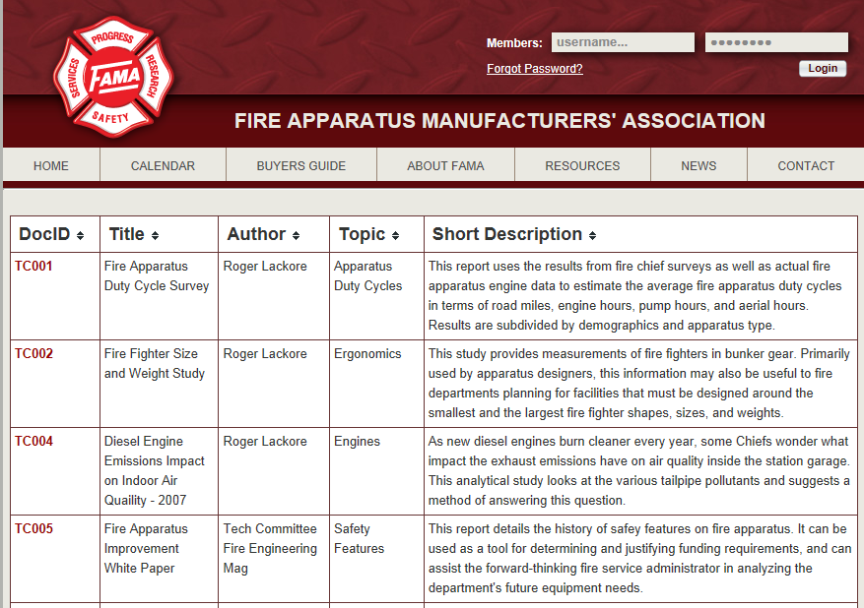
New Resource Page

Slide 19
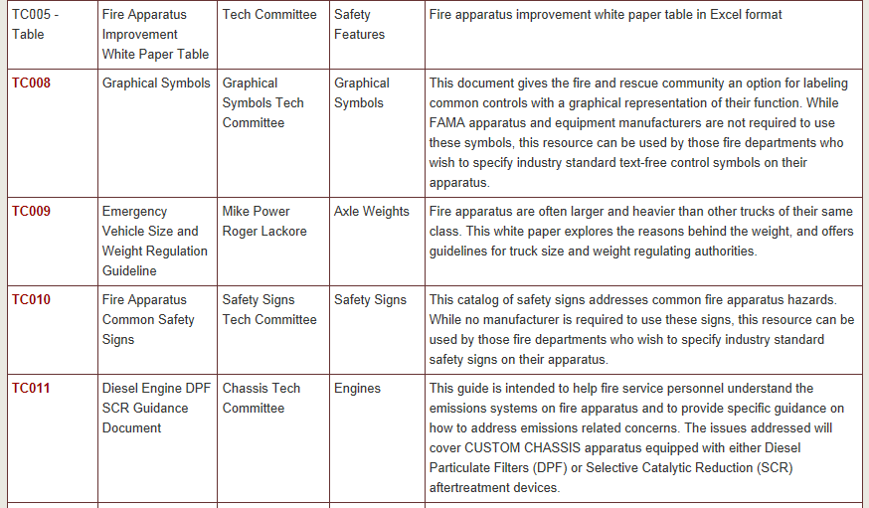

Slide 20
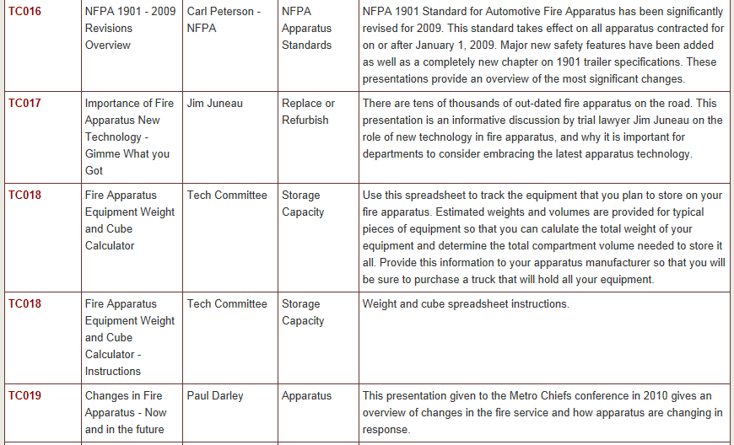

Slide 21
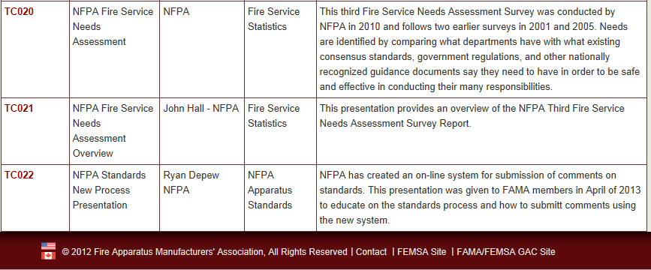

Slide 22
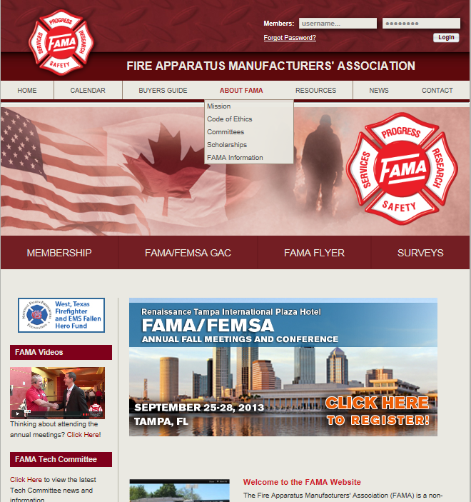
New Home Page

Slide 23
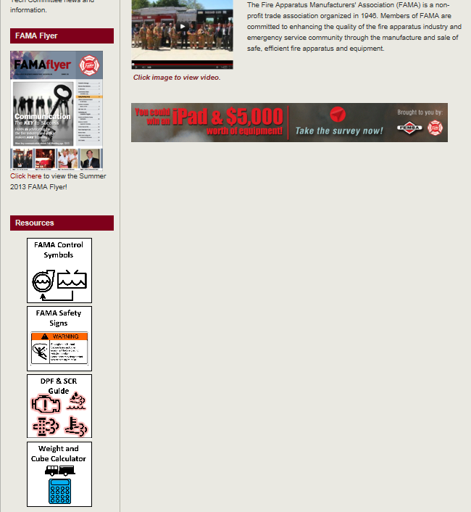
Cameo Resource Documents

Slide 24
Questions?

